Slide 1

Done with Duplicity
Bishop Ronald K. Powell

Slide 2

James 1 New Living Translation (NLT)
1 This letter is from James, a slave of God and of the Lord Jesus Christ.
I am writing to the “twelve tribes”—Jewish believers scattered abroad.
Greetings!

Slide 3
James 1 New Living Translation (NLT)
2 Dear brothers and sisters, when troubles of any kind come your way, consider it an opportunity for great joy. 3 For you know that when your faith is tested, your endurance has a chance to grow. 4 So let it grow, for when your endurance is fully developed, you will be perfect and complete, needing nothing.

Slide 4
James 1 New Living Translation (NLT)
5 If you need wisdom, ask our generous God, and he will give it to you. He will not rebuke you for asking. 6 But when you ask him, be sure that your faith is in God alone. Do not waver, for a person with divided loyalty is as unsettled as a wave of the sea that is blown and tossed by the wind. 7 Such people should not expect to receive anything from the Lord. 8 Their loyalty is divided between God and the world, and they are unstable in everything they do.

Slide 5
James 1 New Living Translation (NLT)
9 Believers who are poor have something to boast about, for God has honored them. 10 And those who are rich should boast that God has humbled them. They will fade away like a little flower in the field. 11 The hot sun rises and the grass withers; the little flower droops and falls, and its beauty fades away. In the same way, the rich will fade away with all of their achievements.

Slide 6
James 1 New Living Translation (NLT)
12 God blesses those who patiently endure testing and temptation. Afterward they will receive the crown of life that God has promised to those who love him. 13 And remember, when you are being tempted, do not say, “God is tempting me.” God is never tempted to do wrong, and he never tempts anyone else. 14 Temptation comes from our own desires, which entice us and drag us away. 15 These desires give birth to sinful actions. And when sin is allowed to grow, it gives birth to death.

Slide 7
James 1 New Living Translation (NLT)
16 So don’t be misled, my dear brothers and sisters. 17 Whatever is good and perfect is a gift coming down to us from God our Father, who created all the lights in the heavens. He never changes or casts a shifting shadow. 18 He chose to give birth to us by giving us his true word. And we, out of all creation, became his prized possession.

Slide 8
James 1 New Living Translation (NLT)
19 Understand this, my dear brothers and sisters: You must all be quick to listen, slow to speak, and slow to get angry. 20 Human anger does not produce the righteousness God desires. 21 So get rid of all the filth and evil in your lives, and humbly accept the word God has planted in your hearts, for it has the power to save your souls.

Slide 9
James 1 New Living Translation (NLT)
2 But don’t just listen to God’s word. You must do what it says. Otherwise, you are only fooling yourselves. 23 For if you listen to the word and don’t obey, it is like glancing at your face in a mirror. 24 You see yourself, walk away, and forget what you look like. 25 But if you look carefully into the perfect law that sets you free, and if you do what it says and don’t forget what you heard, then God will bless you for doing it.

Slide 10
James 1 New Living Translation (NLT)
26 If you claim to be religious but don’t control your tongue, you are fooling yourself, and your religion is worthless. 27 Pure and genuine religion in the sight of God the Father means caring for orphans and widows in their distress and refusing to let the world corrupt you.

Slide 11
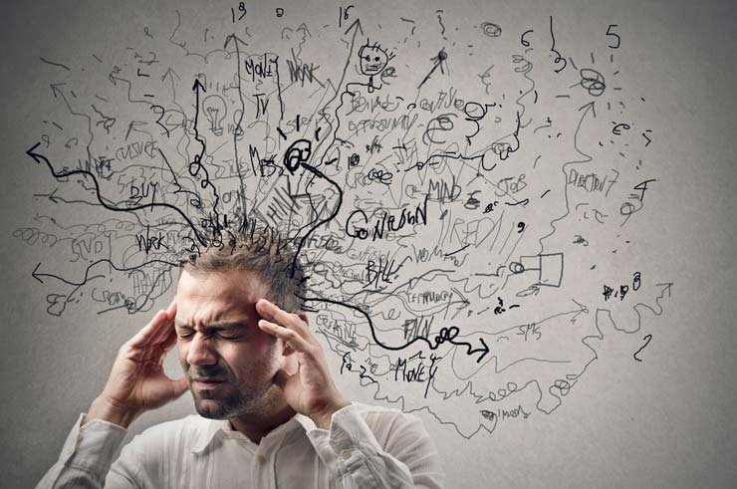
INTRODUCTION
The duplicitous believer is someone who is constantly living in a state of compromise. Half of you lives for God, while the other half lives for your bad habit or self-centered choices.
Have you ever found yourself wanting to please God, but doing something you knew didn’t?
Consider whether or not that experience describes your present spiritual condition.

Slide 12
examples
Like maybe after spending an hour at the gym, you decide to eat a large piece of Pie. Chances are, you’ll never reach your weight goal that way.
You want a great marriage, but you want to keep being selfish.
You want to make impulsive purchases at the mall and have financial growth and security, but your spending habits and checking balance says you are not financially solvent.

Slide 13
examples
Or, you’re not ready to let go of your private addiction (i.e. Drugs, alcohol, sex, porn, gambling, or idolatrous self-preferences) however you want a growing relationship with God.
It will never work that way. These things can’t co-exist, and it’s double-mindedness to even desire such things.

Slide 14

In all your ways
“You must desire and follow what God desires for all believers.” “Seek His ways.”

Slide 15
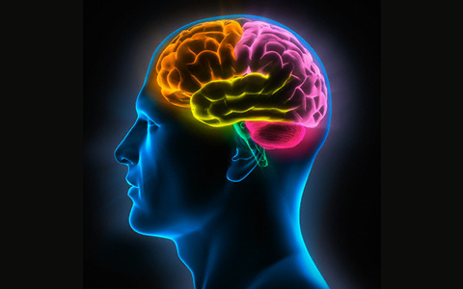
The Issue: Three Types of Minds
Scriptures speak about three types of minds:
The natural mind (an unbeliever),
A double-minded person (a carnal believer)
A single-minded person (a Christian). Single minded about the things of God (obedient)

Slide 16
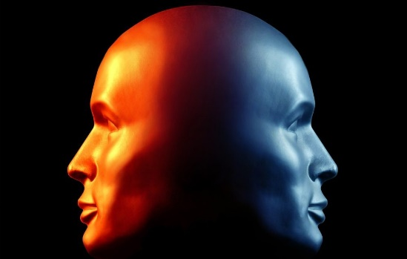
What the Bible says about double-mindedness:
I Corinthians 10:5-6 gives us a very important directive. It tells us to :
“take every thought captive” and to deal with the thoughts that are not of faith. Cast them down…say No!

Slide 17
What the Bible says about double-mindedness:
God knows that taking every thought captive is critical because our thoughts are the first to be triggered in the chain-reaction of our souls.
In other words, our thoughts stir up our emotions; our emotions then influence our choices; and, our choices are what produce our lives.
Thus, whoever controls our thinking will ultimately be the one who controls our lives.

Slide 18
What the Bible says about double-mindedness:
I Corinthians 10:5-6 gives us a very important directive. It tells us to :
“take every thought captive” and to deal with the thoughts that are not of faith. Cast them down…say No!

Slide 19
1- The natural man, (i.e. an unbeliever)
One who has no influence from God at all, is going to be a natural, self-centered conceptual process.
The process begins with the natural man’s spirit, which resides at the core of his being. This spirit creates self-centered thoughts in the natural man’s heart and, eventually, self-centered life actions in his soul.
For this unbelieving person, there is no other choice but to follow what he naturally thinks and feels because there is no other power source (no other spirit within him) to produce anything different.

Slide 20
1 Corinthians 2:14 Living Bible (TLB)
14 But the man who isn’t a Christian can’t understand and can’t accept these thoughts from God, which the Holy Spirit teaches us. They sound foolish to him because only those who have the Holy Spirit within them can understand what the Holy Spirit means. Others just can’t take it in.

Slide 21
2- double-minded people. (Carnal Believers)
There is double-mindedness in all of us.
There are competing things we want that we try to make go together. And we have to begin to think differently about this.
If I really want this, I’m not going to have that.
Truly we have to get off the fence and stop with the in-between. No more half-measures. I have to settle this. What do I really desire? Who do I truly want to serve?

Slide 22
a- double-mindedness creates instability.
We can be believers all of our lives and yet, because we continue to make emotional choices to follow what we think, feel and desire over what God has asked, Gods Life in us becomes quenched and blocked.
Thus, no one will ever see the difference between our life and that of our neighbors who don’t even know God. Gods Life is still in our hearts (we’re believers), but the life that is coming forth from our soul is self-life, our own thoughts and emotions, and not Gods at all.

Slide 23
Titus 1:16 describes this state:
“They profess that they know God [intimately], but in works [actions] they deny Him”….
You might try to hide it publicly, but the people close to you see it and they never know what to expect from you.
The bottom line is that you want two things that can’t coexist, and it makes you unstable in all you do.

Slide 24
3- double-mindedness affects everything we do, say or think.
Seriously, everything. The guy who is double-minded about his marriage? It’s affecting his home life and career and finances.
The wife who’s double-minded about finances? It’s affecting her parenting and relationship to her husband (not to mention God).
You might say, “I make some bad financial decisions occasionally, but I would never do anything to hurt my family!” Well, you actually are. Double-mindedness affects everything.

Slide 25
3- double-mindedness affects everything we do, say or think.
c- Ending double-mindedness isn’t easy, but it’s pretty simple.
You have to want to think differently. And you have to take action that reinforces your desire.
Later in that same chapter of James, we read, “But be doers of the word, and not hearers only, deceiving yourselves” (James 1:22, esv).
Are you ready to put an end to (duplicity) double-mindedness?

Slide 26
d- Do you really want what God wants?
Seek His ways in His Word.
Confess your desire for two things that cannot coexist, and put off the behavior that is keeping you from doing the thing that will make you more like Christ.
In which areas of your life do you find yourself wanting two things that you know can’t go together?

Slide 27
d- Do you really want what God wants?
How does this area of double-mindedness create instability for you or someone close to you?

Slide 28
Closing & Prayer
Lord God, I confess that I don’t always want what You want. Sometimes I desire one thing but act in a totally different way. I confess that my behavior can create instability in other areas of my life and hurt those around me. Thank You, Lord, for opening my eyes to my double-mindedness. Help me to think differently. By Your grace, help me to do the things that reflect Your power in my life. In Jesus’ name, amen.

