Slide 1
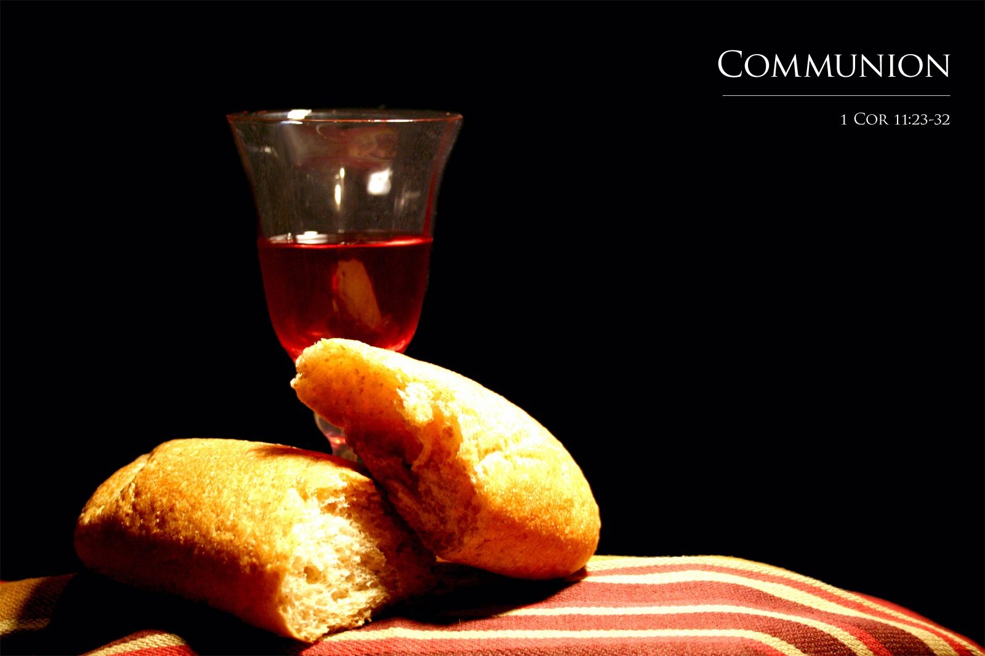
Our Promises are in the Blood
Bishop Ronald Powell

Slide 2
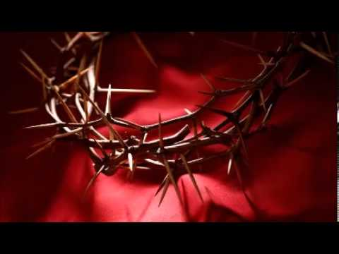
1 Corinthians 11:23-32 New King James Version (NKJV)
Institution of the Lord’s Supper
23 For I received from the Lord that which I also delivered to you: that the Lord Jesus on the same night in which He was betrayed took bread;
24 and when He had given thanks, He broke it and said, “Take, eat; this is My body which is broken for you; do this in remembrance of Me.”
25 In the same manner He also took the cup after supper, saying, “This cup is the new covenant in My blood. This do, as often as you drink it, in remembrance of Me.”
26 For as often as you eat this bread and drink this cup, you proclaim the Lord’s death till He comes.

Slide 3
Examine Yourself
27 Therefore whoever eats this bread or drinks this cup of the Lord in an unworthy manner will be guilty of the body and blood of the Lord.
28 But let a man examine himself, and so let him eat of the bread and drink of the cup.
29 For he who eats and drinks in an unworthy manner eats and drinks judgment to himself, not discerning the Lord’s body.
30 For this reason many are weak and sick among you, and many sleep.
31 For if we would judge ourselves, we would not be judged.
32 But when we are judged, we are chastened by the Lord, that we may not be condemned with the world.

Slide 4
John 6:51-54
51 I am the living bread which came down from heaven: if any man eat of this bread, he shall live for ever: and the bread that I will give is my flesh, which I will give for the life of the world.
52 The Jews therefore strove among themselves, saying, How can this man give us his flesh to eat?
53 Then Jesus said unto them, Verily, verily, I say unto you, Except ye eat the flesh of the Son of man, and drink his blood, ye have no life in you.
54 Whoso eateth my flesh, and drinketh my blood, hath eternal life; and I will raise him up at the last day.

Slide 5
John 6:54-56 King James Version (KJV)
54 Whoso eateth my flesh, and drinketh my blood, hath eternal life; and I will raise him up at the last day.
55 For my flesh is meat indeed, and my blood is drink indeed.
56 He that eateth my flesh, and drinketh my blood, dwelleth in me, and I in him.

Slide 6
Introduction
The power of the blood of Jesus has provided everything you need to live a life of victory, including Redemption, fellowship, healing, deliverance, protection, prosperity and complete authority over the devil.
Let’s take a look at what His death means and what it provides. (See Isaiah 53:4-5)

Slide 7
Isaiah 53:4-5 New King James Version (NKJV)
4 Surely He has borne our [a]griefs
And carried our [b]sorrows;
Yet we [c]esteemed Him stricken,
[d]Smitten by God, and afflicted.
5 But He was wounded[e] for our transgressions,
He was [f]bruised for our iniquities;
The chastisement for our peace was upon Him,
And by His stripes[g] we are healed.
/ Footnotes:
Isaiah 53:4 Lit. sicknesses
Isaiah 53:4 Lit. pains
Isaiah 53:4 reckoned
Isaiah 53:4 Struck down
Isaiah 53:5 Or pierced through
Isaiah 53:5 crushed
Isaiah 53:5 Blows that cut in

Slide 8
As Christians, we know about the blood, sing hymns about the blood, and remember it during Communion.
But how many of us truly know how deep its power runs, and all that it has provided for us?
Even more important—how many of us use it and apply it in our lives every day?

Slide 9
From Genesis to Revelation, the words “the blood” are kept before our eyes—a reminder of its importance and significance to God and to us.
The sacrifices of Abel, Noah and Isaac, and the Passover lamb, and the giving of the Law all came to pass, but “not without blood” (Hebrews 9:7, NKJV).
The blood symbolizes cleansing and purification—the settling of a matter.

Slide 10
God is love.
God is love. And the greatest expression of His love toward us is the blood of Jesus.
That love covers every need man has had or ever will have, and every time we apply the blood, we experience an outpouring of this love.
It is love, through the blood, that has created a barrier between you and all the works of the devil.

Slide 11
The Blood
Let’s elevate the blood of Jesus to the same place in our hearts that it has in God’s heart—and awaken in our spirits those powerful things the blood has procured for us.
The power of the blood of Jesus has provided everything you need to live a life of victory, including redemption, fellowship, healing, protection and authority over the devil.

Slide 12
Isaiah 54:17 New King James Version (NKJV)
17 No weapon formed against you shall prosper,
And every tongue which rises against you in judgment
You shall condemn.
This is the heritage of the servants of the Lord,
And their righteousness is from Me,”
Says the Lord.

Slide 13
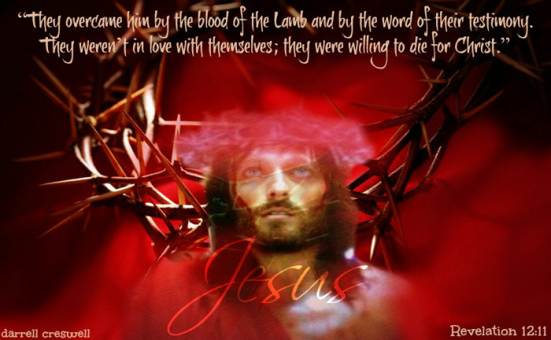
Rev 12:11

Slide 14
Redemption Through the Blood of Jesus
“We have redemption through His blood.” –Ephesians 1:7 (NKJV)

Slide 15
Fellowship With God Through the Blood of Jesus
“Having boldness to enter the Holiest by the blood of Jesus.” –Hebrews 10:19 (NKJV)
Another word for fellowship is “communion”.
One way we recognize that the blood provided for fellowship with God is through the taking of Communion.
Jesus said, “Do this in remembrance of me” (1 Corinthians 11:23-26).
That’s why Communion is much deeper than a religious observance—it’s a recognition of (and fellowship with) what God did for us through the blood of Jesus. You are a friend of God (John 15:15)!

Slide 16
Healing Through the Blood of Jesus
“By His stripes we are healed.” –Isaiah 53:5 (NKJV)
But according to Isaiah 53:4-5, Jesus’ sacrifice covered every area of man’s existence.
He bore spiritual torment for our sins, mental distress for our worry, care, sorrow and fear, as well as physical pain for our sickness and disease.
The stripes He bore and the blood He shed were for our healing. By His stripes we are healed.
God gave everything He had to redeem mankind from the curse. When we receive only part of His sacrifice, it’s an insult to Him!

Slide 17
Healing Through the Blood of Jesus
“By His stripes we are healed.” –Isaiah 53:4-5 (NKJV)
The stripes He bore and the blood He shed were for our healing. By His stripes we are healed.

Slide 18
Healing Through the Blood of Jesus
“By His stripes we are healed.” –Isaiah 53:5 (NKJV)
When you take Communion, do you think of healing? Most Christians take the emblem of the blood and say, “Thank God, we are delivered from sin,” and that is true. Praise God for it!

Slide 19
Healing Through the Blood of Jesus
“By His stripes we are healed.” –Isaiah 53:4-5 (NKJV)
When we apply the blood of Jesus, and receive its power, we need to remember to apply it in its fullness. Don’t just receive and apply it halfway.

Slide 20
Receiving
James 4:7 Amplified Bible (AMP)
7 So submit to [the authority of] God. Resist the devil [stand firm against him] and he will flee from you.

Slide 21
John 15:15 New King James Version (NKJV)
¹⁵ No longer do I call you servants, for a servant does not know what his master is doing; but I have called you friends, for all things that I heard from My Father I have made known to you.

Slide 22
Closing
Accept everything Jesus’ sacrifice provided. If you fail to understand and receive the full power of the blood, you will be missing out. Paul wrote, “For this cause many are weak and sickly among you, and many sleep” (1 Corinthians 11:30, KJV).

