Slide 1
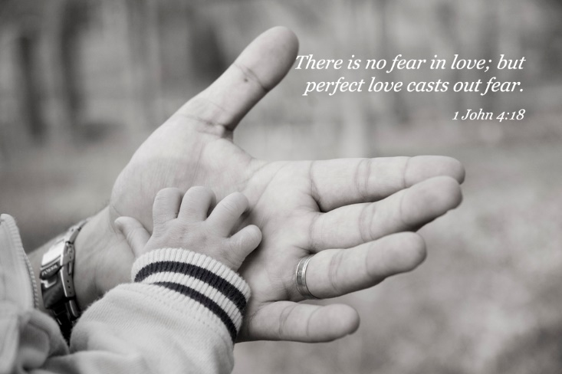
“Fear Not”
Bishop Ronald Powell

Slide 2
INTRODUCTION
All emotions are God given and they each send empowering messages to help us change an event, thought process, action or situation.
We all face fear. Fear is a normal and healthy emotion. However, allowing fear to control us to the point of inaction is not healthy.
However, when Satan twist the God given message of your emotions he can control the moment of your choice!

Slide 3
Being afraid does not define your character, but what you do in the face of fear does!

Slide 4
A wise Zen master
One day, a wise Zen master went to visit a remote mountain temple accompanied by a monk. As the two approached the temple a pair of ferocious dogs began running toward them. The dogs were barking and angry, sending fear down the spines of both men.
The monk, who was still in training, saw the dogs and yelled to the master to run for his life. But the master did just the opposite. Instead of running away, he sprinted directly at the dogs while screaming and waving his arms frantically. The dogs were so surprised to see the Master running at them that they turned around and ran away filled with fear of their own.
After the ordeal, the young monk asked sheepishly, “Master! How could you do that? Weren’t you scared of the vicious dogs?” The master replied, “Of course I was. But the only way to conquer a fear is to run directly at it. If we run away, our fears will consume us.”

Slide 5
Fear!
a distressing emotion aroused by impending danger, evil, pain, etc., whether the threat is real or imagined; the feeling or condition of being afraid.
a specific instance of or propensity for such a feeling: an abnormal fear of heights.
concern or anxiety; solicitude: a fear for someone's safety.

Slide 6
Fear
Having said that, fear is something that can take away your joy and ruin your life. (Insecurities that produce a loss of opportunity or relationship)
Fear has likely destroyed more lives and ruined more Christian witnesses than just about anything else.
Make no mistake about it, fear is a tool the devil uses and in his hands it is an extremely effective instrument.
Like any good workman the devil will only employ tools that work and he has discovered that fear works through his countless encounters with us.

Slide 7
“Fear Not”
God however encourages his followers to fear not 365 times in the Bible!
God's repeated mentioning of the phrase "don't be afraid" is clear evidence that he didn't want humans' minds shrouded by fear.

Slide 8
FEAR IS A PRIMARY EMOTION (explain)
Fear leads the way to anger, frustration and many other negative results and behaviors out of a sense of loss of control…(we are not to be in control but surrendered to God)
God never wants our minds to believe less than His promises and assurances.
He wants us developed and mature enough that events do not move us from our secure stand which exist in His Love.

Slide 9
FEAR IS THE PRODUCT OF OUR FAILURE TO REST IN GOD'S LOVE
Today’s Text: 1 John 4:18
There is no fear in love; but perfect love casts out fear (Secures the Believer), because fear involves torment (Thoughts of punishment or loss of Love). But he who fears has not been made perfect in love (Forgetting or not believing what Christ did for us). NKJV

Slide 10
When we're being tormented by our fears we can be sure it isn't God who's behind it.
Romans 8:15 15 For you did not receive the spirit of bondage again to fear, but you received the Spirit of adoption by whom we cry out, ''Abba, Father.''

Slide 11
How do we know God doesn't torment us with fear?
We know this because He loves us with an indescribable, agape love.
Who do you love? Your spouse? Your children or grandchildren?
Can you ever conceive of a situation when you would torment them in the same manner you've been tormented by fear in the past?

Slide 12
Why did God stress the importance of avoiding fear?
"Because our hurts and hang-ups can often cause us to think that God is out to get us, that all He wants to do is condemn us and punish us. But that simply isn't true. Jesus is the proof of that."

Slide 13
Men & Women (actions, understanding, and overcoming fears.
Men were created with a need to be honored & respected. (Give Examples)
When they do not feel that they are honored and respected it is easy for Satan to cause an ego sense of loss of control, then their fears of loss lead them to angry impulses in the flesh.
James 1:20 New International Version (NIV)
²⁰ because human anger does not produce the righteousness that God desires.

Slide 14
Men & Women (actions, understanding, and overcoming fears.
Women were created with a need for Security! (External locus of Identity)
When situations and thoughts lead a women to believe is not loved or appreciated, she is lead off to seek for love and appreciation through twisted thoughts that Satan impresses upon her mind. (Give examples)
Result: loss of connection and a search for security outside the bounds of Christ Word.

Slide 15
Do Not Be Anxious (another word for fear)
Luke 12:22
²²And he said to his disciples, “Therefore I tell you, do not be anxious about your life, what you will eat, nor about your body, what you will put on

Slide 16
Worry is like telling our omnipotent God the unthinkable: “I don’t trust You.”
Yet worry is still a struggle for many who have experienced God’s goodness—even mature believers.
Reflecting on Jesus’ words about anxiety, we can think rightly about our troubles when we view them in light of God’s Word.

Slide 17
1 Peter 5:7 AMPC
7 Casting the whole of your care [all your anxieties, all your worries, all your concerns, once and for all] on Him, for He cares for you affectionately and cares about you watchfully.
Only then will we trust our burdens to the One who can truly bear them.

Slide 18
Practical Daily Deterrents;
What's the answer?
First, get yourself out of the state of fear.
In order to be able to think you need to be able to use the other parts of your brain.
If you are having difficulty getting out of fear, here are a few practical things you can do:

Slide 19
Practical Daily Deterrents;
Get in touch with the God. Pray and meditate on what He has promised you in His Word!
TURN OFF YOUR TELEVISION!
Especially the news. Have you ever felt wonderful, or even good, after you watched the news? Even the commercials are designed to make you feel sick and fearful.
Go for a walk without your cell phone or CD player and truly pay attention to the beauty that surrounds you.

Slide 20
Practical Daily Deterrents;
Notice all the things that are there to support you - trees for shade, all vegetation for oxygen, ants to clean up the minutest messes, birds to spread seed for more plants to grow.
Show appreciation to your body by giving it something nice - a massage, a cup of herbal tea, organic food, and pure water. It will thank you by feeling more energized.
Don't hang around negative people or people who are being negative at the time. You don't need to absorb their fear any more than you need to absorb the fear from the news on TV.

Slide 21
Unity with God
As you begin to emerge from the state of fear and can once again think rationally and creatively, look at how you can create unity in your life instead of the polarity caused by fear.

Slide 22
Closing & Prayer
I would have lost heart, unless I had believed that I would see the goodness of the LORD in the land of the living. Wait on the LORD; be of good courage, And He shall strengthen your heart; Wait, I say, on the LORD! Psalm 27:13-14

