Slide 1
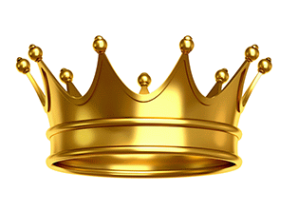
Spiritual Conquest and the Children of God
Bishop Ronald K. Powell

Slide 2
Introduction
We are called to invade, occupy, and influence this world for Christ.
The war is on. As part of the remnant, you have been authorized for spiritual conquest and occupation.
You are unstoppable having received a kingdom that cannot be moved.
“Wherefore we receiving a kingdom which cannot be moved, let us have grace, whereby we may serve God acceptably with reverence and godly fear.”
—Hebrews 12:28

Slide 3
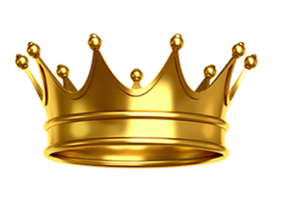
2 Peter 1:3-8
“According as his divine power hath given unto us all things that pertain unto life and godliness, through the knowledge of him that hath called us to glory and virtue: Whereby are given unto us exceeding great and precious promises: that by these ye might be partakers of the divine nature, having escaped the corruption that is in the world through lust. And beside this, giving all diligence, add to your faith virtue; and to virtue knowledge; And to knowledge temperance; and to temperance patience; and to patience godliness; And to godliness brotherly kindness; and to brotherly kindness charity. For if these things be in you, and abound, they make you that ye shall neither be barren nor unfruitful in the knowledge of our Lord Jesus Christ.”

Slide 4
Degeneration of society
To escape the degeneration of society, scripture teaches you to embrace biblical values.
Values are at the core of your soul.
They define your understanding of right and wrong, good and bad, and determine how you see the world.
Notice Peter uses words that describe Christian values such as faith, virtue, knowledge, temperance, patience, godliness, brotherly kindness and love.

Slide 5

Isaiah 60:1-2 King James Version (KJV)
1 Arise, shine; for thy light is come, and the glory of the Lord is risen upon thee.
2 For, behold, the darkness shall cover the earth, and gross darkness the people: but the Lord shall arise upon thee, and his glory shall be seen upon thee.

Slide 6
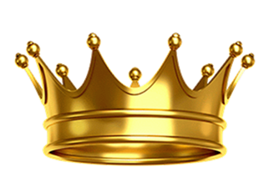
Christ has called you into a royal priesthood of disciples
Christ has called you into a royal priesthood of disciples empowered to manifest the Kingdom of God on earth.
In prayer one day, the Holy Ghost said to me, “Only the sons of God walking in the Spirit can manifest the kingdom.”
This I say then, Walk in the Spirit, and ye shall not fulfil the lust of the flesh. Galatians 5:16-26 (KJV)

Slide 7
Manifesting the Kingdom is found in the Lord’s Prayer.
Jesus taught his disciples to pray: “Our Father which art in heaven, Hallowed be thy name. Thy kingdom come. Thy will be done in earth, as it is in heaven. Give us this day our daily bread. And forgive us our debts, as we forgive our debtors. And lead us not into temptation, but deliver us from evil: For thine is the kingdom, and the power, and the glory, forever. Amen” (Matthew 6:9-13).
This prayer has been prayed by millions of believers, yet how many believe they have a part to play in the process?
Scripture says the entire earth is waiting for the manifestation of the sons of God.
How much longer does the earth need to wait?

Slide 8
The manifestation of the Kingdom of God is the responsibility of every disciple of Christ.
Disciples of Christ are part of the Church at large. There is only one “church model” in the New Testament and that’s the apostolic church.
No New Testament churches in the bible were built by prophets, evangelists, pastors, or teachers; they were all built by apostles.
Scripture says, “And God hath set some in the church, first apostles, secondarily prophets, thirdly teachers, after that miracles, then gifts of healings, helps, governments, diversities of tongues” (1 Corinthians 12:28).

Slide 9

Apostolic church model
An apostolic church model includes apostles, prophets, evangelists, pastors, teachers, priests, kings, and rulers. Together they are citizens of Zion and a governing body of believers.
Jesus said, "I will build my church and the gates of hell shall not prevail against it.” Matthew 16:18
The church that Christ is building is a governing Church full of governing believers.
Paul confirmed this writing, “Jesus is the King of kings and the Lord of lords” (1 Timothy 6:15).

Slide 10
Lords
Lords, Greek kurieuo, means rulers. Jesus is the “Ruler of rulers.” To understand the governing nature of every believer we need a solid definition of the word ruler. According to “Thayer’s Greek Lexicon” ruler means:
to be lord of, to rule, have dominion over
2) of things and forces
3) to exercise influence upon, to have power over. “Strong’s Greek Lexicon” agrees. To rule: 1) have dominion over 2) lord, be lord of 3) exercise lordship over.

Slide 11
Notice all of these are governing definitions such as lord, dominion, and rule. The word dominion was first used by God, not man, when blessing Adam and Eve. They were commanded to rule (Genesis 1:26).
So who are the kings and lords that Christ is the king and ruler of?
The answer is you, the born again believer and disciple of Christ.
With these definitions in mind to rule means, you have the right and responsibility to take dominion by influencing this world for Christ.

Slide 12

1 Peter 5:3 King James Version (KJV)
3 Neither as being lords over God's heritage, but being examples to the flock.

Slide 13
Matthew 5:14-16 English Standard Version (ESV)
¹⁴ “You are the light of the world. A city set on a hill cannot be hidden. ¹⁵ Nor do people light a lamp and put it under a basket, but on a stand, and it gives light to all in the house. ¹⁶ In the same way, let your light shine before others, so that they may see your good works and give glory to your Father who is in heaven.

Slide 14
The dominion-minded teach that the body of Christ is called to be salt, light, and a city set on a hill.
They are also called into the ministry of the “restoration of all things” (Acts 3:19-21).
In short they are given a measure of delegated spiritual authority by Christ to invade, occupy, and influence the world.

Slide 15

Closing
Christ has called you into the royal priesthood of disciples empowered to manifest the Kingdom of God on earth.
1 Peter 2:9 King James Version (KJV)
9 But ye are a chosen generation, a royal priesthood, an holy nation, a peculiar people; that ye should shew forth the praises of him who hath called you out of darkness into his marvelous light;

