Slide 1
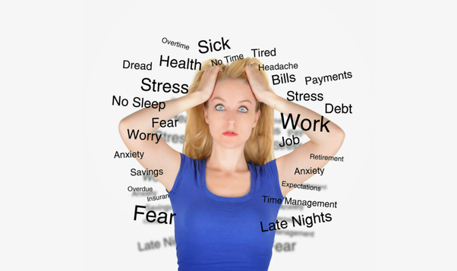
The Spiritual Roots of Dis-ease
The Mind and Body Connection
With Bishop Ronald K. Powell

Slide 2

Proverbs 4:23

Slide 3
Introduction
Medical science has conclusively demonstrated that emotional stress is a root issue for most of our diseases.
Living in the Peace of Christ is the antidote for emotional stress.
This medical insight is a wakeup call to everyone in the Body of Christ.
Romans 6:23
For the wages of sin is death, but the gift of God is eternal life in Christ Jesus our Lord.

Slide 4
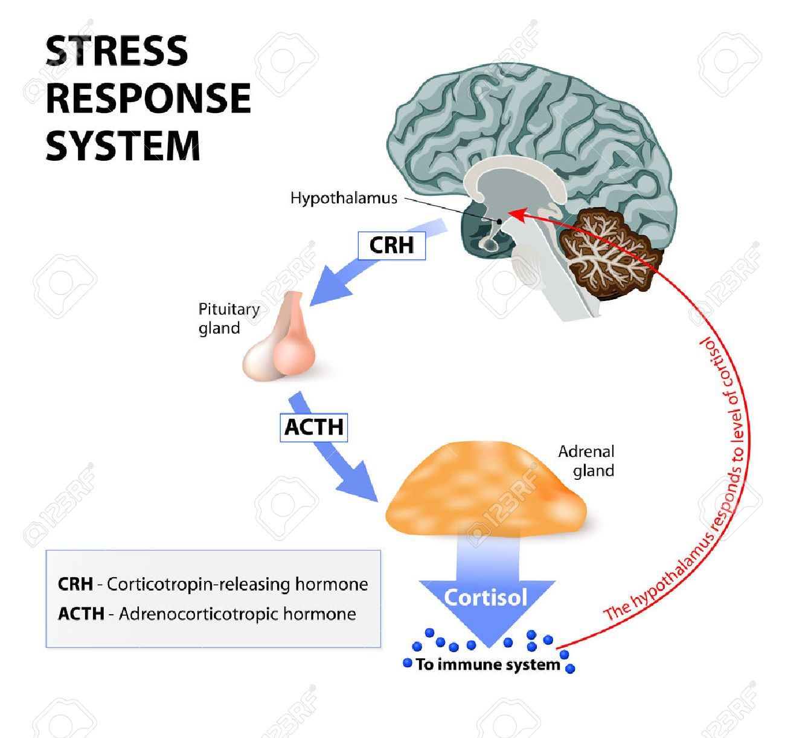

Slide 5
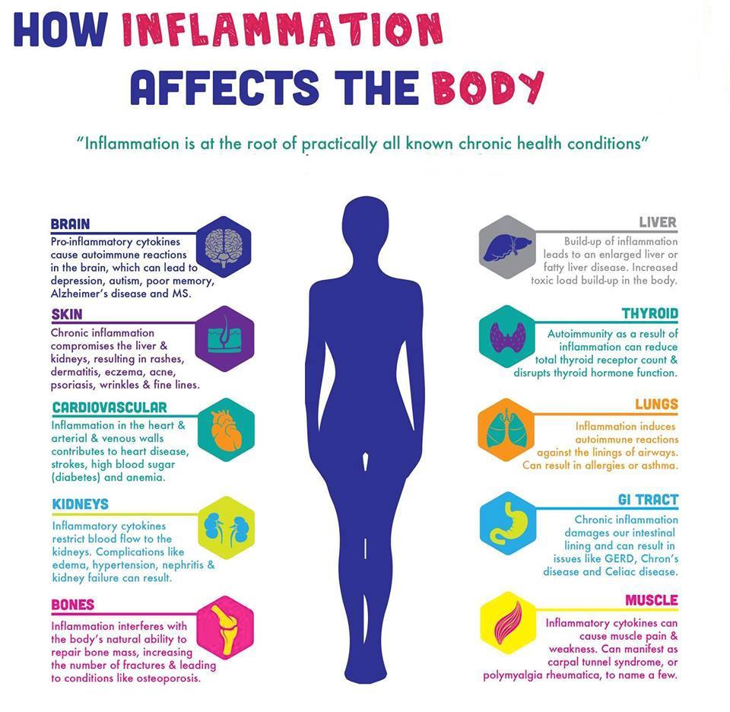

Slide 6
Spiritual Roots of Disease
Though we begin with the body, this series of lessons is not primarily about physical health and the means to achieve it. Rather, it is about seeking emotional and spiritual health of the highest order.
Finding the life that is 'hidden with Christ in God' or entering into 'the glorious liberty of the children of God' would be excellent Biblical ways of expressing the goal.
As it happens, however, modern medical science shows us a connection between our emotional life and the root issues of disease that gives us a practical place to begin looking at our deeper, truer need.

Slide 7
C. S. Lewis once described pain as 'God's megaphone
Meaning that He gets our attention when our bodies break down.
So, it is in seeking to find a remedy to our illnesses that we have been drawn into a far greater understanding of the ways in which we are actually going astray from our God.
The diseases of our bodies are but reflections of the dis-ease of our souls!

Slide 8
Three Flawed Theories
Before we look at what is actually making us sick, let's go over some cherished notions that we may still be carrying around in the back of our minds.
There are three flawed theories of why we get sick.

Slide 9
1) The germ theory:
As an explanation of why we get sick, this is accurate but misleading, since germs account for only part of all diseases.
Nor does this theory tell us why we had the weakened immune system that allowed germs to infect us in the first place.
Stressing the body by lack of sleep, poor nutrition, or lack of exercise can weaken the immune system, but are you aware that research has shown that just six minutes of a negative emotion can suppress the immune system for more than 21 hours?

Slide 10
2) The 'out of the blue' theory:
This provides a graceful covering for us, since we are claiming to have no idea of any connection between our lifestyle and the disease. (Surely it is nothing we have done. It just came on us out of the blue!)
Yet everything on earth happens by cause and effect.
The real problem with this theory is that it seems to be pointing a finger at God who lives in those 'blue' heavens.
However, God is never the author of evil: Untainted by any shadow He is instead the Giver of 'every good gift.‘
Death, disorders and disease are consequences of the fall of man.

Slide 11
3) The Punishment theory:
According to this theory we sinned, so God is punishing us. But that cannot be! God punished Jesus fully and completely at the cross for our sins; it would be a breach of justice for God to punish us when the penalty has already been paid in full by Another.
A further problem is that it seems to suggest that God reaches, in anger, into His bag of punishments and puts one on us without regard to the natural order.

Slide 12
The Mind-Body Connection
The truth is that there is a natural connection between the way that we live and the diseases that come upon us. As much as 80% or more of all incurable diseases Stress Test have a known mind-body connection.
According to one study, stress related disorders account for 75-90% of all visits to primary care physicians.

Slide 13
Consider these connections between disease and emotional stress
High blood pressure and heart disease correlate with anger and hostility;
Auto-immune disorders, Multiple Sclerosis, Lupus and arthritis are associated with bitterness, resentments and self-hatred;
Gastrointestinal disorders such as IBS, panic attacks and heart palpitations are related to anxiety; tension and migraine headaches, along with back pain, TMJ and Fibromyalgia are all associated with repressed anger.

Slide 14
Now reflect that our science is just beginning to discover the linkages between specific negative emotions and specific physical disorders, but already these connections can be made.
Negative emotions damage the body.
When we perceive a situation to be dangerous, adrenaline and cortisol are released by our bodies to facilitate 'flight or fight' responses.
This is part of the General Adaptation Syndrome (G.A.S.) which gives us the extra 'gas' we need to power-up for potentially life-threatening situations.
The problem is that most of the 'dangers' that cause stress cannot be resolved by fighting or running away!

Slide 15
Modern life seems to be characterized by a mounting sea of stressful events and daily pressures coming at people from every conceivable direction.
And yet the real culprit isn't the situations which surround us - it is the emotional reactions going off inside of us.

Slide 16
That is why Dr. Don Colbert entitled his book on the mind-body connection Deadly Emotions - not 'deadly situations.'
Stating that emotions are not confined only to the mind or heart, he describes the physiological processes by which all emotions are translated into chemical reactions which occur at both the organ level and the cellular level! Apparently, the 'most damaging' emotions are feelings we might consider 'garden variety' such as un-forgiveness, anger, worry, fear and frustration.
Clearly, no one with an emotional life is immune to the danger!

Slide 17
These negative emotions which place so much stress upon our bodies come in two forms:
1) Those that arise out of present situations
2) Those that are 'embedded' in our deepest memories.’

Slide 18
Doctors Alexander Loyd and Ben Johnson in their book, The Healing Code, state that embedded negative emotions are the most damaging kind, producing 'physiological stress' (at a subconscious level), as opposed to 'situational stress' (the conscious level).

Slide 19
False beliefs and Negative images
These unhealed memories are actually stored as false beliefs and negative images which form 'destructive cellular memories' in the cells of our bodies! In terms of the mind body connection they list three 'one things' which we need to know:
1) There is one thing that can heal anything - our immune system;
2) There is one thing that turns off the immune system - emotional stress;
3) There is one thing that will turn the immune system back on - healing 'the issues of the heart.'

Slide 20
Proverbs 4:23 New International Version (NIV)
²³ Above all else, guard your heart, for everything you do flows from it.

Slide 21
From the Bible's perspective there are a few 'good' emotions that we might perceive as negative ones due to the way that they feel:
godly fear (awe and respect for God as both holy and all-powerful);
'danger fear' (in life-threatening moments);
righteous anger (hating the sin, yet still loving the person);
pure grief (mourning that is uncontaminated by anger, fear, doubt or guilt).
These emotions are actually very good to have even if they don't feel like it at the time.

Slide 22
From a medical point of view all other negative emotions are stressors to the body, and it is extremely evident how damaging they are to our physical health.
Man with a Headache : Stress Related Diseases, However, from a Christian point of view they represent something that is also very damaging to our spiritual health - they are sins!
Now this may seem like adding to the bad news:
The negative emotions we don't like feeling in the first place are not only the spiritual roots of disease, they are also sins, separating us from God!
Isn't this very bad news indeed? No, not at all: It is wonderful news! It shows us there is a way out, both from disease and from the entrapment of negative emotions.

Slide 23
If the negative emotions, causing us so much loss of peace and joy as well as health, are actually things in our personality that God has given us and wants us to have, then we are stuck with them - and the diseases they induce.
However, if they are sins then He has provided a way of freedom, since Jesus died to free us from sin's power as well as from its penalty.
That way of freedom will be the subject of all of the following lessons.
For now let us consider the negative emotions in relationship to their polar opposite - the peace of Christ.

Slide 24
The Peace of Christ
We always have a choice how we will respond to life: Will we give in to stress, take on the negative emotions so close at hand, or will we choose to find the path of peace that comes from trusting and obeying God? God created us to live in peace with His peace.
Even under the terms of the Hebrew covenant, it was possible to live with perfect peace, but there was a condition: Keeping one's mind fixed or stayed on the Lord. How does one do that? In a word - trust. Trusting God is how we 'live by faith.'

Slide 25
Isaiah 26:3 ESV
You keep him in perfect peace whose mind is stayed on you,because he trusts in you.

Slide 26
Peace comes to us on the basis of our actual heart-trust in God, not the doctrinal rightness of our beliefs.
Our minds judge right and wrong, but it is with our hearts that we judge who to trust.
Whenever we actually release our hearts to trust God, our minds naturally become rested or stayed upon Him, until something else disturbs our rest.
In the New Covenant Jesus also promises us peace and His peace goes far beyond any of the outward things that disturb us.

Slide 27
John 14:27 ESV
Peace I leave with you; my peace I give to you. Not as the world gives do I give to you. Let not your hearts be troubled, neither let them be afraid.

Slide 28
How does the world give us peace?
Anyone can get peace from the world in this way: I see the problem; I go to work on it; I begin to see the thing get better; I get peace back. You don't have to be a believer in anything but yourself to get peace in this way.
But there are real problems with getting peace this way: I can't always make things better so I lose even more peace in the attempt; I have to wait until things look like they are getting better before peace begins to return to me; and as soon as one trouble is fixed, I may lose peace over two more things that just flared up.
This way is guaranteed to produce many seasons of significant stress over the course of a lifetime. We know it all too well - it is the way of trusting Self to be our savior.

Slide 29
Jesus gives believing, trusting hearts peace at the first sign of trouble - whenever we cast our cares on Him as our only Savior.
All of us get a daily Dove of Peace report card on how well we are doing at trusting and obeying the Lord.
In fact it is personally delivered moment by moment as the Holy Spirit reveals our actual peace levels to us.
In any moment the peace of Christ is either going up, holding steady, or going down - all according to our ability to trust and follow Jesus throughout the day.

Slide 30
When our hearts and minds fully trust Him with the whole of our life and that of our loved ones, we are at peace.
Our bodies can then experience peace (homeostasis or physiological equilibrium) and all systems work in balance to maintain health.
As Dr. Art Mathias of Wellsprings Ministries in Alaska likes to say, our bodies are barometers of our spiritual health.
Seen in this light the diseases and disorders we can't ignore are 'warning bells' alerting us of our need to return to living in the peace of Christ.

Slide 31
The Pathway of Disease
Pay close attention to this pathway of disease for it is also the way by which mental illness, addictions and all sinful behaviors become entrenched:
1) Loss of health comes from loss of peace in the mind or heart: This is the overwhelming evidence of mainstream science.
2) Loss of peace comes through the entry of negative emotions: This is simple displacement - after an internal 'tug-of-war' either the peace of Christ or stress will always win out.

Slide 32
3) Negative emotions draw power from unresolved issues carried from the past: These are the root causes.
4) Unresolved issues always reveal that there are broken relationships of trust and love with God, self or others: The two Great Commandments have been breached. These issues are crying out to be healed, not buried.
5) Loss of peace indicates there is a sin issue to deal with: We have been turning from God, which is why His peace was lifted.
6) Loss of peace warns that the other kingdom is manifesting through us: We have been turning to the enemy, which is why un-Christ-like thoughts and feelings are beginning to grip us.

Slide 33
Just as peace, love, joy and the other delectable fruit of the Spirit manifest the life of Christ and the working of God's Kingdom through us, so too do negative emotions actually manifest the 'emotional life' of the enemy, coming out of our carnal or fallen nature, and advance his dark kingdom through us.
We are paying a terrible price for not living in the peace of Christ.

Slide 34
Let’s Pray
Father, in the course of these lessons enable me to be honest, open and transparent before You.
Please help me to choose to deal with You and with anything You may want to bring up.
Despite the pain I may have to work through, I am determined to break free of my past and truly learn how to live with Your peace established in my heart.
NEXT: Truth or Consequences

