Slide 1
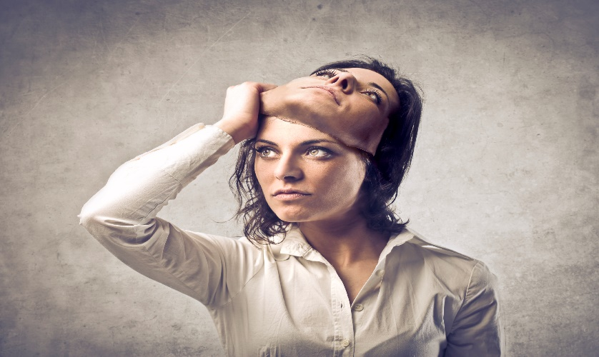
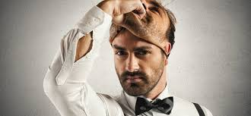
Do you Have Two Faces
With Bishop Ronald K. Powell

Slide 2
Text: Romans 6:14-23 King James Version
¹⁴ For sin shall not have dominion over you: for ye are not under the law, but under grace.
¹⁵ What then? shall we sin, because we are not under the law, but under grace? God forbid.
¹⁶ Know ye not, that to whom ye yield yourselves servants to obey, his servants ye are to whom ye obey; whether of sin unto death, or of obedience unto righteousness?
¹⁷ But God be thanked, that ye were the servants of sin, but ye have obeyed from the heart that form of doctrine which was delivered you.
¹⁸ Being then made free from sin, ye became the servants of righteousness.

Slide 3
Text: Romans 6:14-23 King James Version
¹⁹ I speak after the manner of men because of the infirmity of your flesh: for as ye have yielded your members servants to uncleanness and to iniquity unto iniquity; even so now yield your members servants to righteousness unto holiness.
²⁰ For when ye were the servants of sin, ye were free from righteousness.
²¹ What fruit had ye then in those things whereof ye are now ashamed? for the end of those things is death.
²² But now being made free from sin, and become servants to God, ye have your fruit unto holiness, and the end everlasting life.
²³ For the wages of sin is death; but the gift of God is eternal life through Jesus Christ our Lord.

Slide 4
Godly Sorrow: 2 Corinthians 7:10 (NIV)
¹⁰ Godly sorrow brings repentance that leads-> to salvation and <-leaves no regret, but worldly sorrow brings death.
The Carnal Mind
Romans 8:7 King James Version (KJV)
⁷ Because the carnal mind is enmity against God: for it is not subject to the law of God, neither indeed can be.
First, the carnal mind is identified as being “enmity against God” (v. 7), a rampant disregard for God’s law. Furthermore, the carnal mind is equated with death, specifically eternal, spiritual death. A physically living person may have a carnal mind, bringing with it a spiritual deadness and eternal doom. This also serves us as a working definition of death—being hostile toward God, or minding the things of the flesh. “So then they that are in the flesh cannot please God. But ye are not in the flesh, but in the Spirit, if so be that the Spirit of God dwell in you” (vv. 8-9).

Slide 5
SIn does not have Dominion
When we become Christians, the Holy Spirit indwells us and empowers us to walk with God, displaying godly behavior in our daily lives .

Slide 6
the spiritual mind is “life and peace”
Next, we see that the spiritual mind is “life and peace” (Romans 8:v. 6)—a supreme preference for God and subjection to His will.
This state not only leads to eternal life but is life, along with peace, even now.
There can be no peace for the carnally minded.

Slide 7
Titus 2:11-14 King James Version (KJV)
¹¹ For the grace of God that bringeth salvation hath appeared to all men,
¹² Teaching us that, denying ungodliness and worldly lusts, we should live soberly, righteously, and godly, in this present world;
¹³ Looking for that blessed hope, and the glorious appearing of the great God and our Savior Jesus Christ;
¹⁴ Who gave himself for us, that he might redeem us from all iniquity, and purify unto himself a peculiar people, zealous of good works.

Slide 8
Galatians 5:22-23 King James Version (KJV)
²² But the fruit of the Spirit is love, joy, peace, longsuffering, gentleness, goodness, faith,
²³ Meekness, temperance: against such there is no law.

Slide 9
More than one Scripture refers to "good works" as evidence of our Christian behavior
Ephesians 2:10 New International Version (NIV)
¹⁰ For we are God’s handiwork, created in Christ Jesus to do good works, which God prepared in advance for us to do.

Slide 10
Titus 2:14 New International Version (NIV)
¹⁴ who gave himself for us to redeem us from all wickedness and to purify for himself a people that are his very own, eager to do what is good.

Slide 11
1 Peter 2:12 (ERV)
¹² People who don’t believe are living all around you. They may say that you are doing wrong. So live such good lives that they will see the good you do, and they will give glory to God on the day he comes.
So, in short, Christian behavior will provide outward evidence of the Spirit that is present within us.

Slide 12
Surrendered Life
It is important to recognize that these aren't things we produce primarily through our own effort; rather they come from the Holy Spirit's work of transformation in our lives .

Slide 13
2 Corinthians 3:18; 5:17
2 Corinthians 3:18 Easy-to-Read Version (ERV)
¹⁸ And our faces are not covered. We all show the Lord’s glory, and we are being changed to be like him. This change in us brings more and more glory, which comes from the Lord, who is the Spirit.

Slide 14
2 Corinthians 5:17 Easy-to-Read Version (ERV)
¹⁷ When anyone is in Christ, it is a whole new world. The old things are gone; suddenly, everything is new!

Slide 15
Philippians 2:12–13
At the same time, we are told to obey God and to do our best to conform to His will. Philippians 2:12–13 says it this way:
"Therefore, my beloved, as you have always obeyed, so now, not only as in my presence but much more in my absence, work out your own salvation with fear and trembling, for it is God who works in you, both to will and to work for his good pleasure."
Also recognize that the Spirit's work in us is progressive.
Christians will mess up; our behavior will not always adhere to God's holy standards or be a very good demonstration of His work in us.
But when we fail, we can trust that "we have an advocate with the Father, Jesus Christ the righteous"

Slide 16
1 John 2:1 Easy-to-Read Version (ERV)
Jesus Is Our Helper
2 My dear children, I write this letter to you so that you will not sin. But if anyone sins, we have Jesus Christ to help us. He always did what was right, so he is able to defend us before God the Father.

Slide 17
1 John 1:9 (ERV)
We can confess our sin and move forward, trusting in God's grace and faithfulness.
⁹ But if we confess our sins, God will forgive us. We can trust God to do this. He always does what is right. He will make us clean from all the wrong things we have done.(1 John 1:9)

Slide 18
Being a Christian means
Being a Christian means that we have been adopted as sons and daughters of God—what a privilege!
1 Peter 2:9–10 says: "But you are a chosen race, a royal priesthood, a holy nation, a people for his own possession, that you may proclaim the excellencies of him who called you out of darkness into his marvelous light. Once you were not a people, but now you are God's people; once you had not received mercy, but now you have received mercy."
As Christians, we should use our behavior to "proclaim the excellencies" of God to others.

Slide 19
2 Chronicles 16:9 (ERV)
⁹ The eyes of the Lord go around looking in all the earth for people who are faithful to him so that he can make them strong. Asa, you did a foolish thing. So from now on you will have wars.”

Slide 20
Our lives should exemplify the salvation and the changes He has worked within us.
⁸ Show that you are my followers by producing much fruit. This will bring honor to my Father. (John 15:8).
We are to be doers of the word, evidencing our faith through our actions (James 1:22, 27; 2:17, 26).
We should be unashamed in our witness for Christ: "For I am not ashamed of the gospel, for it is the power of God for salvation to everyone who believes" (Romans 1:16).

Slide 21
Walking out Christian behavior
Walking out Christian behavior not only showcases God in us to others; it also protects us from the war against the fleshly desires within ourselves:
"abstain from the passions of the flesh, which wage war against your soul" (1 Peter 2:11;
²⁰ So I am not the one living now—it is Christ living in me. I still live in my body, but I live by faith in the Son of God. He is the one who loved me and gave himself to save me. Galatians 2:20 Easy-to-Read Version (ERV)

Slide 22
Give Your Lives to God
Romans 12:1-2 Easy-to-Read Version (ERV)
12 So I beg you, brothers and sisters, because of the great mercy God has shown us, offer your lives as a living sacrifice to him—an offering that is only for God and pleasing to him. Considering what he has done, it is only right that you should worship him in this way. ² Don’t change yourselves to be like the people of this world, but let God change you inside with a new way of thinking. Then you will be able to understand and accept what God wants for you. You will be able to know what is good and pleasing to him and what is perfect.

Slide 23
Ephesians 4:14 Easy-to-Read Version (ERV)
¹⁴ Then we will no longer be like babies. We will not be people who are always changing like a ship that the waves carry one way and then another. We will not be influenced by every new teaching we hear from people who are trying to deceive us—those who make clever plans and use every kind of trick to fool others into following the wrong way.

Slide 24
If you're looking for one great passage that sums up Christian behavior
The heading for this section in many Bibles is "Marks of a True Christian" and it says: "Let love be genuine. Abhor what is evil; hold fast to what is good. Love one another with brotherly affection. Outdo one another in showing honor. Do not be slothful in zeal, be fervent in spirit, serve the Lord. Rejoice in hope, be patient in tribulation, be constant in prayer. Contribute to the needs of the saints and seek to show hospitality. Bless those who persecute you; bless and do not curse them. Rejoice with those who rejoice, weep with those who weep. Live in harmony with one another. Do not be haughty, but associate with the lowly. Never be wise in your own sight. Repay no one evil for evil, but give thought to do what is honorable in the sight of all. If possible, so far as it depends on you, live peaceably with all. Beloved, never avenge yourselves, but leave it to the wrath of God, for it is written, 'Vengeance is mine, I will repay, says the Lord.' To the contrary, 'if your enemy is hungry, feed him; if he is thirsty, give him something to drink; for by so doing you will heap burning coals on his head.' Do not be overcome by evil, but overcome evil with good. "Romans 12:9–21

