Slide 1
Bishop Ronald K. Powell

Slide 2
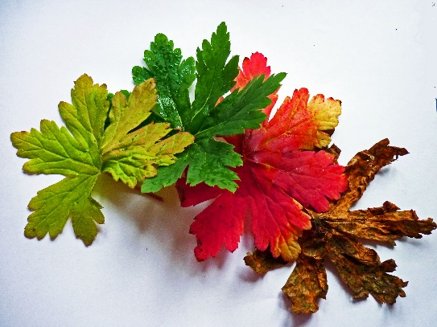
Introduction
Recently many of you have been through life changes which meant different directions than how you have viewed a life and a future.
Upsets to our routines.
My Neurologist findings and new diet!

Slide 3
Jeremiah 12:4-6 21st Century King James Version (KJ21)
⁴ How long shall the land mourn and the herbs of every field wither, for the wickedness of them that dwell therein? The beasts are consumed, and the birds, because they said, “He shall not see our last end.”
⁵ “If thou hast run with the footmen and they have wearied thee, then how canst thou contend with horses? And if in the land of peace, wherein thou trusted, they wearied thee, then how wilt thou do in the swelling of the Jordan?
⁶ For even thy brethren and the house of thy father, even they have dealt treacherously with thee; yea, they have called a multitude after thee; believe them not, though they speak fair words unto thee.

Slide 4
Matthew 5:44-46 21st Century King James Version (KJ21)
⁴⁴ But I say unto you, love your enemies, bless them that curse you, do good to them that hate you, and pray for them that despitefully use you and persecute you,
⁴⁵ that ye may be the children of your Father who is in Heaven. For He maketh His sun to rise on the evil and on the good, and sendeth rain on the just and on the unjust.
⁴⁶ For if ye love them that love you, what reward have ye? Do not even the publicans the same?

Slide 5
Human Thought
“Some Peoples Theology is eschewed thinking when you get saved you are no longer going to have Drama.”
The truth of the matter is that getting saved does not circumvent trouble from coming to your house.
The difference is that before you were saved you didn’t know how to deal with drama, but after you have help understanding the drama.

Slide 6
In The book of Job:
In one day extensive pain and drama came to Job. His world as he knew it was turned upside down.
A Servant came into him and said your 500 oxen and 500 donkeys were raided by the Sabeans.
They took all the oxen and donkeys and killed all the servants and I alone escaped to tell you.

Slide 7
The Bible says:
While he was talking another one came knocking on the door. He said to Job, your seven thousand sheep were consumed with a fire that fell from heaven. It killed all the sheep and all the servants and I alone was left to come tell you about it.
While he was talking another one came knocking on the door. He said your three thousand camels were raided and they took the camels and fled.
While he was talking another one came knocking and said your 10 children were all eating at your eldest child’s house and a strong wind came and blew in the roof and it collapsed on them and killed all your children. That’s all in Chapter one!

Slide 8
In Chapter two:
Job was stricken with boils from the top of his head to the soles of his feet.
His drama was further complicated by His wife when she said “why don’t you Just Curse God and die.”

Slide 9
Chapters one and two were the testing of Job
Christians don’t want to hear about testing, but you don’t know if you have real faith until you have to endure a test.

Slide 10
Chapters 2 through 37 Job talks with his so called friends.
They came to accuse job of wrong doing as the cause of all this drama.
They suggested that he must have done something to make God angry.
They also felt it was their job to help Job figure out what He did wrong.
These Chapters were about them accusing Job of wrong and Job defending himself against the accusations.

Slide 11
Chapters 38 through chapter 42 vs 6
Now God Speaks… and Job starts responding to God.

Slide 12
Job 42:7-8 King James Version (KJV)
7 And it was so, that after the LORD had spoken these words unto Job, the LORD said to Eliphaz the Temanite, My wrath is kindled against thee, and against thy two friends: for ye have not spoken of me the thing that is right, as my servant Job hath.
8 Therefore take unto you now seven bullocks and seven rams, and go to my servant Job, and offer up for yourselves a burnt offering; and my servant Job shall pray for you: for him will I accept: lest I deal with you after your folly, in that ye have not spoken of me the thing which is right, like my servant Job.
Note: God will give you the right to pray for those who accuse you!

Slide 13
Job 42:10 King James Version (KJV)
¹⁰ And the Lord turned the captivity of Job, when he prayed for his friends: also the Lord gave Job twice as much as he had before.

Slide 14
Job 42:12-13 King James Version (KJV)
¹² So the Lord blessed the latter end of Job more than his beginning: for he had fourteen thousand sheep, and six thousand camels, and a thousand yoke of oxen, and a thousand she asses.
¹³ He had also seven sons and three daughters.

Slide 15
Somebody get ready your latter day are going to better than your former day.

Slide 16
1. Change is inevitable but how we prepare to respond to it is a lifelong challenge.
The cycles of ups and downs are a part of every persons and nations’ cycles. No person can be assured of a continual straight line of episodes.

Slide 17
Closing:
Let us learn how to make the most of life’s undulating cycles by learning all we can from the life of Job.

Slide 18
Application:
: Expect that social, political, financial, emotional, and personal undulations of life. Life is always a cycle of light and darkness, sweetness and bitterness, glory and shame, hope and fear, joy and sorrow.
Do not think that it is strange when you are going through a roller coaster experience.
Ask the Lord to help you to take up the full armor of God so that you can prepare for the evil day and the changes that will be required of you.

Slide 19
Application:
The Lord has the prerogative of changing of changing our honor to shame, our success into defeat, our joy into sorrow, our gloom into gladness, our lowliness into elevation.
He does whatever He pleases.
Ask the Lord to help you to roll your trust more on God’s sovereign power, wisdom and loving care.

Slide 20
Application:
Trust the Lord to send light when it seems darkest.

