Slide 1
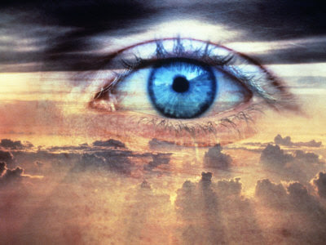
“Coram Deo”
With Bishop Ronald K. Powell

Slide 2
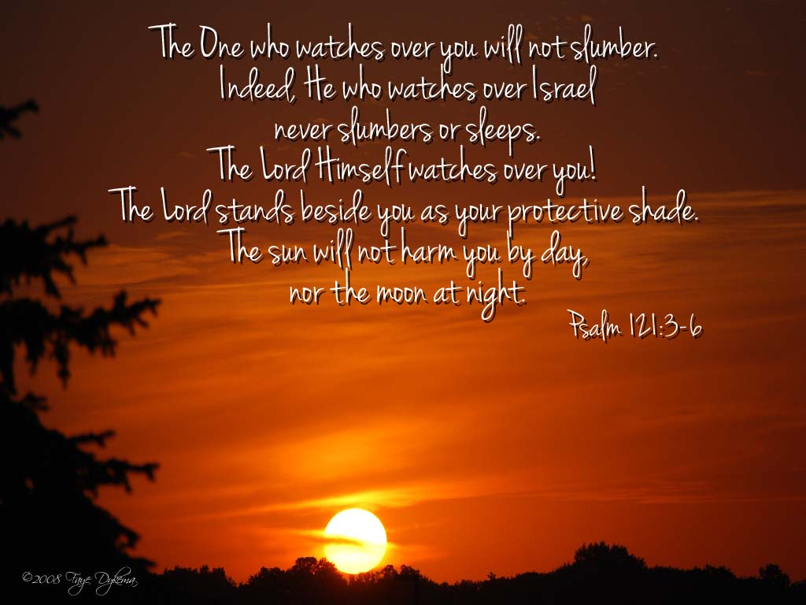
Psalm 121:3-6

Slide 3
“Coram Deo” (Latin)
This phrase literally refers to something that takes place in the presence of, or before the face of, God.
To live “Coram Deo” is to live one’s entire life in the presence of God, under the authority of God, to the glory of God.

Slide 4
To live in the presence of God
To live in the presence of God is to understand that whatever we are doing and wherever we are doing it, we are acting under the gaze of God.
God is omnipresent. There is no place so remote that we can escape His penetrating gaze.

Slide 5
To be aware of the presence of God
To be aware of the presence of God is also to be acutely aware of His sovereignty.
The uniform experience of the saints is to recognize that if God is God, then He is indeed sovereign.
When Saul was confronted by the shining glory of the risen Christ on the road to Damascus, his immediate question was, “Who is it, Lord?”
He wasn’t sure who was speaking to him, but he knew that whomever it was, was certainly sovereign over him.

Slide 6
Living under divine sovereignty
Living under divine sovereignty involves more than a reluctant submission to sheer sovereignty that is motivated out of a fear of punishment.
It involves recognizing that there is no higher goal than offering honor to God. Our lives are to be living sacrifices, oblations offered in a spirit of adoration and gratitude.

Slide 7
To live all of life Coram Deo
To live all of life Coram Deo is to live a life of integrity.
It is a life of wholeness that finds its unity and coherency in the majesty of God.
A fragmented life is a life of disintegration.
It is marked by inconsistency, disharmony, confusion, conflict, contradiction, and chaos.

Slide 8
The Christian who compartmentalizes his or her life
The Christian who compartmentalizes his or her life into two sections of the religious and the nonreligious has failed to grasp the big idea.
The big idea is that all of life is religious or none of life is religious.
To divide life between the religious and the nonreligious is itself a sacrilege.

Slide 9
No matter what we are doing
This means that if a person fulfills his or her vocation as a steelmaker, attorney, or homemaker Coram Deo, then that person is acting every bit as religiously as a soul-winning evangelist who fulfills his vocation.
It means that David was as religious when he obeyed God’s call to be a shepherd as he was when he was anointed with the special grace of kingship.
It means that Jesus was every bit as religious when He worked in His father’s carpenter shop as He was in the Garden of Gethsemane.

Slide 10
Integrity, consistency, principle, humility
Integrity is found where men and women live their lives in a pattern of consistency.
It is a pattern that functions the same basic way in church and out of church.
It is a life that is open before God.
It is a life in which all that is done is done as to the Lord.
It is a life lived by principle, not expediency; by humility before God, not defiance.
It is a life lived under the tutelage of conscience that is held captive by the Word of God.

Slide 11
Coram Deo … before the face of God.
That’s the big idea.
Next to this idea our other goals and ambitions become mere trifles.

Slide 12
Matthew 24:13
13 But the one who endures to the end will be saved.

Slide 13
Romans 8:31–36
God’s Everlasting Love
31 What then shall we say to these things? If God is for us, who can be against us? 32 He who did not spare his own Son but gave him up for us all, how will he not also with him graciously give us all things? 33 Who shall bring any charge against God’s elect? It is God who justifies. 34 Who is to condemn? Christ Jesus is the one who died—more than that, who was raised—who is at the right hand of God, who indeed is interceding for us. 35 Who shall separate us from the love of Christ? Shall tribulation, or distress, or persecution, or famine, or nakedness, or danger, or sword? 36 As it is written,
“For your sake we are being killed all the day long; we are regarded as sheep to be slaughtered.”

Slide 14
2 Corinthians 4:7–16 / Treasure in Jars of Clay
7 But we have this treasure in jars of clay, to show that the surpassing power belongs to God and not to us.
8 We are afflicted in every way, but not crushed; perplexed, but not driven to despair;
9 persecuted, but snot forsaken; struck down, but not destroyed;
10 always carrying in the body the death of Jesus, so that the life of Jesus may also be manifested in our bodies.
11 For we who live are always being given over to death for Jesus’ sake, so that the life of Jesus also may be manifested in our mortal flesh. 12 So death is at work in us, but life in you.
13 Since we have the same spirit of faith according to what has been written, “I believed, and so I spoke,” we also believe, and so we also speak,
14 knowing that he who raised the Lord Jesus will raise us also with Jesus and bring us with you into his presence.
15 For it is all for your sake, so that as grace extends to more and more people it may increase thanksgiving, to the glory of God.
16 So we do not lose heart. Though our outer self is wasting away, our inner self his being renewed day by day.

Slide 15
Hebrews 6:9–12
9 Though we speak in this way, yet in your case, beloved, we feel sure of better things—things that belong to salvation.
10 For God is not unjust so as to overlook your work and the love that you have shown for his name in serving the saints, as you still do.
11 And we desire each one of you to show the same earnestness to have the full assurance of hope until the end,
12 so that you may not be sluggish, but imitators of those who through faith and patience inherit the promises.

Slide 16
Hebrews 10:35–39
35 Therefore do not throw away your confidence, which has a great reward. 36 For you have need of endurance, so that when you have done the will of God you may receive what is promised. 37 For, "Yet a little while,
and the coming one will come and will not delay;
38 but my righteous one shall live by faith,
and if he shrinks back, my soul has no pleasure in him.”
39 But we are not of those who shrink back and are destroyed, but of those who have faith and preserve their souls.

