Slide 1
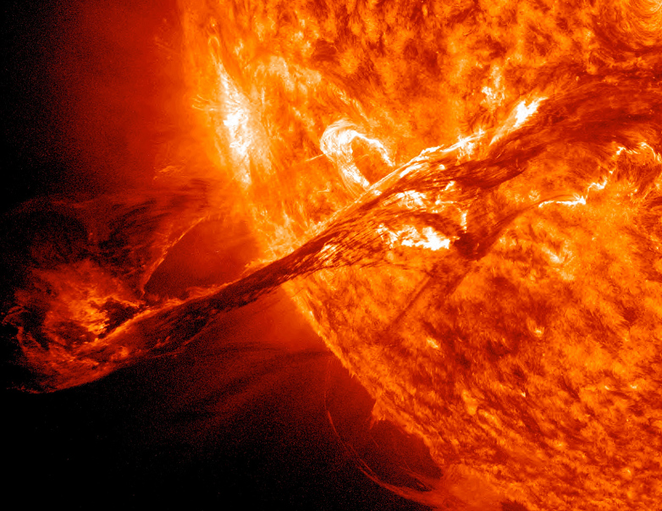
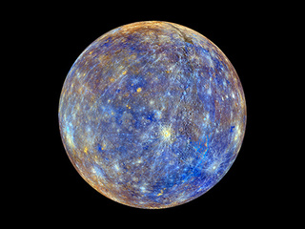
Dreams and Discernment
With
Bishop Ronald K. Powell

Slide 2
Job 33:14-19 (NKJV) 14 For God may speak in one way, or in another, Yet man does not perceive it. 15 In a dream, in a vision of the night, When deep sleep falls upon men, While slumbering on their beds, 16 Then He opens the ears of men, And seals their instruction. 17 In order to turn man from his deed, And conceal pride from man, 18 He keeps back his soul from the Pit, And his life from perishing by the sword. 19 “Man is also chastened with pain on his bed, And with strong pain in many of his bones,

Slide 3
Numbers 12:6 (NKJV) 6 Then He said, “Hear now My words: If there is a prophet among you, I, the Lord, make Myself known to him in a vision; I speak to him in a dream.
Does God Make Himself Known Only To Prophets?
Answer: No

Slide 4
Joel 2:28-29 (NKJV) God’s Spirit Poured Out 28 “And it shall come to pass afterward That I will pour out My Spirit on all flesh; Your sons and your daughters shall prophesy, Your old men shall dream dreams, Your young men shall see visions. 29 And also on My menservants and on My maidservants I will pour out My Spirit in those days.

Slide 5
Daniel 7:1-2 (NKJV) Vision of the Four Beasts 1 In the first year of Belshazzar king of Babylon, Daniel had a dream and visions of his head while on his bed. Then he wrote down the dream, telling the main facts. 2 Daniel spoke, saying, “I saw in my vision by night, and behold, the four winds of heaven were stirring up the Great Sea.
Is there a difference in a dream or vision?
Yes and No, but the end result is the same.
God communicating His will
Or telling us of things to come.

Slide 6
Write what should NOT be forgotten.
“Date, Time, Significant People, Emotions, Weather”

Slide 7
Are Dreams and Visions for Today?
Hebrews 13:8 (NKJV)
⁸ Jesus Christ is the same yesterday, today, and forever.
Malachi 3:6 New King James Version (NKJV)
⁶ “For I am the Lord, I do not change; Therefore you are not consumed, O sons of Jacob.

Slide 8
Who will God speak to?
Genesis 40:5-22
God spoke to the Butcher and the Baker. A Picture of the righteous and un- righteous.
Genesis 20:3-7
God Spoke To Abimelech about Sarah And Abraham

Slide 9
Warnings Corrections Prophetic Promises Direction Future Revelation Prophetic Words Confirmation and Encouragement
God’s Purpose for Dreams
Proverbs 3:5-6
⁵ Trust in the Lord with all your heart, And lean not on your own understanding;
In all your ways acknowledge Him, And He shall direct your paths.

Slide 10
Divine
Psalm 16:7 (NKJV)
⁷ I will bless the Lord who has given me counsel; My heart also instructs me in the night seasons.

Slide 11
Divination
Can Satan Give us Dreams?
Nowhere in scripture does it say Satan can directly give you dreams!
Satan Can influence our heart and soul areas.

Slide 12
Jeremiah 23:9-11
False Prophets and Empty Oracles
⁹ My heart within me is broken Because of the prophets; All my bones shake. I am like a drunken man, And like a man whom wine has overcome, Because of the Lord, And because of His holy words. ¹⁰ For the land is full of adulterers; For because of a curse the land mourns. The pleasant places of the wilderness are dried up. Their course of life is evil, and their might is not right.
¹¹ “For both prophet and priest are profane; Yes, in My house I have found their wickedness,” says the Lord.

Slide 13
Jeremiah 23:13-14
13 “And I have seen folly in the prophets of Samaria:
They prophesied by Baal
And caused My people Israel to err.
14 Also I have seen a horrible thing in the prophets of Jerusalem:
They commit adultery and walk in lies;
They also strengthen the hands of evildoers,
So that no one turns back from his wickedness.
All of them are like Sodom to Me,
And her inhabitants like Gomorrah.

Slide 14
Jeremiah 23:16-17
16 Thus says the Lord of hosts:
“Do not listen to the words of the prophets who prophesy to you.
They make you worthless;
They speak a vision of their own heart,
Not from the mouth of the Lord.
17 They continually say to those who despise Me,
‘The Lord has said, “You shall have peace” ’;
And to everyone who walks according to the [a]dictates of his own heart, they say,
‘No evil shall come upon you.’ ”

Slide 15
Jeremiah 23:21-22
²¹ “I have not sent these prophets, yet they ran. I have not spoken to them, yet they prophesied. ²² But if they had stood in My counsel, And had caused My people to hear My words, Then they would have turned them from their evil way And from the evil of their doings.

Slide 16
Jeremiah 23:25-27
25 “I have heard what the prophets have said who prophesy lies in My name, saying, ‘I have dreamed, I have dreamed!’ 26 How long will this be in the heart of the prophets who prophesy lies? Indeed they are prophets of the deceit of their own heart, 27 who try to make My people forget My name by their dreams which everyone tells his neighbor, as their fathers forgot My name for Baal.

Slide 17
Ezekiel 33:1-3
Ezekiel 33:1-3 Amplified Bible (AMP)
The Watchman’s Duty
33 And the word of the Lord came to me, saying, 2 “Son of man, speak to the sons of your people [who are exiled in Babylon] and say to them, ‘If I bring a sword on a land, and the people of the land take one man from among them and make him their watchman, 3 and he sees the sword coming on the land, and he blows the trumpet and warns the people,

Slide 18
dreams .

Slide 19
We can only see a SHORT distance ahead,

