Slide 1
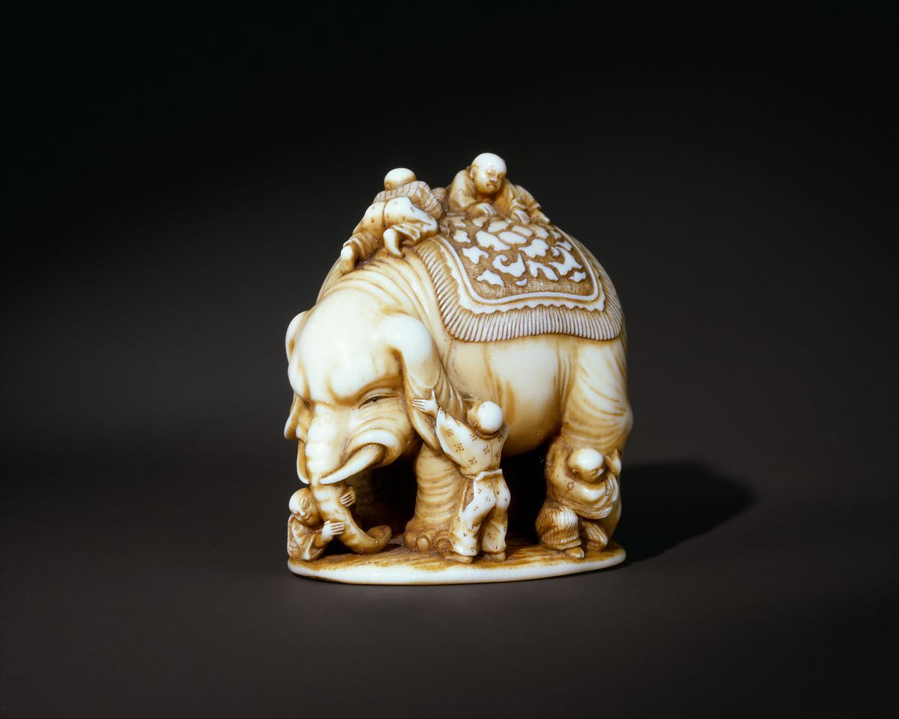
“Blind Spots” A look at spiritual blindness
With Bishop Ronald K. Powell

Slide 2
1 Corinthians 13:9-12
9 For we know in part, and we prophesy in part.
10 But when that which is perfect is come, then that which is in part shall be done away.
11 When I was a child, I spake as a child, I understood as a child, I thought as a child: but when I became a man, I put away childish things.
12 For now we see through a glass, darkly; but then face to face: now I know in part; but then shall I know even as also I am known.

Slide 3
Can you see everything in your surroundings?
Most of us would say yes. But the truth is, whether your vision is 20/20 or corrected by lenses, the answer is the same: no matter how hard you try, you cannot see everything around you.

Slide 4
The human eye has a blind spot
A small area on the retina, about the size of a pencil eraser, without photoreceptors.
We usually aren’t aware of this blind spot because our brain fills in this blank area with the surrounded images, making our vision field appear seamless.

Slide 5
We all have blind spots or gaps in our perception that keep us from seeing the full truth.
We stumble around in life with blind spots blocking the work God wants to do in us. But it doesn’t have to be this way. No matter how broken or hurt, every person can discover the way to healing, hope, and a joyful new way of living.

Slide 6
Blind Men and the Elephant – A Poem by John Godfrey Saxe
Here is John Godfrey Saxe’s (1816-1887) version of Blind Men and the Elephant:

Slide 7
Blind Men and the Elephant
It was six men of Indostan,
To learning much inclined,
Who went to see the Elephant
(Though all of them were blind),
That each by observation
Might satisfy his mind.

Slide 8
Blind Men and the Elephant
The First approach'd the Elephant,
And happening to fall
Against his broad and sturdy side,
At once began to bawl:
"God bless me! but the Elephant
Is very like a wall!"

Slide 9
Blind Men and the Elephant
The Second, feeling of the tusk,
Cried, -"Ho! what have we here
So very round and smooth and sharp?
To me 'tis mighty clear,
This wonder of an Elephant
Is very like a spear!"

Slide 10
Blind Men and the Elephant
The Third approach'd the animal,
And happening to take
The squirming trunk within his hands,
Thus boldly up and spake:
"I see," -quoth he- "the Elephant
Is very like a snake!"

Slide 11
Blind Men and the Elephant
The Fourth reached out an eager hand,
And felt about the knee:
"What most this wondrous beast is like
Is mighty plain," -quoth he,-
"'Tis clear enough the Elephant
Is very like a tree!"

Slide 12
Blind Men and the Elephant
The Fifth, who chanced to touch the ear,
Said- "E'en the blindest man
Can tell what this resembles most;
Deny the fact who can,
This marvel of an Elephant
Is very like a fan!"

Slide 13
Blind Men and the Elephant
The Sixth no sooner had begun
About the beast to grope,
Then, seizing on the swinging tail
That fell within his scope,
"I see," -quoth he,- "the Elephant
Is very like a rope!"

Slide 14
Blind Men and the Elephant
And so these men of Indostan
Disputed loud and long,
Each in his own opinion
Exceeding stiff and strong,
Though each was partly in the right,
And all were in the wrong!

Slide 15
MORAL
So, oft in theologic wars
The disputants, I ween,
Rail on in utter ignorance
Of what each other mean;
And prate about an Elephant
Not one of them has seen!

Slide 16
Blind Men and the Elephant – Theological Truth
When it comes to the moral of the Blind Men and the Elephant, it seems that today’s philosophers end their agenda too quickly. Doesn’t the picture of the blind men and the elephant also point to something bigger -- The elephant?
Actually, if we know the Whole Elephant is out there, shouldn’t this drive us to open our eyes wider and seek every opportunity to experience more of Him?

Slide 17
Psalm 119:18
David Said: “Open my eyes, that I may behold wonderful things from your law.”
This verse combines prayer and the Word, and we need to see how, so that we can combine them this way in our lives and in our church.

Slide 18
There are three things that we learn from this verse.
“We cannot even see what the word really is without God’s supernatural help.”

Slide 19
1. There are wonderful things in the word of God.
“Open my eyes, that I may behold wonderful things from your law.”
The word “law” is “Torah” and means “instruction” or “teaching” in this psalm.
There are wonderful things in God’s teaching to us. In fact, they are so wonderful that when you really see them, they change you profoundly and empower holiness and love and missions
Which is why reading and knowing and meditating on and memorizing the word of God is so crucial.

Slide 20
2 Corinthians 3:18
18 And we all, with unveiled face, beholding the glory of the Lord, are being transformed into the same image from one degree of glory to another. For this comes from the Lord who is the Spirit.

Slide 21
2. No one can see these wonderful things for what they really are without God’s supernatural help.
“Open my eyes, that I may behold wonderful things from your law.” If God does not open our eyes, we will not see the wonder of the word. We are not naturally able to see spiritual beauty. When we read the Bible without the help of God, the glory of God in the teachings and events of the Bible is like the sun shining in the face of a blind man. Not that you can’t construe its surface meaning, but you can’t see the wonder, the beauty, the glory of it such that it wins your heart.

Slide 22
3. We must pray to God for supernatural illumination when we read the Bible.
“Open my eyes, that I may behold wonderful things from your law.” Since we are helpless in ourselves to see spiritual beauty and the wonder of God in the teachings and events of the Bible without God’s gracious illumination, we should ask him for it. “Open my eyes.”

Slide 23
Closing
We must be people who treasure the word in our hearts, but more, a people who know our desperate condition apart from God and that he has appointed prayer as the way that our eyes will be opened to see wonder in the word and so be changed.
“Open my eyes, that I may behold wonderful things from your law.”

Slide 24
Closing
How earnest was he in these kinds of prayers? How earnest should we be?
One answer is given in Psalm 119:147, “I rise before dawn and cry for help; I wait for your words.”

