Slide 1
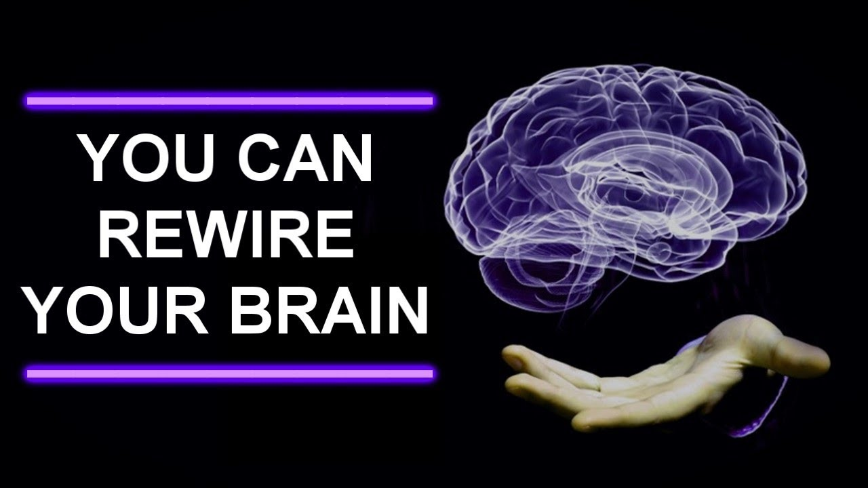
With Bishop Ronald K. Powell

Slide 2
CHANGE your THOUGHTS and it will
Change YOU!
Our Central Text
Romans 12:1-4 New International Version (NIV)
A Living Sacrifice
1 Therefore, I urge you, brothers and sisters, in view of God’s mercy, to offer your bodies as a living sacrifice, holy and pleasing to God—this is your true and proper worship.
2 Do not conform to the pattern of this world, but be transformed by the renewing of your mind. Then you will be able to test and approve what God’s will is—his good, pleasing and perfect will.

Slide 3
Our Central Text
Romans 12:1-4 New International Version (NIV)
Humble Service in the Body of Christ
3 For by the grace given me I say to every one of you: Do not think of yourself more highly than you ought, but rather think of yourself with sober judgment, in accordance with the faith God has distributed to each of you. 4 For just as each of us has one body with many members, and these members do not all have the same function,

Slide 4
Introduction
Psychologists teach us that there are two mental laws that contribute heavily to our mental state of being.
In other words, whether we’re happy or sad.
They are:
1: The Law of Concentration.
2: The Law of Substitution.

Slide 5
The Law of Concentration
The Law of Concentration states that whatever we dwell upon grows in our life experience.
Whatever we think about on a continual basis becomes a part of us.
Yes, we become what we think, and the more we dwell on something, the more we have of it in our lives.

Slide 6
The Law of Substitution
The Law of Substitution states that our conscience mind can only hold one thought at a time.
It makes no difference to our mind whether the thought is “negative” or “positive,” it can only hold one at a time.
However, we can choose to substitute “negative” thoughts with “positive” thoughts, thus changing our mental state of being.

Slide 7
The Lord understood these principles when He inserted a couple of scriptures into the Bible:
Proverbs 23:7a, “For as he thinketh in his heart, so is he.”
Isaiah 26:3, “Thou wilt keep him in perfect peace, whose mind is stayed on thee: because he trusteth in thee.”

Slide 8
Now here is where the rubber meets the road . . .
We are what we are because of what we have allowed ourselves to concentrate on!
If you find yourself an OLD crabby, miserable, negative person that nobody likes to be around . . . guess what?
You’re that way because you have allowed yourself to feast on a steady diet of crabby, miserable, negative thoughts.

Slide 9
If you bake a cake…
If you bake a cake and it doesn’t turn out like you want, you can blame the oven all day long . . .
but that won’t change the outcome of your next cake.
If you want to change the outcome of the next cake . . . change the recipe!

Slide 10
Are You Who You Want to BE?
If you find that you’re not the person you want to be, you can blame your circumstances all day long, but that will never change anything.
If you want to change . . . change the recipe of your life!
Try substituting negative thoughts with positive ones.

Slide 11
And do you know what? . . .
If you’ll concentrate on what’s right in your life instead of what is wrong . . .
What’s good instead of what’s bad . . .
What’s sweet instead of what’s bitter . . .
You’ll find that you’re a totally different person . . .
And the only thing that changed . . . was you!

Slide 12
There are two simple mental and Spiritual laws to happiness in life, and psychologist didn’t invent them . . God did!
1: Concentration: Proverbs 23: 7a, “For as he thinketh in his heart, so is he.”
2: Substitution: Isaiah 26: 3, “Thou wilt keep him in perfect peace, whose mind is stayed on thee: because he trusteth in thee.”
Happiness comes when we stop wailing about the troubles we have, and offer thanks for all the troubles we don’t have.

Slide 13
1 Corinthians 2:16
“For who has known or understood the mind(the counsels and purposes) of the Lord so as to guide and instruct [Him] and give Him knowledge?
But we have the mind of Christ, the Messiah, and do hold the thoughts (feelings and purposes) of His heart.” (1 Corinthians 2:16, The Amplified Bible)

Slide 14
Epiphany!
Isn’t it exciting to realize that you can hold the thoughts and feelings and purposes of God’s very own heart in your heart? Isn’t it thrilling to know the Creator of heaven and earth wants to be one spirit with you and transmit His thoughts to your mind?

Slide 15
1 Corinthians 6:17
1 Corinthians 6:17 says; that when you were joined to the Lord you became one spirit with Him. He came into union with you so that He can talk to you heart to heart. God wants you in this harmony with Him so that His thoughts can become your actions.

Slide 16
God’s Desire For You!
He wants you to walk so closely with Him that you never lack power to overcome the evil of this world.
He wants you to be so in tune with His Spirit that you are able to feel His heart of compassion toward those around you who are hurting or bowed down with sickness and pain.

Slide 17
God’s Desire For You!
He wants you to consent to become one with Him, just as He has committed to be one with you, so He can reach out through your hands and fulfill His purposes in the earth.
Make a fresh commitment today to walk in union with your God.
Give your attention to His Spirit in your inner man.
Determine to yield to His voice and not to the voices of the world or the flesh!
Determine to yield to His fresh leadership of your life, and not to the traditions of men.

Slide 18
Ask yourself:
1- Do I realize the reality of Christ living in me?
2 Cor. 13:5
Examine yourselves to see whether you are in the faith; test yourselves.
Do you not realize that Christ Jesus is in you–unless, of course, you fail the test?

Slide 19
2- What voice am I listening to in times of crisis or decision making?
The call of the flesh for gratification?
The call of the world to act and to as it says?
The Word of God as it applies to the situation you find confronting you?

Slide 20
Romans 8:12-15
Therefore, brethren, we are debtors, not to the flesh, to live after the flesh.
[13] For if ye live after the flesh, ye shall die: but if ye through the Spirit do mortify the deeds of the body, ye shall live.
[14] For as many as are led by the Spirit of God, they are the sons of God.
[15] For ye have not received the spirit of bondage again to fear; but ye have received the Spirit of adoption, whereby we cry, Abba, Father.

Slide 21
Allow the mind of Christ to flow through you!
By faith you can have your mind renewed if you will begin to read the Word of God daily and to the best of your understanding and ability, begin to apply that part of it that applies to you, in your daily responses to life.

Slide 22
Romans 12:1-4
Therefore, I urge you, brothers, in view of God’s mercy, to offer your bodies as living sacrifices, holy and pleasing to God–this is your spiritual act of worship.
2Do not conform any longer to the pattern of this world, but be transformed by the renewing of your mind. Then you will be able to test and approve what God’s will is–his good, pleasing and perfect will.

Slide 23
This is a written directive of God’s will.
2Do not conform any longer to the pattern of this world, but be transformed by the renewing of your mind.
Now then, since you know what God wants and how he wants you to begin.

Slide 24
It is your decision.
Will you continue to use the same old recipes which have not worked?
Try God’s new recipes- they have worked in countless millions of lives who became serious about their situation, and decided to let God help.

