Slide 1
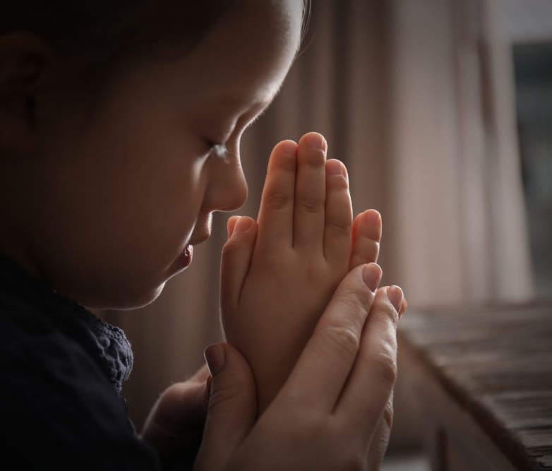
Praying through our Anxieties
October 2019
With
Bishop Ronald K. Powell

Slide 2
1-Our Anxieties
Philippians 4:72
And the peace of God, which transcends all understanding, will guard your hearts and your minds in Christ Jesus. Philippians 4:72

Slide 3
Our Need For God
Father, I acknowledge my need for you today.
I pray that you would breathe peace into me through your Holy Spirit.
Would you guard my heart? Would you show me how to protect my mind?
I know I am weak on my own, and I fall back on your strength today. Be near to me, guiding me and equipping me as I go. In your name, amen.

Slide 4
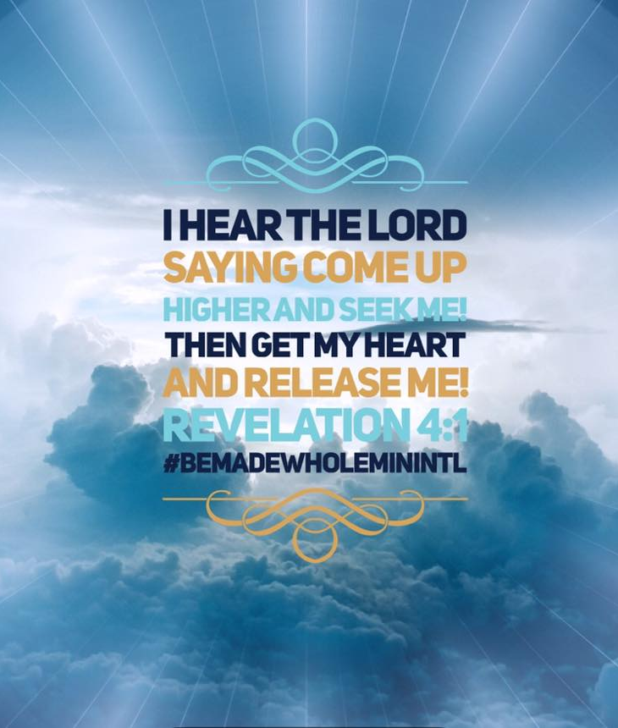
2-When I am afraid,
When I am afraid, I put my trust in you. Psalm 56:3
Jesus, I put my trust in you today.
Anxious thoughts are taking over my mind, and it’s easy to take my eyes off of you when I feel afraid.
Would you remind me of who you are?
Would you pour out your love on me, that I might remember you are always good and always faithful, even when I am afraid?

Slide 5
When I am afraid,
When I am afraid, I put my trust in you. Psalm 56:3
I want to put all my trust, all my hope, and all my faith in you alone. Amen.

Slide 6
3-So do not fear
Isaiah 41:10
So do not fear, for I am with you; do not be dismayed, for I am your God. I will strengthen you and help you; I will uphold you with my righteous right hand. Isaiah 41:10

Slide 7
Lord Jesus, thank you for always being with me.
Your name, Immanuel, means God with us...
I’m so grateful today that you near to me no matter what anxious thoughts might try to creep into my mind. Thank you for being my strength when I feel weak. Thank you for upholding me and never letting me fall. You are faithful, always. I love you, Lord, and I rely on you today and every day. Amen

Slide 8
4- For God has not given us a spirit of fear, but of power and of love and of a sound mind. 2 Timothy 1:7
Father, thank you for this truth.
Thank you for the gifts you bestow on us-- gifts that help ease our anxious spirits and remind us of who we are in Christ. Thank you for giving us power to fight the lies. Thank you for loving us even in our brokenness. Thank you for clearing our minds and whispering your words over us. We are grateful, Lord. Amen.

Slide 9
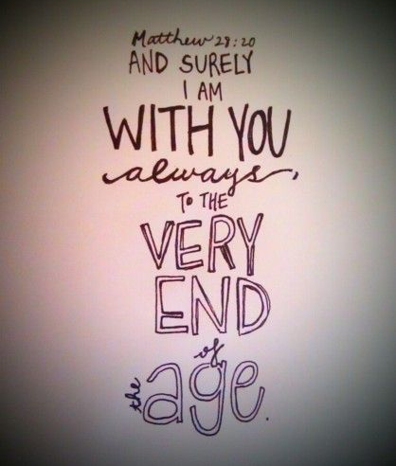
5- When I am Weak then you are strong
Be strong and courageous.
Have I not commanded you? Be strong and courageous. Do not be terrified; do not be discouraged, for the Lord your God will be with you wherever you go. Joshua 1:9

Slide 10
Let’s Pray
Sometimes, it can feel so hard to believe that. We don’t feel strong or courageous, and we worry relentlessly about our lives and circumstances. Would you remind us today that we can be strong and brave in you? Would you send your Spirit to remind us we are not alone? We surrender our hearts to you today. Be our strength. In your name, amen.
Lord Jesus, we know in you we are conquerors.

