Slide 1

Teaching Your Heart to Listen
With Bishop Ronald K. Powell

Slide 2
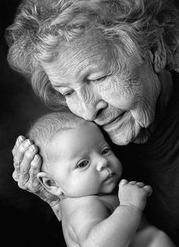
Whether they are the complaints of an elderly woman, the arguments of a defensive teenager or the incessant chatter of a four-year-old, words of others are either endured or embraced. (June Hunt)

Slide 3
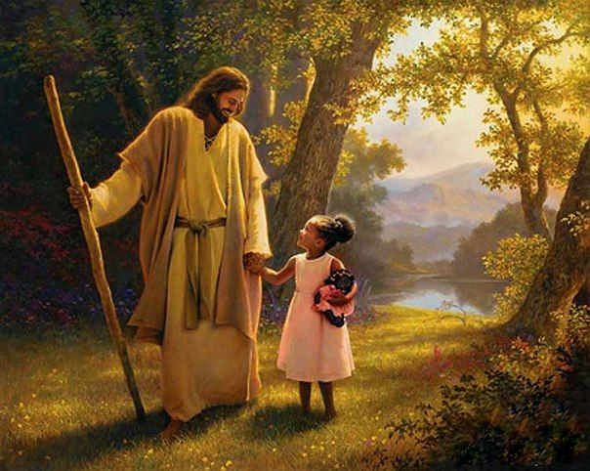
Matthew 25:40
And the King will reply, 'Truly I tell you, whatever you did for one of the least of these brothers of Mine, you did for Me.

Slide 4
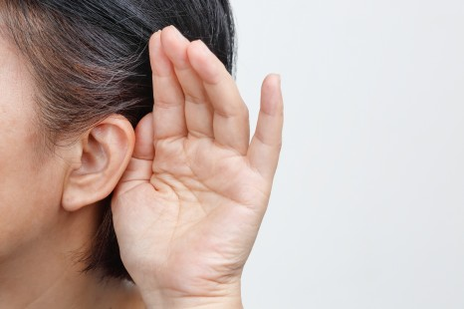
Matthew 13:12-14 English Standard Version (ESV)
¹² For to the one who has, more will be given, and he will have an abundance, but from the one who has not, even what he has will be taken away. ¹³ This is why I speak to them in parables, because seeing they do not see, and hearing they do not hear, nor do they understand. ¹⁴ Indeed, in their case the prophecy of Isaiah is fulfilled that says:
“‘“You will indeed hear but never understand,
and you will indeed see but never perceive.”

Slide 5

Listening is easy to fake, attentiveness is simple to pretend, but real listening requires effort.
Our self-centered tendency is to tune others out and our own thoughts in.
We tend to muse and reminisce or think about what we are going to say next.

Slide 6
"Let the wise listen and add to their learning, and let the discerning get guidance." (Proverbs 1:5)
As you begin to understand that God, more often than not, communicates to you through the words of others (and through your words to others), your heart will desire to be an attentive listener.
The major step to becoming a genuine listener is learning how to listen to God!

Slide 7
Listening to God
Listening to God requires a belief that God loves me and desires to communicate with me.
"The Lord appeared to us in the past, saying: 'I have loved you with an everlasting love; I have drawn you with loving-kindness.'" (Jeremiah 31:3)

Slide 8
Listening to God
Listening to God requires consistent reading, studying and meditating on His living Word, the Bible.
"My word that goes out from my mouth: It will not return to me empty, but will accomplish what I desire and achieve the purpose for which I sent it." (Isaiah 55:11)

Slide 9
Listening to God
Listening to God means regularly getting alone and giving Him my undivided attention.
"He went up on a mountainside by himself to pray. When evening came, he was there alone." (Matthew 14:23)

Slide 10
Listening to God
Listening to God is opening my heart and letting God point His finger of truth on the real me.
"Search me, O God, and know my heart; test me and know my anxious thoughts. See if there is any offensive way in me, and lead me in the way everlasting." (Psalm 139:23-24)

Slide 11
Listening to God
Listening to Godis listening carefully to others, realizing that God may be using them to communicate His personal message to me.
"Pride only breeds quarrels, but wisdom is found in those who take advice." (Proverbs 13:10)

Slide 12
Listening to God

Slide 13
Listening to God
Listening to God is recognizing the presence of the Holy Spirit within me and responding to His guidance for communicating with others.

Slide 14

"But the Counselor, the Holy Spirit, whom the Father will send in my name, will teach you all things and will remind you of everything I have said to you." (John 14:26)

