Slide 1
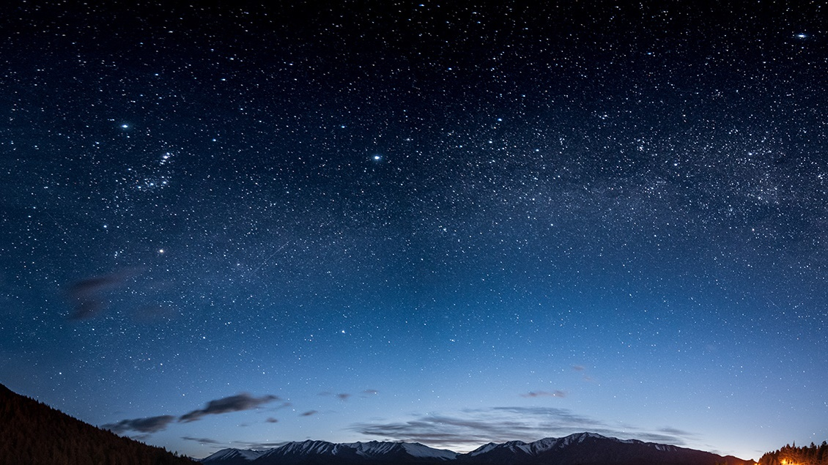
Our Plans Without God
With Bishop Ronald K. Powell

Slide 2
KEY PASSAGE: Genesis 11:1-9
11 And the whole earth was of one language, and of one speech.
² And it came to pass, as they journeyed from the east, that they found a plain in the land of Shinar; and they dwelt there.
³ And they said one to another, Go to, let us make brick, and burn them thoroughly. And they had brick for stone, and slime had they for mortar.
⁴ And they said, Go to, let us build us a city and a tower, whose top may reach unto heaven; and let us make us a name, lest we be scattered abroad upon the face of the whole earth.

Slide 3
KEY PASSAGE: Genesis 11:1-9
⁶ And the Lord said, Behold, the people is one, and they have all one language; and this they begin to do: and now nothing will be restrained from them, which they have imagined to do.
⁷ Go to, let us go down, and there confound their language, that they may not understand one another's speech.
⁸ So the Lord scattered them abroad from thence upon the face of all the earth: and they left off to build the city.
⁹ Therefore is the name of it called Babel; because the Lord did there confound the language of all the earth: and from thence did the Lord scatter them abroad upon the face of all the earth.

Slide 4
SUPPORTING SCRIPTURES: Genesis 9:7 Proverbs 3:5-6 | Matthew 7:7
^{Genesis 9:7}
⁷ And you, be ye fruitful, and multiply; bring forth abundantly in the earth, and multiply therein.

Slide 5
SUPPORTING SCRIPTURES: Proverbs 3:5-6 | Matthew 7:7
Proverbs 3:5-6 King James Version (KJV)
⁵ Trust in the Lord with all thine heart; and lean not unto thine own understanding.
⁶ In all thy ways acknowledge him, and he shall direct thy paths.

Slide 6
SUPPORTING SCRIPTURES: Matthew 7:7
Matthew 7:7 King James Version (KJV)
⁷ Ask, and it shall be given you; seek, and ye shall find; knock, and it shall be opened unto you:

Slide 7
Introduction
Sometimes we might wonder why a plan of ours doesn’t turn out as we had hoped.
We were careful to think through every step, but it didn’t work.
One possible reason is that we foolishly left God out of the plan.
Instead of relying on the One who knows everything and has all power, we depended on our own knowledge, understanding, and resources to determine what we wanted to accomplish, where we desired to go, and how we would complete the plan.

Slide 8
SERMON POINTS
An example of this kind of mindset is found in Genesis 11:1-9. After the flood, the Lord had told Noah’s sons, “Be fruitful and multiply; populate the earth abundantly and multiply on it” (Gen. 9:7).
But their descendants gathered on a plain in Shinar and settled there, saying, “Come, let us build for ourselves a city, and a tower whose top will reach into heaven, and let us make for ourselves a name, otherwise we will be scattered abroad over the face of the whole earth” (Gen. 11:4).

Slide 9
SERMON POINTS
Although God had made it very clear that He wanted mankind to fill the earth, the people at Babel decided to make their own plan, disregarding the Lord’s instructions.
In response to their rebellion, God confused their language so they could no longer communicate with each other and build the tower.
As a result, His will was accomplished, and they were scattered abroad over the face of the earth.

Slide 10
SERMON POINTS
Sometimes we act as foolishly as the people of Babel when we fail to consider what God would have us do.
He is willing to guide our choices and direct us into His will if we will ask Him before we move ahead on our own.
His plans for us are so much better than anything we could devise.

Slide 11
SERMON POINTS
If we claim that Jesus Christ is our Savior and Lord, we should consult Him regarding every decision.
He loves us, understands our weaknesses, knows what’s best for us and how to accomplish it, and can save us from the pain and trouble that could result from following our own self-directed path.
When He directs our way, He ensures that everything works out according to His will because He has the power to accomplish it.

Slide 12
SERMON POINTS
We need God’s guidance for every area of our lives—financial decisions, marriage, business, education, or anything that concerns us.
Sometimes we’re going in the right direction, but the timing isn’t right. God not only knows what we should do, but how and when as well.
Some choices may seem fantastic from our perspective, but if they aren’t God’s will, we will regret them eventually. As Christ’s followers, we have the Holy Spirit within us to guide us into all truth.
But if we neglect His divine leadership and insist on going our own way, the Lord will let us face the consequences until we finally repent and turn back to Him.

Slide 13
SERMON POINTS
The Consequences of Leaving God Out of Our Plans
We can’t claim the promise of provision and God’s protection.
He doesn’t give us His assistance and power to accomplish what’s not His will.

Slide 14
SERMON POINTS
We can’t honestly ask the Lord for His blessing.
The goal is to pray for guidance, not to make up our minds and ask God to bless what we’ve planned.
As children of God we belong to Him, and He’s committed to guide and provide for us, but not always in a way that makes immediate sense to us.

Slide 15
SERMON POINTS
The absence of God in our plans limits the possibilities of whatever we do.
The Lord’s will for our lives is far more profitable for us than anything we could devise apart from Him.
How we make decisions is important because we face choices every day, and the only way to make them according to God’s will is to rely on the guidance of the Holy Spirit.
God’s plan is not something we can come up with on our own.

Slide 16
SERMON POINTS
Leaving God out of our plans reveals our pride.
We may not think we need the Lord’s direction for a normal day, but that’s really an attitude of personal pride.
We should begin every day seeking His guidance for whatever lies ahead and end the day with gratitude for His protection, provision, and direction.

Slide 17
SERMON POINTS
If we don’t seek God’s guidance, we may choose less than He would have provided.
We may look at a situation and think we know the best option, but if we wait on the Lord, He may lead us to something better than we would have chosen on our own.
To receive God’s best, we must ask for His direction regarding what to do, when to do it, and how to accomplish it.

Slide 18
SERMON POINTS
Results of Disobedience to God
When we refuse to consult the Lord and are determined to go our own way, we can expect the following results:

Slide 19
SERMON POINTS
Confusion. We’ll start to question our decision and wonder if we made a wrong choice.
God’s actions at the Tower of Babel demonstrate how He brings confusion when we make decisions apart from Him.
Not only were their plans frustrated, but God accomplished His will despite them, as they scattered over the surface of the earth.

Slide 20
SERMON POINTS
Conflict. We’ll experience internal conflict when the Holy Spirit gives us a sense of uneasiness, inadequacy, and doubt over our course of action.
Cost. Disobedience is always costly when we don’t do the right thing, in the right time, and in the right way.
Loss. We will experience loss at some point in our lives, whether emotionally or physically.

Slide 21
SERMON POINTS
Regret. God chooses the best direction, time, and way. Therefore, if we go in an opposite direction, don’t wait for His timing, or do it our way, we will miss His best and suffer deep regret.
Pain. We may experience physical pain as the result of our disobedience, but the worst pain is that which is emotional. As we look back at our choices, we’ll be filled with thoughts of “If only I’d done this or not done that.”

Slide 22
SERMON POINTS
Disaster. It could come to us financially, emotionally, or in countless other ways, but the result of disobedience is always disastrous because we didn’t follow the Lord.
Discipline. If we will not listen and obey God, He’ll discipline us. His goal is that we learn to trust in Him with all our heart instead of leaning on our own understanding (Prov. 3:5-6).
Only then will He make our paths straight.

Slide 23
RESPONSE
When you are making plans, do you ask the Lord for guidance?
What situations cause you to remember to ask Him for direction?
Which decisions do you usually make on your own?
What hard lessons have you learned from leaving God out of your plans or jumping ahead of Him?
What blessings have you enjoyed as a result of seeking His guidance and following Him in obedience?

