Slide 1
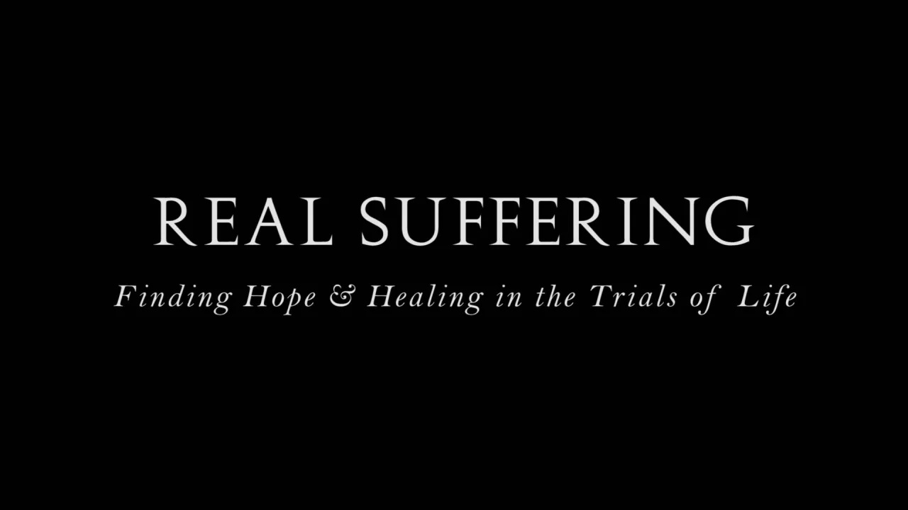
With Bishop Ronald K. Powell

Slide 2
1 John 5:4
"Whatever is born of God overcomes the world; and this is the victory that has overcome the world-our faith."

Slide 3
Sermon Points
As Christians, we delight in the thought of sharing in Christ's glory, but what about sharing in His suffering?
Jesus took care of the death penalty once and for all so we don't ever have to worry about that again. But the Bible teaches that we must suffer times of trial if we are to share in the glory.

Slide 4
Is it worth it?
Read what Paul says in Romans 8:18:
...For I consider that the sufferings of this present time (this present life) are not worth being compared with the glory that is about to be revealed to us and in us and for us and conferred on us!

Slide 5
Acting Right When Things Are Wrong
Many of us think that we suffer because of our circumstances. We believe that if our circumstances would change, we'd be able to act right.
But God wants us to become so mature and stable that we act right even when none of our circumstances are good.

Slide 6
Acting Right When Things Are Wrong
There are different levels of faith, and most of the time we want to use our faith to get rid of a problem.
But sometimes God's plan is for us to exercise a higher level of faith that will carry us through life's challenges. This requires even greater faith than being delivered from a situation.

Slide 7
Acting Right When Things Are Wrong
Too often we marvel at the delivering power of God and overlook His keeping, strengthening and enabling power.
Although there are many reasons why Christians suffer, I would like to address what I believe are eight of the most common reasons why there is suffering in our lives.

Slide 8
#1: Ignorance of the Word
Many Christians suffer because they're too busy seeking carnal knowledge instead of the Word of God. The Lord Himself said,
My people are destroyed for lack of knowledge... (Hosea 4:6).

Slide 9
#1: Ignorance of the Word
Paul was an educated man, with a wealth of carnal knowledge. When he realized the importance of spiritual knowledge, he said,
...I resolved to know nothing (to be acquainted with nothing, to make a display of the knowledge of nothing, and to be conscious of nothing) among you except Jesus Christ (the Messiah) and Him crucified (1 Corinthians 2:2).

Slide 10
#1: Ignorance of the Word
Like Paul, we need to realize the importance of learning spiritual things, for Galatians 6:8 says:
...he who sows to his own flesh (lower nature, sensuality) will from the flesh reap decay and ruin and destruction, but he who sows to the Spirit will from the Spirit reap eternal life.

Slide 11
#2: Disobedience - the trait of being unwilling to obey
Once we know the Word of God, we have a responsibility to be obedient to it. Too many of us intend to be obedient, but put it off.
Even procrastination is disobedience, and it can cause us to suffer.
James 4:7 gives us good advice: Submit yourselves therefore to God... .

Slide 12
#2: Disobedience - the trait of being unwilling to obey
When God tells me to do something, I find it helpful to write it down. This serves as a reminder that I must be obedient if I want God’s blessings.
If you are willing and obedient, you shall eat the good of the land (Isaiah 1:19).

Slide 13
#3: To Purify and Test Your Faith
Sometimes people seem surprised that they must go through a time of trial or suffering. Perhaps they’ve been faithful to learn and obey the Word, and the trials still come.
Sometimes trials come simply to test and purify our faith.

Slide 14
#3: To Purify and Test Your Faith
You should] be exceedingly glad on this account, though now for a little while you may be distressed by trials and suffer temptations, so that [the genuineness] of your faith may be tested, [your faith] which is infinitely more precious than the perishable gold which is tested and purified by fire. [This proving of your faith is intended] to redound to [your] praise and glory and honor when Jesus Christ (the Messiah, the Anointed One) is revealed (1 Peter 1:6-7).

Slide 15
#4: A Need for Brokenness
The word brokenness may strike fear in some people, but it’s really not a bad word. God doesn’t desire to break our spirits, but He wants to break that outer shell, the flesh that prevents Him from being all He wants to be in and through us. He wants to break off things like pride, rebellion, selfishness and independence. God wants us to be totally dependent on Him, and suffering seems to bring us to that point.

Slide 16
#4: A Need for Brokenness
However, having to depend on God shouldn’t cause us to feel sorry for ourselves. I once said, “Oh, God, I’m so lonely, and I don’t have anybody but You.” And the Holy Spirit said, “Poor Ron, you’re just stuck with God.” I’ve discovered that having only God is a good position to be in.

Slide 17
#5: To Build Compassion
Compassion is born out of experiencing similar problems. The Bible says, …we do not have a High Priest Who is unable to understand and sympathize and have a shared feeling with our weaknesses and infirmities and liability to the assaults of temptation, but One Who has been tempted in every respect as we are, yet without sinning (Hebrews 4:15).

Slide 18
#5: To Build Compassion
It comforts me to know that Jesus understands me and has compassion. Going through trials and experiencing God’s deliverance better equips us to minister to others. Our pain is never wasted; it brings about compassion that reaches out to other hurting people by saying, “I’ve been there, and God brought me through it, and He’ll do the same for you.”

Slide 19
#6: To Encourage Others
The apostle Paul said there were many things that God allowed him to go through simply as object lessons for other people.
...I want you to know and continue to rest assured, brethren, that what [has happened] to me [this imprisonment] has actually only served to advance and give a renewed impetus to the [spreading of the] good news (the Gospel)…. most of the brethren have derived fresh confidence in the Lord because of my chains and are much more bold to speak and publish fearlessly the Word of God... (Philippians 1:12-14).

Slide 20
#6: To Encourage Others
Even in Paul’s imprisonment, his stability and ability to be used of God was evident.
If we’re to minister to others, we too must face some adverse circumstances. But if we stand in faith and confidence, God will bring us through to victory, and we’ll be a great encouragement to others in the process.

Slide 21
#7: Because of the Word
Sometimes we suffer attacks from the enemy simply because of our involvement with the Word of God.
Mark 4:17 speaks of those who hear the Word and endure it for a while, …then when trouble or persecution arises on account of the Word, they immediately are offended (become displeased, indignant, resentful) and they stumble and fall away.

Slide 22
#7: Because of the Word
When someone receives the Word of God, Satan delights in coming immediately to try to steal what’s been sown in their heart.
He knows the Word will strengthen us and help us live a victorious Christian life, and he wants to stop it if he can. So it’s imperative to guard the Word in your heart and resist the devil from stealing it away from you.

Slide 23
#8: Because of Living in the World
Christians may also face trials and suffer simply because we live in a world full of sin.
But Jesus said, “I have told you these things, so that in Me you may have [perfect] peace and confidence. In the world you have tribulation and trials and distress and frustration; but be of good cheer [take courage; be confident, certain, undaunted]! For I have overcome the world. [I have deprived it of power to harm you and have conquered it for you]” (John 16:33).

Slide 24
#8: Because of Living in the World
What a promise! Understanding the reason for our suffering and having the assurance of the final glory we’ll share should make it a little easier to enjoy our lives…even during the times of sharing in suffering.

Slide 25
Conclusion:
And if we are [His] children, then we are [His] heirs also: heirs of God and fellow heirs with Christ [sharing His inheritance with Him]; only we must share His suffering if we are to share His glory (Romans 8:17).

