Slide 1
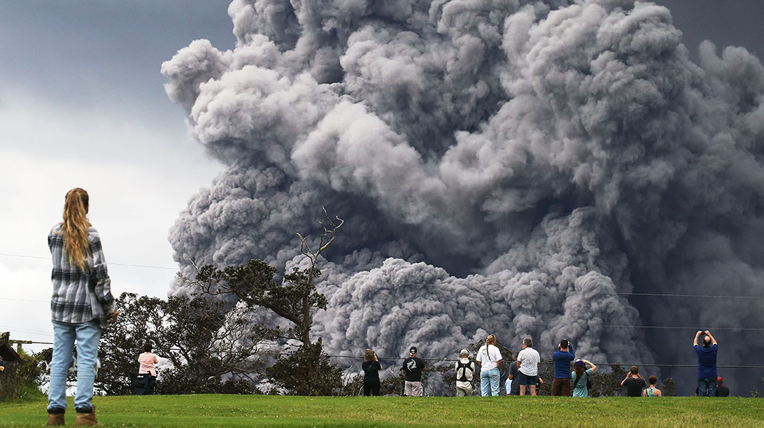
The Beginning of Sorrows Part 1
With Bishop Ronald K. Powell

Slide 2
Matthew Chapter 24
24 And Jesus went out, and departed from the temple: and his disciples came to him for to shew him the buildings of the temple.
² And Jesus said unto them, See ye not all these things? verily I say unto you, There shall not be left here one stone upon another, that shall not be thrown down.
³ And as he sat upon the mount of Olives, the disciples came unto him privately, saying, Tell us, when shall these things be? and what shall be the sign of thy coming, and of the end of the world?
⁴ And Jesus answered and said unto them, Take heed that no man deceive you.

Slide 3
Verses 1-4:
This section forms Jesus’ last major discourse and His most prophetic and apocalyptic message of the coming of the end of the world (or the present age).
While the message includes a prediction of the imminent fall of Jerusalem, it also goes far beyond to point us to the distant future during which the “times of the Gentiles” will continue until the end of the Great Tribulation.

Slide 4
Mount of Olives
Jesus then left the city, crossed the Kidron Valley, and went east of Jerusalem to the “mount of Olives” from which He could look down on the temple courtyard. Here His disciples asked Him three questions:
1. When shall these things be?” The destruction of the temple;
2. What shall be the sign of thy coming?” Greek Parousia, technical term for the coming of the King;
3. And of the end of the world?” Greek aion, “the age”.
Therefore, the entire discourse must be looked upon as answering all three of these questions.

Slide 5
Matthew 24:1
Matthew 24:1 “And Jesus went out, and departed from the temple: and his disciples came to [him] for to shew him the buildings of the temple.”

Slide 6
“Buildings of the temple”:
This temple was begun by Herod the Great in 20 B.C. and was still under construction when the Romans destroyed it in A.D. 70. At the time of Jesus’ ministry, the temple was one of the most impressive structures in the world, made of massive blocks of stone bedecked with gold ornamentation.

Slide 7
“Buildings of the temple”:
Some of the stones in the temple complex measured 40x12x12 feet and were expertly quarried to fit perfectly against one another.
The temple buildings were made of gleaming white marble, and the whole eastern wall of the large main structure was covered with gold plates that reflected the morning sun, making a spectacle that was visible for miles.

Slide 8
“Buildings of the temple”:
The entire temple mount had been enlarged by Herod’s engineers, by means of large retaining walls and vaulted chambers on the South side and Southeast corner. By this means the large courtyard area atop the temple mount was effectively doubled.
The whole temple complex was magnificent by any standard. The disciples’ conversation here may have been prompted by Jesus’ words (in 23:38). They were undoubtedly wondering how a site so spectacular could be left “desolate.”

Slide 9
Matthew 24:2
Matthew 24:2 “And Jesus said unto them, see ye not all these things? verily I say unto you, There shall not be left here one stone upon another, that shall not be thrown down.”

Slide 10
“Not be left here one stone … upon another”:
These words were literally fulfilled in A.D. 70. Titus, the Roman general, built large wooden scaffolds around the walls of the temple buildings, piled then high with wood and other flammable items, and set them ablaze.
The heat from the fires was so intense that the stones crumbled. The rubble was then sifted to retrieve the melted gold, and the remaining ruins were “thrown down” into the Kidron Valley.

Slide 11
“Not be left here one stone … upon another”:
Jesus was speaking prophetically of the destruction of the temple that He loved so well. This was the temple where He had driven the money changers out. He had taught reverence in the house of God, that it should be a House of Prayer.
When Jesus (the Lord of the temple), left, it was desolate. The outward magnificence was gone when the holiness was gone. In less than 40 years, this temple would be destroyed in a bloody battle.

Slide 12
Matthew 24:3
Matthew 24:3 “And as he sat upon the mount of Olives, the disciples came unto him privately, saying, tell us, when shall these things be? and what [shall be] the sign of thy coming, and of the end of the world?”

Slide 13
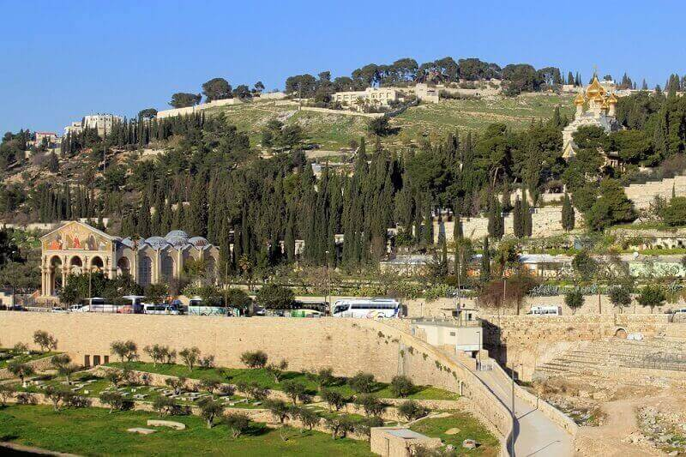
“Mount of Olives (Olivet)”
The “Mount of Olives (Olivet),” is a small range of several summits (highest elevation 2,723 feet), running north-south for two- and one-half miles. The range overlooks Jerusalem from the east, across the Kidron Valley.
Jesus often went to the Mount of Olives to teach (Matt. 24:3), to pray (Luke 23:39-40), and to rest (Luke 21:37).

Slide 14
“Mount of Olives”
On the western slope, near the base, is a spot known as the Garden of Gethsemane where Jesus agonized in prayer on the night before His crucifixion (Luke 22:39-46; Mark 14:32). Jesus fittingly used Olivet to deliver one of His major prophetic discourses (Matt. 24 – 25), since from it He ascended into heaven (Acts 1:9-12), and to it He will return at His second coming (Zech. 14:4).
These disciples had all the things grouped together. One question, when will the temple be destroyed? The physical temple would be destroyed in less than 40 years. The temple of His body would be destroyed in just a few days.

Slide 15
“What will be the sign of thy coming”:
(Luke 19:11), records that the disciples still “supposed that the kingdom of God was going to appear immediately.”
The destruction of the temple (verse 2), did not fit the eschatological scheme they envisioned, so they asked for clarification.

Slide 16
“What will be the sign of thy coming”:
Jesus addressed their questions in reverse order, describing the prophetic sign of His coming (actually a series of signs in verses 4-35), and then addressing their question about the timing of these events beginning (in verse 36).
When they asked about His coming (Greek, Parousia; literally “presence”), they did not envision a second coming in the far-off future.

Slide 17
“What will be the sign of thy coming”:
They were speaking of His coming in triumph as Messiah, an event which they no doubt anticipated would occur presently.
Even if they were conscious of His approaching death, which He had plainly prophesied to them on repeated occasions, they could not have anticipated His ascension to heaven and the long intervening church age.
However, when Jesus used the term Parousia in His discourse, He used it in the technical sense as a reference to His second coming.

Slide 18
Matthew 24:4
Matthew 24:4 And Jesus answered and said unto them, take heed that no man deceive you.”

Slide 19
“Take heed”:
“Take heed”: Jesus, in reply to their question, first gives them a caution to beware of deception. They were to be constantly on their guard, because many would arise to deceive the people. Many shall come in my name, not in the name or by the authority of Jesus, or claiming to be His followers, and to be sent by him, but in the name of the Messiah, or claiming to be the Messiah.
Jesus warned them, the very first thing, that there would be deceivers. His first answer: “Take heed that no man deceive you”.
There were even deceivers then and now, but not the magnitude that there will be in the end days.

Slide 20
Verses 5-14:
Verses 5-14: “Many shall come” refers to the parade of false messiahs who have now spanned the centuries of church history and have led many astray into false religious cults.
“Wars and rumors of wars” refers to peace being taken from the earth and the constant wars that have continually marked the “age of the Gentiles.”

Slide 21
“Famines, and pestilences:”
“Famines, and pestilences:” These events mark only the “beginning of sorrows” (Greek odin), “birth pangs.”
This is followed by martyrdom and the rise of “false prophets and the abounding of “iniquity.”

