Slide 1
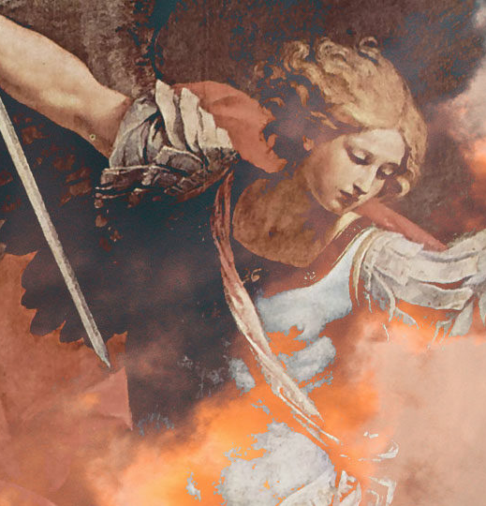
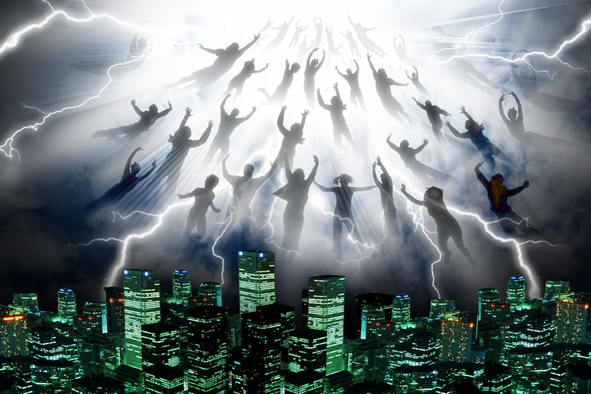
The Rapture of the Church
With Bishop Ronald K. Powell

Slide 2
When the Rapture will occur…
This question is not an assertion as to WHEN the Rapture will occur. The Scriptures reveal that It will occur.
It is merely a question about being ready. Jesus said to watch and pray.

Slide 3
Luke 21:36 (KJV)
“Watch ye therefore, and pray always, that ye may be accounted worthy to escape all these things that shall come to pass, and to stand before the Son of man.”

Slide 4
Rapture of the Church
Without question, the Rapture of the Church will be one of the most pivotal events in modern history, and there are so many signs taking place that point to the Lord’s soon return.

Slide 5
Luke 21:36 (KJV)
“Watch ye therefore, and pray always, that ye may be accounted worthy to escape all these things that shall come to pass, and to stand before the Son of man.”

Slide 6
Translations
The Greek word from this term “rapture” is derived appears in 1 Thessalonians 4:17, translated “caught up.”
The Latin translation of this verse used the word rapturo.
The Greek word it translates is harpazo, which means to snatch or take away.

Slide 7
1 Thessalonians 4:13 -18
13 But I would not have you to be ignorant, brethren, concerning them which are asleep, that ye sorrow not, even as others which have no hope.
14 For if we believe that Jesus died and rose again, even so them also which sleep in Jesus will God bring with him.
15 For this we say unto you by the word of the Lord, that we which are alive and remain unto the coming of the Lord shall not prevent them which are asleep.

Slide 8
1 Thessalonians 4:13 -18
16 For the Lord himself shall descend from heaven with a shout, with the voice of the archangel, and with the trump of God: and the dead in Christ shall rise first:
17 Then we which are alive and remain shall be caught up together with them in the clouds, to meet the Lord in the air: and so shall we ever be with the Lord.
18 Wherefore comfort one another with these words.

Slide 9
Jesus Said: Revelation 3:10-11 King James Version (KJV)
10 Because thou hast kept the word of my patience, I also will keep thee from the hour of temptation, which shall come upon all the world, to try them that dwell upon the earth. 11 Behold, I come quickly: hold that fast which thou hast, that no man take thy crown.

Slide 10
Tom Constable explained these verses well in The Bible Knowledge Commentary. He wrote:
Then the dead in Christ will be resurrected, that is, believers of this dispensation will be raised.
Old Testament saints, it seems, will be raised at the end of the Great Tribulation (Dan. 12:2), for the phrase “in Christ” usually refers exclusively to Church-Age saints.
The bodies of the dead in Christ will rise before the living Christians are caught up to meet the Lord in the air.

Slide 11
Tom Constable explained these verses well in The Bible Knowledge Commentary. He wrote:
Again, the basic idea of the Rapture is drawn from the Latin term for “caught up”—rapturo.
It means that the church of Jesus Christ, those who have trusted in Christ as their Savior, will literally be transported from earth to heaven in an instant.
There will be no death for those who are raptured. They will be taken—caught up—in the air to be with Jesus!

Slide 12
Paul
Paul believed that Jesus return was imminent, and that brought great comfort to him in his daily struggles.
It is not difficult to understand Paul’s longing for this to occur when faced with the trials we are confronted with daily.
However, no one knows when this will happen. We do know that we are given His Word as the assurance that it will happen.

Slide 13
A Closer Examination
If you have made any attempt to study scriptural references to what the future holds, you know that the major discussion among believers today concerns the point of time that the Rapture will take place in relation to the Tribulation.
There are several theories, but two dominate.

Slide 14
A Closer Examination
The first is the pre-tribulation view.
This is the belief that the church will be raptured prior to the Tribulation. I believe this is the view From supporting Scriptures.

Slide 15
A Closer Examination
The second is the post tribulation view.
This is the belief that the church will not be raptured until the very end of Tribulation; that the Rapture and the second coming of Christ are a single event rather than two separate events as held to by those who adhere to the pre-tribulation Rapture.

Slide 16
Dr. Charles Ryrie
In his book What You Should Know About the Rapture, Dr. Charles Ryrie compares these two theories concerning the Rapture.
But he also asks a very important question for anyone who is about to study the end times.
He asks, “Does it really make any difference when the Lord will come?

Slide 17
Dr. Charles Ryrie
Is it not His coming that is important? If His coming should be pre-tribulation, then we will praise Him for the fact that we missed that terrible time.
If it is post-tribulation, then we will gladly suffer for His sake.
Either way, we still have the blessed hope of His coming.”

Slide 18
Dr. Charles Ryrie
The fact that God has chosen to reveal some things regarding the timing of the Rapture is significant.
Additionally, the time factor is important as it relates to the power and motivation of an impending event or events that are soon to come.

Slide 19
It could happen at any time
If the Rapture is to occur prior to the Tribulation, it could happen at any time, and that adds anticipation to the thought of being raptured into the heavens with Jesus.

Slide 20
It could happen at any time
On the other hand, if the Rapture is not to occur until the very end of the Tribulation—after all the prophecy concerning the events of the Tribulation has transpired—we certainly won’t find ourselves living as if He could appear at any moment.

Slide 21
The two views have different effects.
Clearly, the question of when is important in light of what we can expect and the revelation of God to the church.

Slide 22
The two views have different effects.
The fact that Revelation 3:10 promises to keep us from the hour of temptation is the basis for my belief that the church will be raptured prior to the Tribulation:
“10Because you have kept My command to persevere, I also will keep you from the hour of trial which shall come upon the whole world, to test those who dwell on the earth.”

Slide 23
The two views have different effects.
The only way to keep us from the hour of the temptation is to eliminate our presence, and the means of doing that is the rapture of the church into the air to meet Jesus!

Slide 24
The two views have different effects.
Others argue the point.
There is nothing wrong with debate, and questions have never changed the truth.
Whatever you believe about when it will happen, rest assured, the time will come.

Slide 25
What is the Rapture?
In addition to what you believe about when the Rapture will happen, there is much to be gleaned concerning exactly what the rapture is.
From the definition, we have determined that it means the church will be caught up or carried away into the air to be with the Lord, but exactly what does that mean?
Well, I believe it covers a number of things.

Slide 26
First, Christ will return.
That this event will be one of great drama is vividly portrayed in Scripture.
His coming will be accompanied with a loud command from what will sound like the voice of an archangel.
This will be accompanied by the trumpet call of God. The implication is that these sounds will be heard all around the world.

Slide 27
First, Christ will return.
That this event will be one of great drama is vividly portrayed in Scripture.
His coming will be accompanied with a loud command from what will sound like the voice of an archangel.
This will be accompanied by the trumpet call of God. The implication is that these sounds will be heard all around the world.

Slide 28
Second
The second thing we can know about the Rapture is that there will be a resurrection of those who have died “in Christ.”
The dead will be raised even before those who are living will be changed. And yet both groups will experience their respective changes “in the twinkling of an eye” (1 Cor. 15:52).
Neither will be a process occurring over a period of time. It will be as Scripture describes it—instantaneous.

Slide 29
Third
There will be a rapture of living believers who will be caught up to be with Jesus without experiencing death.
Although we have used the word rapture to encompass the entire experience, the Rapture specifically refers to the transformation of living believers into immortal bodies without the event of physical death.
Paul calls it a mystery, and I can add nothing beyond that description. Whatever happens in that instant is a mystery, but what a glorious one to consider!

Slide 30
Fourth
The fourth aspect of the Rapture relates to the reunion with loved ones who have died and our union with Christ.
Can you imagine what that will be like?
Perhaps you never met your father or grandmother because each died before you were born.

Slide 31
Fourth
Many children born during times of war lost their fathers without knowing them. Just think about what kind of reunion that day will entail!
And yet, it holds no comparison at all to what it will be like when we see Jesus.
The very thought makes my heart long for the day.

Slide 32
Fifth
Fifth: There is one more truth regarding the Rapture we need to take a look at. This is the most practical of the five. The doctrine of the Rapture is to be a source of comfort and encouragement. Paul writes, “Comfort one another with these words.” (1 Thess. 4:18).

Slide 33
Closing
It is not difficult for me to find comfort in Paul’s words. The knowledge that we will be united in heaven is encouraging to me. Several years ago, my mom died. To know that one day we will be reunited is comforting.

Slide 34
Closing
There will be questions about future events. However, the fact that Jesus is coming back is the bottom line and the source of comfort for me as a believer, as I hope it is for you.
Whether you believe that the Rapture will happen prior to the Tribulation or at the very end, the fact that it’s going to happen should encourage your heart as you look to the future with great hope.

Slide 35
Let’s Pray

