Slide 1
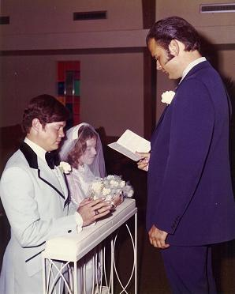
Love that will Last
With
Bishop Ronald K. Powell

Slide 2
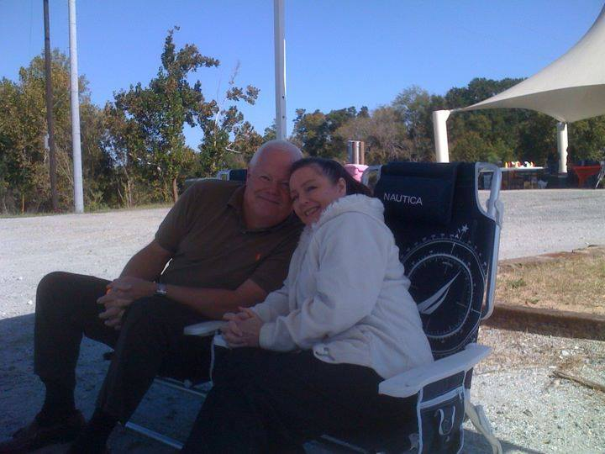
"The greatest miracle of love is not 'love at first sight,' it's love after a long, long look!
Marriage is that long, long look.
There's no better advice for couples today than to submit to the Lordship of Christ in their home.“
In this message I will share seven Principle that will produce a lasting Love.

Slide 3
1. REINFORCE FAITH
Build each other up in the faith. Ecclesiastes 4:12 says "a threefold cord is not quickly broken." A three-fold cord is a man, a woman, and God. God must be first in your life and hers. If God is first in your life, your wife will be even more secure in your love. You can love her more by putting her second than you ever could by putting her first.
Ecclesiastes 4:12 12 And though a man might prevail against one who is alone, two will withstand him—a threefold cord is not quickly broken.

Slide 4
2. REMEMBER ROLES
God made us different that He might make us one (see 1 Peter 3:1, 7). He made the husband with a hard exterior and the wife more gentle - but not inferior. The husband is the head of the home, as Jesus is the head of the church and gave Himself for it (Ephesians 5:23-25). It is servant, not dictator, leadership. There is no male superiority and female inferiority when it comes to God. Most women won't mind submitting to a man who loves her enough to die for her and shows it by the way he lives for her.

Slide 5
1 Peter 3:1-4, 7 New International Version
3 Wives, in the same way submit yourselves to your own husbands so that, if any of them do not believe the word, they may be won over without words by the behavior of their wives, ² when they see the purity and reverence of your lives. ³ Your beauty should not come from outward adornment, such as elaborate hairstyles and the wearing of gold jewelry or fine clothes. ⁴ Rather, it should be that of your inner self, the unfading beauty of a gentle and quiet spirit, which is of great worth in God’s sight.
⁷ Husbands, in the same way be considerate as you live with your wives, and treat them with respect as the weaker partner and as heirs with you of the gracious gift of life, so that nothing will hinder your prayers.

Slide 6
Ephesians 5:23-25 New International Version
²³ For the husband is the head of the wife as Christ is the head of the church, his body, of which he is the Savior. ²⁴ Now as the church submits to Christ, so also wives should submit to their husbands in everything.
²⁵ Husbands, love your wives, just as Christ loved the church and gave himself up for her

Slide 7
3. NURTURE CONTENTMENT
Learn that you can do without anything except God, one another, and the basic necessities of life. Sheila and I decided to get married before finishing college. We worked our way through school and did a lot of doing without. But we were happy.
A wise man once said, "To whom little is not enough, nothing is enough." If you're not careful, your marriage is going to be until "debt" do us part. Learn to be content (see Philippians 4:11-12).

Slide 8
Philippians 4:11-12 New International Version
¹¹ I am not saying this because I am in need, for I have learned to be content whatever the circumstances. ¹² I know what it is to be in need, and I know what it is to have plenty. I have learned the secret of being content in any and every situation, whether well fed or hungry, whether living in plenty or in want.

Slide 9
4. PUT AWAY BITTERNESS
Every home is going to be attacked. Ours has; yours will, too. There are no problems too big to solve, just people too small to solve them. If we would banish bitterness and attack the problem rather than one another, our families would be a lot better off. Don't go to bed angry with your backs to each other.
Ephesians 4:26 says, "Be angry and do not sin: do not let the sun go down on your wrath."
Sheila and I have tried to practice that. Sometimes we've stayed up for several nights in a row, but we have worked through our bitterness!

Slide 10
5. KEEP COMMUNICATING
Communication is so important because it is truly what builds intimacy in marriage. 1 Peter 3:8-10 has much to say about the communication a couple needs to have in order to enjoy a lasting love. Sheila and Ronald are very different. We took a psychological profile - the very areas I was the highest in, she's lowest in (& visa versa). In many ways we are total opposites. Yet this is typical. What attracts two people before marriage is often what drives us crazy afterwards.

Slide 11
Have a good date life.
There are three kinds of dates every spouse should keep:
a daily date with God;
a regular date with each child (if there are children);
and a regular date-night with each other.

Slide 12
Suffering for Doing Good
1 Peter 3:8-10 New International Version (NIV)
⁸ Finally, all of you, be like-minded, be sympathetic, love one another, be compassionate and humble. ⁹ Do not repay evil with evil or insult with insult. On the contrary, repay evil with blessing, because to this you were called so that you may inherit a blessing. ¹⁰ For, "Whoever would love life and see good days must keep their tongue from evil and their lips from deceitful speech.

Slide 13
6. REACTIVATE ROMANCE
Keep the love light burning.
So many couples stop courting one another after they marry. Never let it end. Complement one another. Because I am a man, I have more to say to men about what they can do to keep romance alive.
Men, never cease flirting with your wife and never flirt with any other woman. Keep your wife "first" above all other women. Respect and be courteous to her at all times.

Slide 14
Revelation 2:3-5 Living Bible (TLB)
³ You have patiently suffered for me without quitting.
⁴ “Yet there is one thing wrong; you don’t love me as at first! ⁵ Think about those times of your first love (how different now!) and turn back to me again and work as you did before; or else I will come and remove your candlestick from its place among the churches.

Slide 15
7. PRACTICE PRAYER
1 Peter 3:7 tells the husband to "...dwell with them with understanding...that your prayers may not be hindered." (emphasis mine).
Sheila and I started out our marriage praying together and continue it this way, praying for our daughter and grandchildren by name because we know the Bible says:
"Unless the LORD builds the house, They labor in vain who build it; Unless the LORD guards the city, The watchman stays awake in vain." (Psalm 127:1).

Slide 16
Closing
To the men who may be hearing or reading this, let me say that most men don't want to pray with women because we have a hard outer shell. But husband, I implore you to humble yourself.
Get down on your knees with your wife and practice prayer. Let her know you are praying for her. Let her hear you pouring out your heart before God. It will give her great confidence and comfort.
If you are married or are contemplating marriage, prayerfully ask God to enable you to do these things. In doing so, you will be creating a love that will last.

