Slide 1
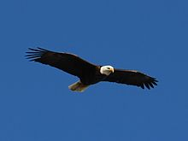
Eagles Gathered Around the Body
With Bishop Ronald K. Powell

Slide 2
What Did Jesus Mean in Luke 17: verse 37 - About the Eagles Gathered Around the Body?
Notes:
Luke 17:37 (ESV)
37 And they said to him, “Where, Lord?” He said to them, “Where the corpse is, there the vultures will gather.”

Slide 3
Introduction

Slide 4
Bishop Ronald Powell
August 18 at 2:58 PM · Today, as I talked with my Grandson Dillon Lynch about miracles and new beginnings. We had birds that showed up which is not unusual on our property but then something prophetic happened.
Eight bald eagles flew over our house and then one Red Hawk, Eight is the number of new beginnings or a New season. Eagles represent a prophetic time. The Hawk is a watchman in scriptures... none of these Predator birds eat dead things which means everything will be new not old or deceased.
I wish that the pictures could have happened while all eight eagles and the hawk were together. I did get the pictures of some of them before they left. We are headed into a new Spiritual Season.

Slide 5
Eagles Gathered Around the Body
“And they answered and said to Him, ‘Where, Lord? So He said to them, ‘Wherever the body is, there the eagles will be gathered together” (Luke 17:37).
When answering the question of what Jesus meant, we must first ask ourselves if there any other verses in the Bible that might help answer this question.

Slide 6
The symbolism
The symbolism in this allegory of Job helps unlock the mysterious but valuable message Jesus Christ gave many years later. Other scriptures show by analogy, metaphor, or allegory what “eagles” can symbolize. Isaiah spoke of eagles as an allegory of Gods faithful people:
“But those who wait on the LORD shall renew their strength; they shall mount up with wings like eagles, they shall run and not be weary, they shall walk and not faint” (Isaiah 40:31).
Notes:
Isaiah 40:31 (ESV)
31 but they who wait for the Lord shall renew their strength;
they shall mount up with wings like eagles; they shall run and not be weary; they shall walk and not faint.

Slide 7
Where does Job say the eagle dwells?
On the rocks, when using the symbolism of Gods people, points to Jesus Christ, who is our spiritual Rock (1 Corinthians 10:4).
Notes:
1 Corinthians 10:4 (ESV)
4 and all drank the same spiritual drink. For they drank from the spiritual Rock that followed them, and the Rock was Christ.

Slide 8
“What is the prey”
Which is “afar off” that the “eagles” seek? The answer is found in Matthew 6:33—
33 But seek ye first the kingdom of God, and his righteousness; and all these things shall be added unto you.

Slide 9
Eagles Gathered Around the Body
Now that we have unlocked the symbolic meaning of Job 39:27-30, we need to read Christ’s statement in Luke 17:37 and Matthew 24:28 and ask what the context surrounding these verses is.
Notes:
Luke 17:37 (ESV)
37 And they said to him, “Where, Lord?” He said to them, “Where the corpse is, there the vultures / Eagles will gather.”
Matthew 24:28 (ESV)
28 Wherever the corpse is, there the vultures/ Eagles will gather.

Slide 10
In both accounts, the context is about the coming Kingdom of God on Earth.
Notice how right before Luke 17:37 in Luke 17:24-36, Jesus prophesies the events immediately preceding His return to this earth and the resurrection of Gods faithful people:
Notes:
Luke 17:24-36
24 For as the lightning, that lighteneth out of the one part under heaven, shineth unto the other part under heaven; so shall also the Son of man be in his day.
25 But first must he suffer many things, and be rejected of this generation.
26 And as it was in the days of Noe, so shall it be also in the days of the Son of man.
27 They did eat, they drank, they married wives, they were given in marriage, until the day that Noe entered into the ark, and the flood came, and destroyed them all.
28 Likewise also as it was in the days of Lot; they did eat, they drank, they bought, they sold, they planted, they builded;
29 But the same day that Lot went out of Sodom it rained fire and brimstone from heaven, and destroyed them all.
30 Even thus shall it be in the day when the Son of man is revealed.
31 In that day, he which shall be upon the housetop, and his stuff in the house, let him not come down to take it away: and he that is in the field, let him likewise not return back*.
32 Remember Lot's wife.
33 Whosoever shall seek to save his life shall lose it; and whosoever shall lose his life shall preserve it.
34 I tell you, in that night there shall be two men in one bed; the one shall be taken, and the other shall be left.
35 Two women shall be grinding together*; the one shall be taken, and the other left.
36 Two men shall be in the field; the one shall be taken, and the other left.

Slide 11
Eagles Gathered Around the Body
“For as the lightning that flashes out of one part under heaven shines to the other part under heaven, so also the Son of Man will be in His day…Two women will be grinding together: the one will be taken and the other left. Two men will be in the field: the one will be taken and the other left” (Luke 17:24, Luke 17:35-36).

Slide 12
Eagles Gathered Around the Body
The same is true in the verses right before Matthew 24:28. So the context of the statement is of the end of the age, just preceding Christ’s return and the resurrection of Gods people.

Slide 13
Eagles Gathered Around the Body
We can now understand that Jesus Christ is the “body” around whom the “eagles” (the Church, His faithful people) will congregate at the resurrection when Jesus returns to this world to rule over all the nations as King of Kings (Revelation 11:15, Zechariah 14:9, Revelation 5:10).
Notes:
Revelation 11:15 (ESV)
15 Then the seventh angel blew his trumpet, and there were loud voices in heaven, saying, “The kingdom of the world has become the kingdom of our Lord and of his Christ, and he shall reign forever and ever.”
Zechariah 14:9 (ESV)
9 And the Lord will be king over all the earth. On that day the Lord will be one and his name one.
Revelation 5:10 (ESV)
10 and you have made them a kingdom and priests to our God, and they shall reign on the earth.”

Slide 14
Eagles Gathered Around the Body
It was our Savior Jesus Christ who allowed Himself to be pierced and bleed to death to become a “carcass” before He was resurrected. He was dead for three days and three nights and did not go to His Father in heaven during His time in the grave.

Slide 15
Eagles Gathered Around the Body
Did the faithful “eagles (Gods faithful disciples) gather around Jesus Christ when He was resurrected then?
Yes, they certainly did. Paul recorded how Jesus was seen by over 500 brethren during the 40 days He revealed Himself after His resurrection to life again (1 Corinthians 15:6).
Notes:
1 Corinthians 15:6
6 After that, he was seen of above five hundred brethren at once; of whom the greater part remain unto this present, but some are fallen asleep.

Slide 16
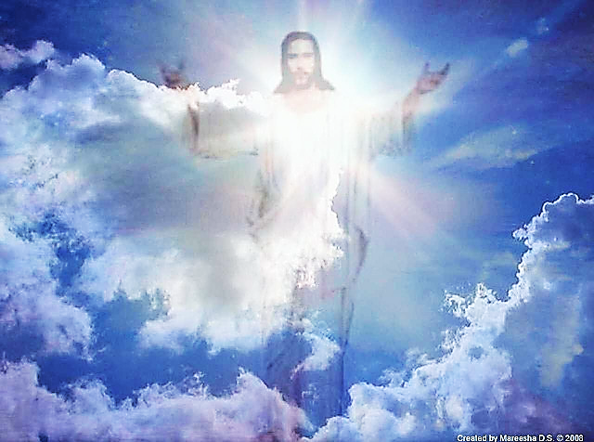
Eagles Gathered Around the Body
Will Gods faithful people be resurrected in the end of the age and gather around the “body” of the returning Jesus Christ? Yes, indeed they will:
“For the Lord Himself will descend from heaven with a shout, with the voice of an archangel, and with the trumpet of God. And the dead in Christ will rise first. Then we who are alive and remain shall be caught up together with them in the clouds to meet the Lord in the air. And thus we shall always be with the Lord” (1 Thessalonians 4:16-17).

Slide 17
Closing
We too can be considered by God to be worthy “eagles” in that resurrection, to be with the “body” of Jesus Christ when He returns in power to set up His Kingdom on Earth, and to rule over all the nations with His faithful people.

