Slide 1

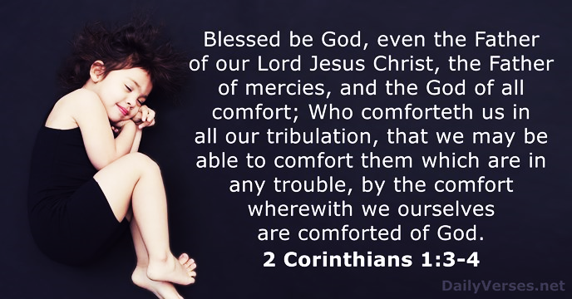
Disturbing the Peace and how to restore it!
With:
Bishop Ronald K. Powell

Slide 2
Colossians 3:15
How would you define peace? Perhaps a more important question is, Do you have peace in your heart?
In Colossians 3:15, Paul tells believers, “Let the peace of Christ rule in your hearts, to which indeed you were called in one body; and be thankful.”
Peace is more than a mere word, idea, or feeling. It is actually an awesome gift of God that He gives to those who, through faith in Jesus Christ, belong to Him and walk obediently in His ways.

Slide 3
Introduction
God has provided His peace to every believer.
If there is an absence of it, it’s because we have not let it rule in our hearts.
Or in other words, we haven’t practiced and applied the truth of His peace to our lives in a way that governs our hearts, no matter what our circumstances may be.

Slide 4
We will experience God’s all-sufficient peace when we believe and practice the following truths:
1. When we place our trust in Jesus Christ as our Savior and Lord:
Until we have peace with God through faith in Christ’s payment of our sins with His death on the cross, we won’t have His peace or the assurance of our eternal destiny.
Everyone is going to die and face God’s righteous judgment, but only believers can know with absolute certainty that they will live forever with Christ in heaven. This eternal assurance is available to all who repent of their sins, trust in Christ’s death on their behalf, and surrender their lives to Him as Savior and Lord.

Slide 5
2. When we believe that God sovereignly controls all things, including our personal lives.
Reliance on this truth frees us from anxious wondering.
Psalm 103:19 says, “The Lord has established His throne in the heavens, and His sovereignty rules over all.”
If we don’t believe this, we’ll go through life futilely trying to control every situation, or thinking that we are controlled by other people.
But knowing that our lives are under God’s authority should bring us great peace and assurance because He promises to work everything together for good to those of us who love Him and are called according to His purpose (Rom. 8:28).

Slide 6
3. When we trust the Lord to meet all our needs.
Believing this truth eliminates our daily concerns about not having enough.
Paul gives us the assurance of this when he says, “My God will supply all your needs according to His riches in glory in Christ Jesus” (Phil. 4:19).
Throughout Scripture, God makes similar promises of provision for His obedient children. Therefore, His peace is available to all who are willing to believe that He tells the truth. However, if we doubt His faithfulness, worry and fear will creep back in.
We’ll dwell on all the uncertainties, forget God’s promises, and try to carry the burden ourselves.
Instead, we should take our concerns to the Lord in prayer so that His peace, which surpasses all comprehension, will guard our hearts and minds in Christ Jesus (Phil. 4:7).

Slide 7
4. When we maintain a clear conscience.
This shields and protects our peace. Jesus said to His disciples, “My peace I give to you; not as the world gives do I give to you. Do not let your heart be troubled, nor let it be fearful” (John 14:27).
However, if we have allowed sin in our lives, our conscience will gnaw away at that peace because we are being disobedient to God.
If we try to find relief by seeking substitute serenity from the world, it will be short-lived because the only way to have genuine peace is to turn back to Christ in repentance and receive His forgiveness and cleansing.

Slide 8
5. When we can accept ourselves the way
God has made us.
This guards us from trying to change something about ourselves over which we have no control.
God has created each of us uniquely with our own personality and abilities. If we have trusted Jesus Christ as our Savior, we have also been given spiritual gifts by the Holy Spirit who indwells us (1 Cor. 12:4-11).
It is through these gifts that He enables us to serve one another, yet sometimes we aren’t content with how God designed us. We must learn to trust His wisdom and be satisfied with His choices for us because only then will we have His peace.

Slide 9
6. When we have a sense of His purpose for our lives that protects us from the plague of emptiness
Many people today struggle with feelings of emptiness, but Paul tells us what God says about believers. “For we are His workmanship, created in Christ Jesus for good works, which God prepared beforehand so that we would walk in them” (Eph. 2:10).
His purpose for us includes living a godly life by following and obeying Him and walking in His ways. Although many people try to fill the void in their lives with all that the world offers, a relationship with God through Jesus Christ is the only thing that can truly fill and satisfy the empty heart.
The closer we draw to Him through prayer, His Word, obedience, and service with our spiritual gifts, the more of His peace we will experience.

Slide 10
7. When we have a sense of competency in life because of Christ’s sufficiency.
Knowing that God equips us for whatever He calls us to do protects us from failures that result from an overwhelming feeling of inadequacy.
We are given spiritual gifts to enable us to serve the Lord as He desires. When we depend on Him and live in His sufficiency, we not only experience His peace, but we also become a witness to others as they see how God can work in a life submitted to Him.

Slide 11
8. When we have a sense of belonging.
This shields us from the painful feelings of being rejected or unwanted.
Jesus gives us this invitation: “Come to Me, all who are weary and heavy-laden, and I will give you rest” (Matt. 11:28).
When we come to Christ, we have peace, knowing that nothing can separate us from Him. However, this does not mean that we will never experience rejection from others. That is just part of life in this world. But Jesus died to make us His own, and He promised never to reject us.

Slide 12
Psalm 37:37
“Mark the perfect man, and behold the upright: for the end of that man is peace.”

Slide 13
Philippians 4:6-8
Philippians 4:6 Be anxious for nothing, but in everything, by prayer and petition, with thanksgiving, present your requests to God. 7And the peace of God, which surpasses all understanding, will guard your hearts and your minds in Christ Jesus. 8Finally, brothers, whatever is true, whatever is honorable, whatever is right, whatever is pure, whatever is lovely, whatever is admirable—if anything is excellent or praiseworthy—think on these things.…

Slide 14
Closing and Prayer
God’s peace comes to us when we humble ourselves before Him, acknowledging and repenting of our sin, believing in Jesus for forgiveness and salvation, and submitting ourselves to Him as our Lord.

Slide 15
Closing Prayer
Loving God, please grant me peace of mind and calm my troubled heart. ... Give me the strength and clarity of mind to find my purpose and walk the path you've laid out for me. I trust your Love God, and know that you will heal our stresses. Just as the sun rises each day against the dark of night rise and give me peace of mind and Heart. In Jesus Name ...Amen

