Slide 1
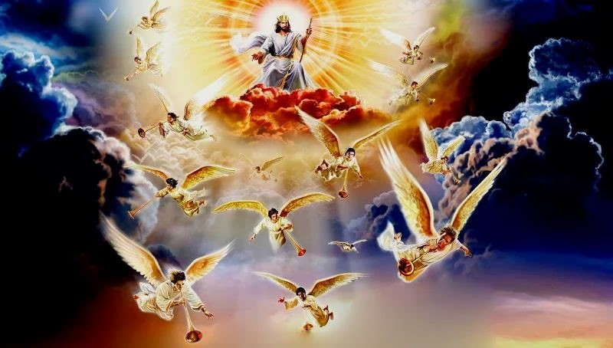
HOW DO I PREPARE FOR JESUS’ RETURN?
With Bishop Ronald K. Powell

Slide 2
JESUS IS RETURNING AS HE SAID
Jesus is returning soon, and He will take home those who have made Him Lord of their lives.
If you have not made this choice, it is time to believe in Jesus and follow Him.
The world is not our home, and Jesus is returning for His people.

Slide 3
HOW DO I PREPARE FOR JESUS’ RETURN?
Matthew 24:37–51 King James Version
37 But as the days of Noah were, so shall also the coming of the Son of man be.38 For as in the days that were before the flood they were eating and drinking, marrying and giving in marriage, until the day that Noe entered into the ark,39 And knew not until the flood came, and took them all away; so shall also the coming of the Son of man be.
(Continued)

Slide 4
HOW DO I PREPARE FOR JESUS’ RETURN?
Matthew 24:37–51 King James Version
40 Then shall two be in the field; the one shall be taken, and the other left.41 Two women shall be grinding at the mill; the one shall be taken, and the other left.42 Watch therefore: for ye know not what hour your Lord doth come.43 But know this, that if the good man of the house had known in what watch the thief would come, he would have watched, and would not have suffered his house to be broken up.44 Therefore be ye also ready: for in such an hour as ye think not the Son of man cometh.
(Continued)

Slide 5
HOW DO I PREPARE FOR JESUS’ RETURN?
Matthew 24:37–51 King James Version
45 Who then is a faithful and wise servant, whom his lord hath made ruler over his household, to give them meat in due season?46 Blessed is that servant, whom his lord when he cometh shall find so doing.47 Verily I say unto you, That he shall make him ruler over all his goods.48 But and if that evil servant shall say in his heart, My lord delayeth his coming;49 And shall begin to smite his fellow servants, and to eat and drink with the drunken;50 The lord of that servant shall come in a day when he looketh not for him, and in an hour that he is not aware of,51 And shall cut him asunder, and appoint him his portion with the hypocrites: there shall be weeping and gnashing of teeth.

Slide 6
How can we know we are prepared for Jesus’ return?
Matthew 25:1–13
25 Then shall the kingdom of heaven be likened unto ten virgins, which took their lamps, and went forth to meet the bridegroom. 2 And five of them were wise, and five were foolish.
3 They that were foolish took their lamps, and took no oil with them: 4 But the wise took oil in their vessels with their lamps. 5 While the bridegroom tarried, they all slumbered and slept.

Slide 7
How can we know we are prepared for Jesus’ return?
Matthew 25:1–13
6 And at midnight there was a cry made, Behold, the bridegroom cometh; go ye out to meet him. 7 Then all those virgins arose, and trimmed their lamps. 8 And the foolish said unto the wise, Give us of your oil; for our lamps are gone out. 9 But the wise answered, saying, Not so; lest there be not enough for us and you: but go ye rather to them that sell, and buy for yourselves.

Slide 8
How can we know we are prepared for Jesus’ return?
Matthew 25:1–13
10 And while they went to buy, the bridegroom came; and they that were ready went in with him to the marriage: and the door was shut. 11 Afterward came also the other virgins, saying, Lord, Lord, open to us. 12 But he answered and said, Verily I say unto you, I know you not. 13 Watch therefore, for ye know neither the day nor the hour wherein the Son of man cometh.

Slide 9
Seven Signs that You Are a True Believer in Jesus
1. You have confessed with your mouth that Jesus is Lord of your life.
2. You believe Jesus is the only way of salvation.
Romans 10:9–10 King James Version⁹ That if thou shalt confess with thy mouth the Lord Jesus, and shalt believe in thine heart that God hath raised him from the dead, thou shalt be saved. ¹⁰ For with the heart man believeth unto righteousness; and with the mouth confession is made unto salvation.

Slide 10
3. Your life has changed since accepting Christ.
2 Corinthians 5:17 17 Therefore if any man be in Christ, he is a new creature: old things are passed away; behold, all things are become new.

Slide 11
4. You hear God’s voice.
John 10:23–29
23 And Jesus walked in the temple in Solomon’s porch. 24 Then came the Jews round about him, and said unto him, How long dost thou make us to doubt? If thou be the Christ, tell us plainly. 25 Jesus answered them, I told you, and ye believed not: the works that I do in my Father’s name, they bear witness of me. 26 But ye believe not, because ye are not of my sheep, as I said unto you. 27 My sheep hear my voice, and I know them, and they follow me: 28 And I give unto them eternal life; and they shall never perish, neither shall any man pluck them out of my hand. 29 My Father, which gave them me, is greater than all; and no man is able to pluck them out of my Father’s hand.

Slide 12
5. You believe you are saved by grace and not by works or being a good person.
Ephesians 2:4–9 4 But God, who is rich in mercy, for his great love wherewith he loved us, 5 Even when we were dead in sins, hath quickened us together with Christ, (by grace ye are saved;) 6 And hath raised us up together, and made us sit together in heavenly places in Christ Jesus: 7 That in the ages to come he might shew the exceeding riches of his grace in his kindness toward us through Christ Jesus. 8 For by grace are ye saved through faith; and that not of yourselves: it is the gift of God: 9 Not of works, lest any man should boast.

Slide 13
6. You receive God’s Word.
John 8:31–38 31 Then said Jesus to those Jews which believed on him, If ye continue in my word, then are ye my disciples indeed; 32 And ye shall know the truth, and the truth shall make you free. 33 They answered him, We be Abraham’s seed, and were never in bondage to any man: how sayest thou, Ye shall be made free? 34 Jesus answered them, Verily, verily, I say unto you, Whosoever committeth sin is the servant of sin. 35 And the servant abideth not in the house for ever: but the Son abideth ever. 36 If the Son therefore shall make you free, ye shall be free indeed. 37 I know that ye are Abraham’s seed; but ye seek to kill me, because my word hath no place in you. 38 I speak that which I have seen with my Father: and ye do that which ye have seen with your father.

Slide 14
7. You love God’s family—the Church.
John 13:34–35; 34 A new commandment I give unto you, That ye love one another; as I have loved you, that ye also love one another. 35 By this shall all men know that ye are my disciples, if ye have love one to another.
1 John 4:20-21 King James Version 20 If a man say, I love God, and hateth his brother, he is a liar: for he that loveth not his brother whom he hath seen, how can he love God whom he hath not seen?21 And this commandment have we from him, That he who loveth God love his brother also.

Slide 15
Parable of the Talents
John 13:34–35; Parable of the Talents
5 Talents to Ten -
2 Talents to Four –
Well done, thou good and faithful servant: thou hast been faithful over a few things, I will make thee ruler over many things: enter thou into the joy of thy lord.
1 Talent Buried –
Cast ye the unprofitable servant into outer darkness: there shall be weeping and nashing of teeth

Slide 16
Luke 6:32–38 32
Luke 6:32–38 32 For if ye love them which love you, what thank have ye? for sinners also love those that love them. 33 And if ye do good to them which do good to you, what thank have ye? for sinners also do even the same. 34 And if ye lend to them of whom ye hope to receive, what thank have ye? for sinners also lend to sinners, to receive as much again. 35 But love ye your enemies, and do good, and lend, hoping for nothing again; and your reward shall be great, and ye shall be the children of the Highest: for he is kind unto the unthankful and to the evil. 36 Be ye therefore merciful, as your Father also is merciful. 37 Judge not, and ye shall not be judged: condemn not, and ye shall not be condemned: forgive, and ye shall be forgiven: 38 Give, and it shall be given unto you; good measure, pressed down, and shaken together, and running over, shall men give into your bosom. For with the same measure that ye mete withal it shall be measured to you again.

Slide 17
1 Peter 3:7 King James Version
1 Peter 3:7 7 Likewise, ye husbands, dwell with them according to knowledge, giving honour unto the wife, as unto the weaker vessel, and as being heirs together of the grace of life; that your prayers be not hindered.

Slide 18
Let’s Pray
If you haven’t already, confess Jesus as Lord of your life right now. You can pray
this prayer to recommit your life to the Lord,
“Jesus I know I am a sinner. I ask You to forgive me for all of my sin.
Come into my life and be my Lord and Savior.
Thank You, Jesus for saving me today.”
If you prayed this prayer, tell someone in your group or family, or write us and let us know at
drronaldpowell@cox.net

