Slide 1
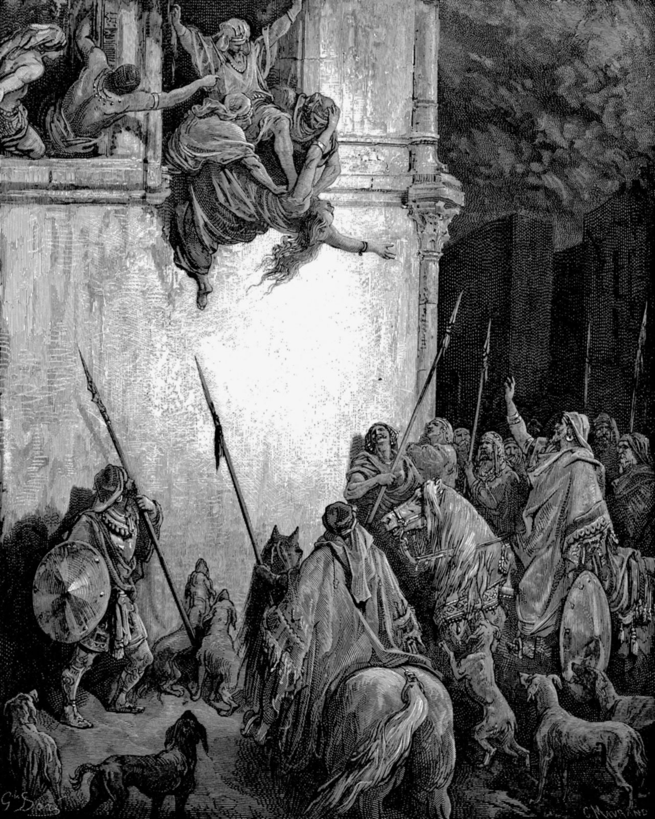
How to overcome the Spirt of Jezebel
Inner Healing and Deliverance
With Bishop Ronald K. Powell

Slide 2
Isaiah 52:1:
Isaiah 52:1: “Awake, awake! Put on your strength, O Zion; Put on your beautiful garments, O Jerusalem, the holy city! For the uncircumcised and the unclean shall come no longer to you. Shake yourself from the dust, rise up; Sit down, O Jerusalem! Loose yourself from the bonds of your neck, O captive daughter of Zion!”

Slide 3
God is speaking through the prophet Isaiah, telling the church of the day:
Wake up! Wake up to what's happening. Wake up spiritually, wake up on the inside, wake up - begin to arise and return to your first love, back to become the people of God!
Shake off the things that have held you down. Arise and begin to take your rightful role and positioning.

Slide 4
God is speaking strongly to a church, which was in a place of defeat, to awaken the church.
In my ministry of 50 years, this one spirit (Jezebel) has been my main adversary.
This spirit comes to attack Families, Marriages, our Lives and All things of God. To confuse Positions!
God continuously led me to the Prophet Elijah in scripture when beginning this ministry.

Slide 5
The Bible is very clear: there is an invisible spirit world, in which spiritual powers operate (Eph 6:12).
Ephesians 6:12, KJV: "For we wrestle not against flesh and blood, but against principalities, against powers, against the rulers of the darkness of this world, against spiritual wickedness in high places."

Slide 6
The nation of Israel got into an alliance with another nation, the Sidonians, by marriage.
Jezebel was the daughter of the priest-king Ethbaal, ruler of the coastal Phoenician cities (now in Lebanon) of Tyre and Sidon (Arabic: Ṣaydā).
When Jezebel married Ahab (ruled c. 874–c. 853 BCE), she persuaded him to introduce the worship of the Tyrian god Baal-Melkart, a nature god.
A woman of fierce energy, she tried to destroy those who opposed her; most of the prophets of Yahweh were killed at her command.

Slide 7
These cruel and despotic actions provoked the righteous wrath of Elijah;
according to 1 Kings 17, he accurately prophesied the onset of a severe drought as divine retribution.

Slide 8
Sometime later Elijah had the Baal priests slain, after they lost a contest with him to see which god would heed prayers to ignite a bull offering, Baal or Yahweh.
When Jezebel heard of the slaughter, she angrily swore to have Elijah killed, forcing him to flee for his life (1 Kings 18:19–19:3).

Slide 9
The last vicious act attributed to Jezebel is recorded in 1 Kings 21:5–16.
Adjacent to Ahab’s palace was a vineyard, which he coveted; it belonged to a commoner, Naboth of Jezreel (an ancient city at the foot of Mount Gilboa, probably the site of the modern Israeli settlement of the same name).

Slide 10
The last vicious act attributed to Jezebel is recorded in 1 Kings 21:5–16.
When Naboth refused to part with his vineyard (“the inheritance of my fathers”), Jezebel falsely charged him with blaspheming “God and the king,” which led to Naboth’s death by stoning.
Elijah confronted Ahab in the vineyard, predicting that he and all his heirs would be destroyed and that dogs in Jezreel would devour Jezebel.

Slide 11
Malachi 4:5-6 King James Version
5 Behold, I will send you Elijah the prophet before the coming of the great and dreadful day of the LORD: 6 And he shall turn the heart of the fathers to the children, and the heart of the children to their fathers, lest I come and smite the earth with a curse.

Slide 12
Malachi 4 speaks of the end times and the spirit of this age.
It speaks of an anointing that will come to restore Families torn apart by the spirit of Jezebel.
Jezebel made eunuchs of men and was vicious and cruel to mankind.
She pulled young girls into a place in society to rule over men.
She taught them to use sex to control men and subdue them.

Slide 13
Jezebel Taking Headship over God’s Word
1 Corinthians 11:2-4
2 Now I praise you, brethren, that ye remember me in all things and keep the ordinances as I have delivered them to you. 3 But I would have you know that the head of every man is Christ, and the head of the woman is the man, and the head of Christ is God. 4 Every man who prayeth or prophesieth, having his head covered, dishonoreth his head.

Slide 14
The Jezebel Spirit Causes:
1: Break downs and relationship between Fathers who are a source of Identity and their sons and daughters.
2: As a consequence of that there will be broken lives, broken people shattered families.
3: In this generation the demonic spirit of Jezebel will have tremendous influence on government's and power over their decisions.

Slide 15
God is wanting to anoint you and empower you today with the assignment Elijah had!
What was Elijah’s assignment?
God called Elijah to influence God’s people with truth and revelation!
To deliver them from deception and corruption of Jezebel!
His call was to confront a power that was influencing a nation, a hidden demonic power.
His call was to return the supernatural power of God to a nation and restore true worship.

Slide 16
What is God’s assignment upon you?
Turn the Hearts.
God calls you to influence your families, your work places your churches to return to the Word of truth and reject Jezebel’s influence over the nations.
To uncover the spiritual influences and to break out from the limitations it brings on your ministry and families, your assignment in the earth.

Slide 17
How many people who come to Church to worship, but there are many things concealed, many things in the heart are covered and so the relationship with Christ is not an intimate one.
Afraid of exposure! It’s very superficial. Not repentant!

Slide 18
The center of a man's life is his heart
Proverbs 23:7 King James Version
7 For as he thinketh in his heart, so is he: Eat and drink, saith he to thee; but his heart is not with thee.
Proverbs 4:23 New International Version
23 Above all else, guard your heart, for everything you do flows from it.

Slide 19
Luke 6:44-46 King James Version
44 For every tree is known by his own fruit. For of thorns men do not gather figs, nor of a bramble bush gather they grapes.
45 A good man out of the good treasure of his heart bringeth forth that which is good; and an evil man out of the evil treasure of his heart bringeth forth that which is evil: for of the abundance of the heart his mouth speaketh.
46 And why call ye me, Lord, Lord, and do not the things which I say?

Slide 20
God Heals Our Hearts from Past Wounds
Psalm 147: 2-3
2 The LORD doth build up Jerusalem: he gathereth together the outcasts of Israel. 3 He healeth the broken in heart, and bindeth up their wounds.

Slide 21
God is interested in your heart and your life and wants to heal the broken hearted
He wants to bind up the wounds.
He wants to heal your heart because He knows it will bring limitations on what you can do and what you can become.

Slide 22
No one gets through life without painful experiences.
It is what you do with those traumas that determines whether the Spirit has power in your life or not.

Slide 23
The Broken hearted in the Scriptures literally means to trample down so that it creates a Rut. (A Hard Place)
God wants to heal the Broken hearted, to go to the deepest wounds and release the grief the pain and the bitterness and anger from your past.
He wants to heal you of the stuff you let get into your heart and mind.

Slide 24
God wants to bind up your wounds which means deep grief and sorrow, but the primary word is this, it means an Idol.
God wants to heal the pains and sorrows in your life that you have allowed to become an Idol that you serve.

Slide 25
You have a choice to let God into your heart to heal it, because the Bible says where the Spirit of the Lord is there is liberty, freedom from oppression.

Slide 26
Closing
The Question Is: will I let Jesus come into the places of pain, brokenness and heal you or will you continue to worship the pain of my past experiences.
Will you repent of inner vows today like:
I will never allow a man or woman to hurt me again, I will never be vulnerable again, I will never trust a man or I will never trust a woman, I will never trust anyone in authority, I will never open up my life again!

Slide 27
Closing
Will you repent of Internal vows you have made to yourselves?
If not, you have given the spirit of Jezebel power to fragment and control your life.
We either yield to God’s way and the freedom He brings or we try to save ourselves and in doing so we create an Idol of your pain and give access to your heart to demonic spirits to assist in controlling your life.

Slide 28
Closing
Today you have a choice!
You can continue as you are or be liberated from your past.
What will you choose? Today you have a choice to be free and also to liberate your families from the Spirit of Jezebel.

Slide 29
Let’s pray

