Slide 1
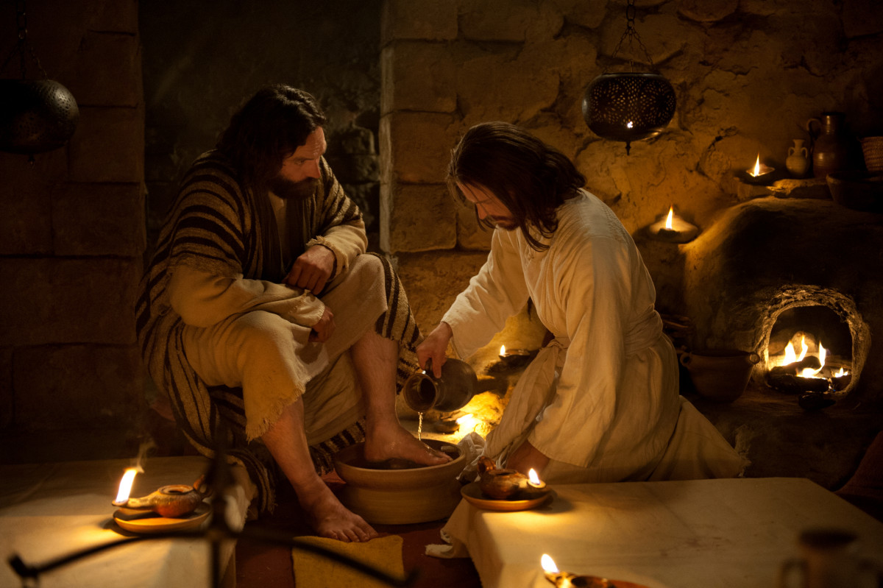
The High Calling / Servant hood
With Bishop Ronald K. Powell

Slide 2

Philippians 2:5-11 KJV
Let this mind be in you, which was also in Christ Jesus: Who, being in the form of God, thought it not robbery to be equal with God: But made himself of no reputation, and took upon him the form of a servant, and was made in the likeness of men: And being found in fashion as a man, he humbled himself, and became obedient unto death, even the death of the cross. Wherefore God also hath highly exalted him, and given him a name which is above every name: That at the name of Jesus every knee should bow, of things in heaven, and things in earth, and things under the earth; And that every tongue should confess that Jesus Christ is Lord, to the glory of God the Father.

Slide 3
Matthew 20:26-27 KJV
26 But it shall not be so among you: but whosoever will be great among you, let him be your minister; 27 And whosoever will be chief among you, let him be your servant:

Slide 4
I. Introduction:
As believers, we should follow the example of Jesus, who was equal with God but humbled Himself and became a man (Phil. 2:5-11).
Christ told His disciples, "Whoever wishes to become great among you shall be your servant, and whoever wishes to be first among you shall be your slave"(Matt. 20:26-27).
Each of us must stop focusing on ourselves and generously meet the needs of others. If we do this without expecting recognition from people, Scripture promises that the Father will honor us.

Slide 5
Revelation 3:22 KJV
He that hath an ear, let him hear what the Spirit saith unto the churches.

Slide 6
II. Servant hood is . . .
A. God's work for every believer. All our actions should reflect the fact that Jesus is not only our Savior but also the master of our lives.
Salvation means more than forgiveness and the assurance of heaven; it signifies that we are now servants of the living God.
By actively serving Him here on earth, we are preparing for eternity with the Lord (Rev. 22:3).

Slide 7
John 14:11-14 KJV
11 Believe me that I am in the Father, and the Father in me: or else believe me for the very works' sake.
12 Verily, verily, I say unto you, He that believeth on me, the works that I do shall he do also; and greater works than these shall he do; because I go unto my Father.
13 And whatsoever ye shall ask in my name, that will I do, that the Father may be glorified in the Son.
14 If ye shall ask any thing in my name, I will do it.

Slide 8
B. How God carries out His work.
In John 14:11-14, Jesus told His disciples that they would do even greater works than He did.
While our actions can not compare to the work Christ accomplished on the cross, none of us know our maximum potential.
As we surrender our lives to the service of the most high God, He will honor us with true greatness.

Slide 9
Hebrews 6:10 KJV
10 For God is not unrighteous to forget your work and labour of love, which ye have shewed toward his name, in that ye have ministered to the saints, and do minister.

Slide 10
C. Essential to spiritual growth.
Unless you are serving God in some fashion, you aren't maturing spiritually.
Ephesians 2:10 says, "We are His workmanship, created in Christ Jesus for good works, which God prepared beforehand so that we would walk in them."
We should humbly seek to serve people with the attitude Christ had. Even when our giving is overlooked or taken for granted by everyone, our heavenly Father notices (Heb. 6:10).

Slide 11
1 Peter 4:10 KJV
10 As every man hath received the gift, even so minister the same one to another, as good stewards of the manifold grace of God.

Slide 12
D. The purpose for spiritual gifts
Every believer has one or more spiritual gifts, which we are to use in serving the body of Christ (1 Peter 4:10).
That same attitude of humble service should extend outside the church as well.

Slide 13
Acts 15:36-38 KJV
36 And some days after Paul said unto Barnabas, Let us go again and visit our brethren in every city where we have preached the word of the Lord, and see how they do.
37 And Barnabas determined to take with them John, whose surname was Mark.
38 But Paul thought not good to take him with them, who departed from them from Pamphylia, and went not with them to the work.

Slide 14
E. No assurance against conflict.
Servant hood does not guarantee harmonious relationships.
Paul and Barnabas disagreed about whether or not to take John Mark with them on the second missionary journey (Acts 15:36-38).

Slide 15
1. Those who serve the Lord aren't always popular.
Some people may not like you, or they may falsely accuse you.
When that happens, concentrate on maintaining a servant spirit, and allow the Lord to handle the unfair criticism.
And don't leave a job or ministry position unless He tells you it's time to move on.

Slide 16
2. How can you get through a difficult conflict?
A. Remember that serving God means allowing Him to work in and through you-not striving to serve Him in your own strength.

Slide 17
Colossians 3:23 KJV
23 And whatsoever ye do, do it heartily, as to the Lord, and not unto men;

Slide 18
B. Keep in mind that you are working for the Lord Jesus Christ (Col. 3:23).
C. Let go of selfishness. If you angrily decide to walk away from a position, you are serving yourself.
Serving God means obeying His commands and trusting Him to take care of you despite hardship.

Slide 19
III. Conclusion: Greatness is not found in a title, a salary, or a position of influence.
True greatness is found in servant hood.
Willingly meet the needs of others without looking for recognition from people.

Slide 20
John 12:26 KJV
26 If any man serve me, let him follow me; and where I am, there shall also my servant be: if any man serve me, him will my Father honour.
God's Word promises that He will honor your humility (John 12:26).

Slide 21
When believers finally realize that our calling is to serve-not merely to seek our own interests-then we will have an irresistible impact on this world.

Slide 22
John 13:15 KJV
15 For I have given you an example, that ye should do as I have done to you.
Let’s Pray

