Slide 1
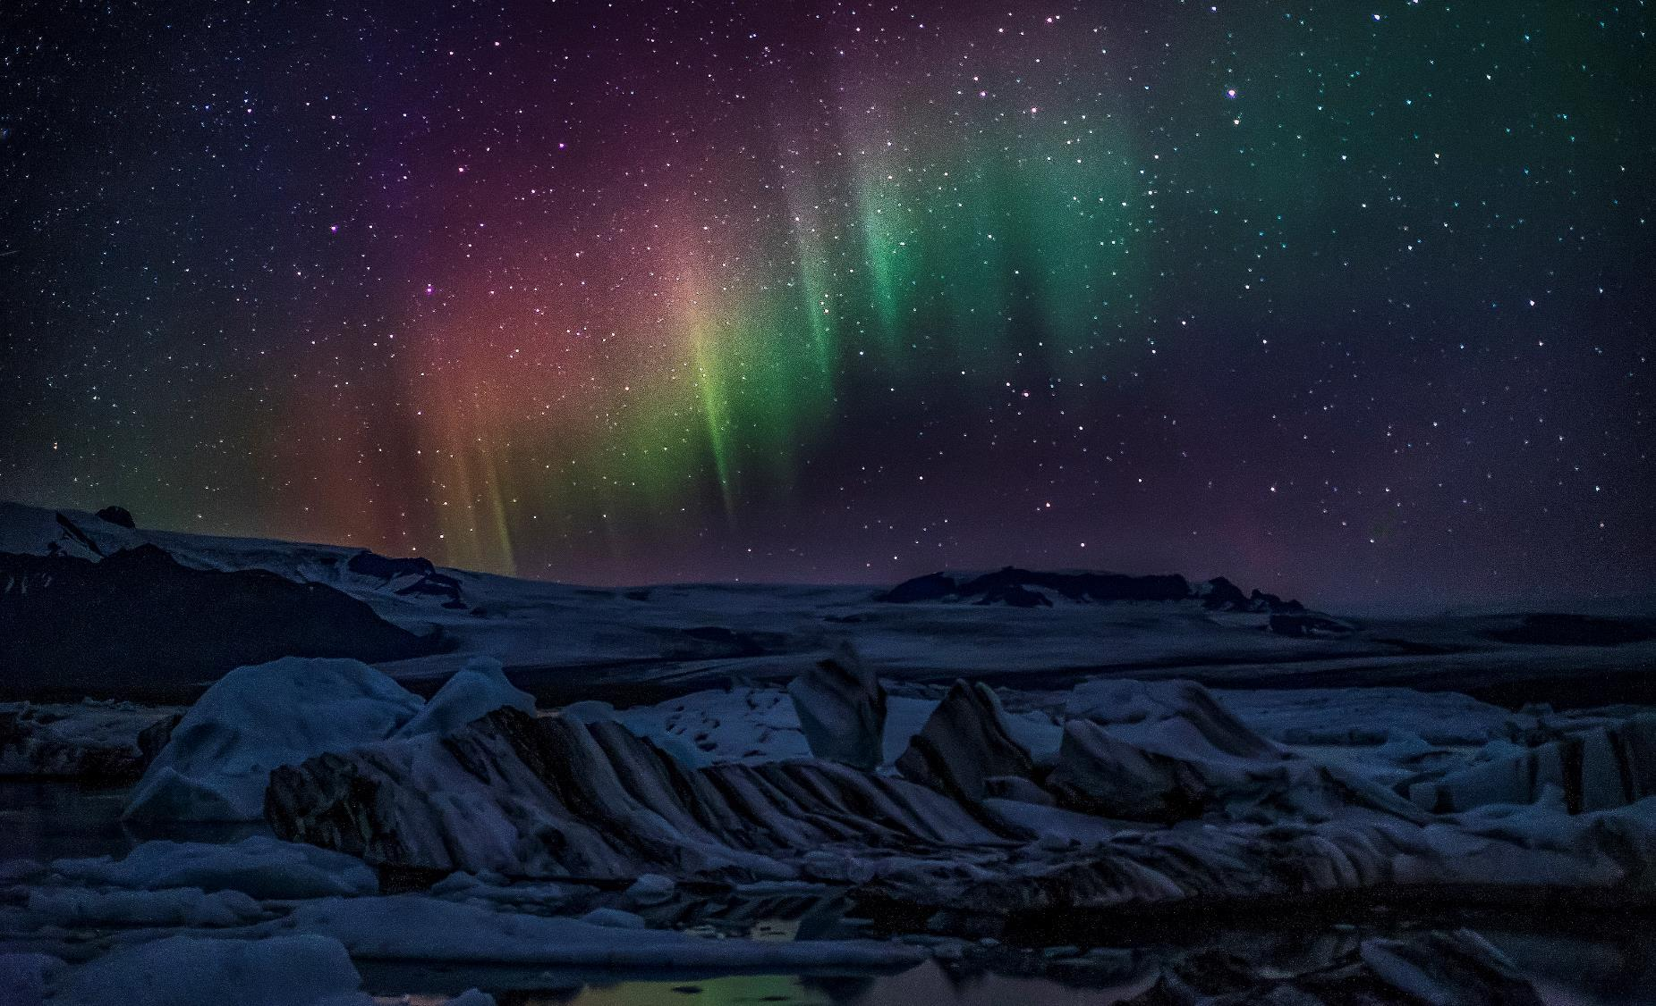
A People of the Impossible
With Bishop Ronald K. Powell

Slide 2
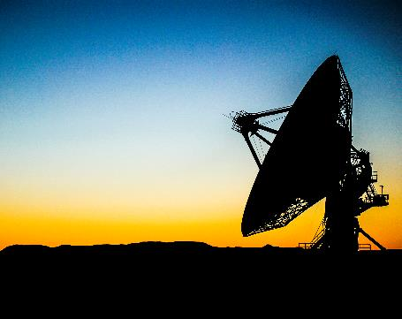
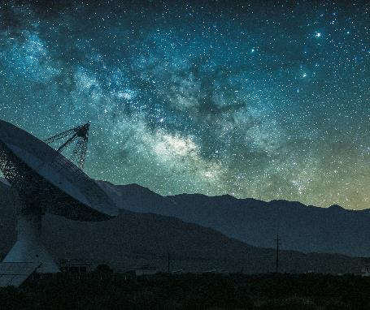
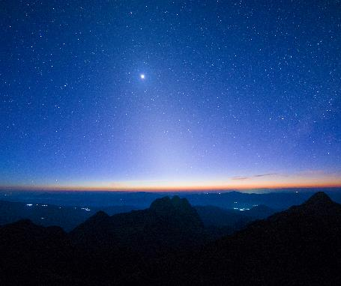
Introduction
For with God nothing shall be impossible. Luke 1:37
Jesus said unto him, if thou canst believe, all things are possible to him that believeth. Mark 9:23

Slide 3
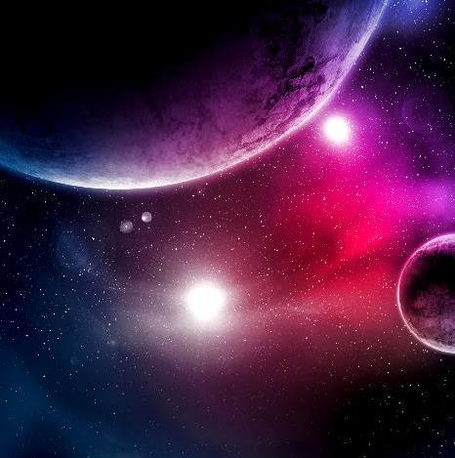
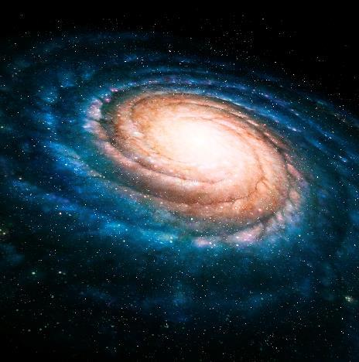
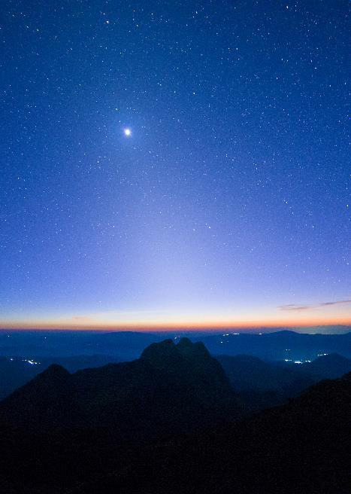
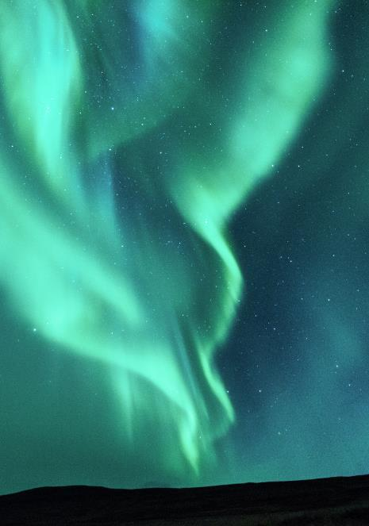
I- A People of the Impossible must think Like God.
1- You must have the mind of Christ – 1 Cor. 2:15-16
2- A Transformed mind – Romans 12:2
3- A Renewed Mind – Ephesians 4:23-24
4- A transferred Mind – Phil 2:5-6 Let/allow this mind to be in you

Slide 4
II- A People of the Impossible must have the kind of relationship that Jesus had with the
Father.
For whosoever shall do the will of my father which is heaven the same is my brother and sister and mother. Matt 15:5
Not everyone who says to me, ‘Lord, Lord,’ will enter the kingdom of heaven, but he who does the will of My Father who is in heaven will
enter. Matthew 7:21

Slide 5
What is the will of God?
This is the purpose, desire, wish, volition, inclination, and determination.
In other words it is what the mind of God is disposed to.
Jesus did nothing of Himself – John 5:19 -20
In Him we live and move and have our Being – Acts 17:28

Slide 6
III-A People of the Impossible must Know Who you are!
I am complete in Him who is the Head of all principality and power (Colossians 2:10).
I am alive with Christ (Ephesians 2:5).
I am free from the law of sin and death (Romans 8:2).
I am far from oppression, and fear does not come near me (Isaiah 54:14).

Slide 7
III- A People of the Impossible must Know Who you are!
I am born of God, and the evil one does not touch me (1 John 5:18).
I am holy and without blame before Him in love.(Ephesians 1:4; 1 Peter 1:16).\
I have the mind of Christ (1 Corinthians 2:16; Philippians 2:5).
I have the peace of God that passes all understanding (Philippians 4:7).

Slide 8
III- A People of the Impossible must Know Who you are!
I have the Greater One living in me; greater is He Who is in me than he who is in the world (1 John
4:4).
I have received the gift of righteousness and reign as a king in life by Jesus Christ (Romans 5:17).
I have received the spirit of wisdom and revelation in the knowledge of Jesus, the eyes of my understanding being enlightened (Ephesians 1:17- 18).

Slide 9
III-A People of the Impossible must Know Who you are!
I have received the power of the Holy Spirit to lay hands on the sick and see them recover, to cast out demons, to speak with new tongues. I have power over all the power of the enemy, and nothing shall by any means harm me (Mark 16:17-18; Luke 10:17-19).
I have put off the old man and have put on the new man, which is renewed in the knowledge after the image of Him Who created me (Colossians 3:9-10).

Slide 10
III-A People of the Impossible must Know Who you are!
I have given, and it is given to me; good measure, pressed down, shaken together, and running over, men give into my bosom (Luke 6:38).
I have no lack for my God supplies all of my need according to His riches in glory by Christ Jesus (Philippians 4:19).

Slide 11
III-A People of the Impossible must Know Who you are!
I can quench all the fiery darts of the wicked one with my shield of faith (Ephesians 6:16).
I can do all things through Christ Jesus (Philippians 4:13).
I show forth the praises of God who has called me out of darkness into His marvelous light (1 Peter 2:9).

Slide 12
III-A People of the Impossible must Know Who you are!
I am God’s child for I am born again of the incorruptible seed of the Word of God, which lives and abides forever (1 Peter 1:23).
I am God’s workmanship, created in Christ unto good works (Ephesians 2:10).
I am a new creature in Christ (2 Corinthians 5:17).

Slide 13
III-A People of the Impossible must Know Who you are!
I am a spirit being alive to God (Romans 6:11; 1 Thessalonians 5:23).
I am a believer, and the light of the Gospel shines in my mind (2 Corinthians 4:4).
I am a doer of the Word and blessed in my actions (James 1:22, 25).

Slide 14
III-A People of the Impossible must Know Who you are!
I am a joint-heir with Christ (Romans 8:17).
I am more than a conqueror through Him Who loves me (Romans 8:37).
I am an overcomer by the blood of the Lamb and the word of my testimony (Revelation 12:11).

Slide 15
III-A People of the Impossible must Know Who you are!
I am a partaker of His divine nature (2 Peter 1:3-4).
I am an ambassador for Christ (2 Corinthians 5:20).
I am part of a chosen generation, a royal priesthood, a holy nation, a purchased people (1 Peter 2:9).

Slide 16
III-A People of the Impossible must Know Who you are!
I am the righteousness of God in Jesus Christ (2 Corinthians 5:21).
I am the temple of the Holy Spirit; I am not my own (1 Corinthians 6:19).
I am the head and not the tail; I am above only and not beneath (Deuteronomy 28:13).

Slide 17
III-A People of the Impossible must Know Who you are!
I am the light of the world (Matthew 5:14).
I am His elect, full of mercy, kindness, humility, and long suffering (Romans 8:33; Colossians 3:12).
I am forgiven of all my sins and washed in the Blood (Ephesians 1:7).

Slide 18
III-A People of the Impossible must Know Who you are!
I am delivered from the power of darkness and translated into God’s kingdom (Colossians 1:13).
I am redeemed from the curse of sin, sickness, and poverty (Deuteronomy 28:15-68; Galatians 3:13).
I am firmly rooted, built up, established in my faith and overflowing with gratitude (Colossians 2:7).

Slide 19
III-A People of the Impossible must Know Who you are!
I am called of God to be the voice of His praise (Psalm 66:8; 2 Timothy 1:9).
I am healed by the stripes of Jesus (Isaiah 53:5; 1 Peter 2:24).
I am raised up with Christ and seated in heavenly places (Ephesians 2:6; Colossians 2:12).

Slide 20
III-A People of the Impossible must Know Who you are!
I am greatly loved by God (Romans 1:7; Ephesians 2:4; Colossians 3:12; 1 Thessalonians 1:4).
I am strengthened with all might according to His glorious power (Colossians 1:11).
I am submitted to God, and the devil flees from me because I resist him in the Name of Jesus (James 4:7).

Slide 21
III-A People of the Impossible must Know Who you are!
I press on toward the goal to win the prize to which God in Christ Jesus is calling us upward (Philippians 3:14).
For God has not given us a spirit of fear; but of power, love, and a sound mind (2 Timothy 1:7).
It is not I who live, but Christ lives in me (Galatians 2:20).

Slide 22
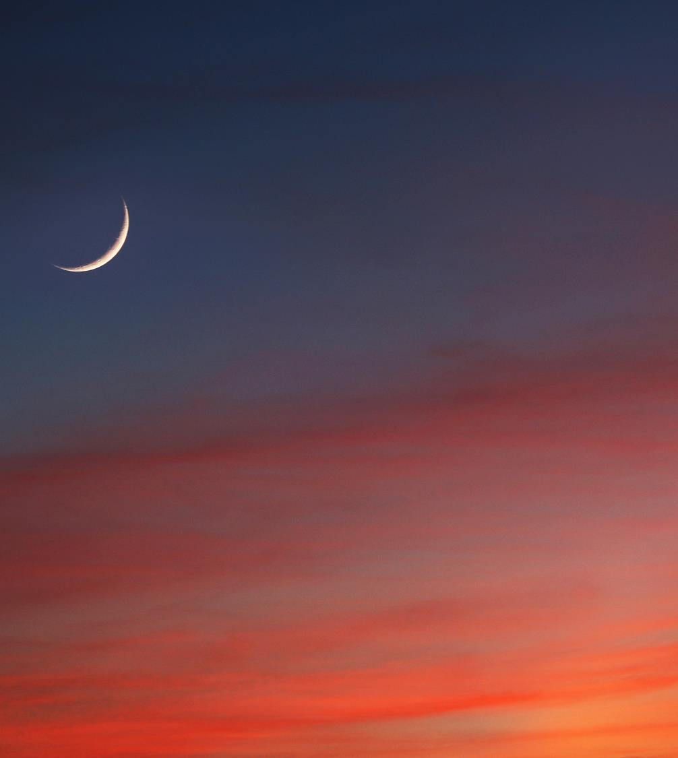
Closing:
  “How can two walk together unless they agree? “Amos 3:3
  Try reading the above list every day for a month, preferably out loud.
  The more you know who you are in Christ, the more your behavior will reflect your true identity.

Slide 23
Closing:
  The best way to renew your mind and experience inner transformation is by knowing,
  thinking and speaking out loud who you are in Christ.
  Train yourself to say the same things that God says in His word.
  Become who you ALREADY ARE in Christ.
  God wants to do more in your life than you imagine. He wants you to become a people of the Impossible.

Slide 24
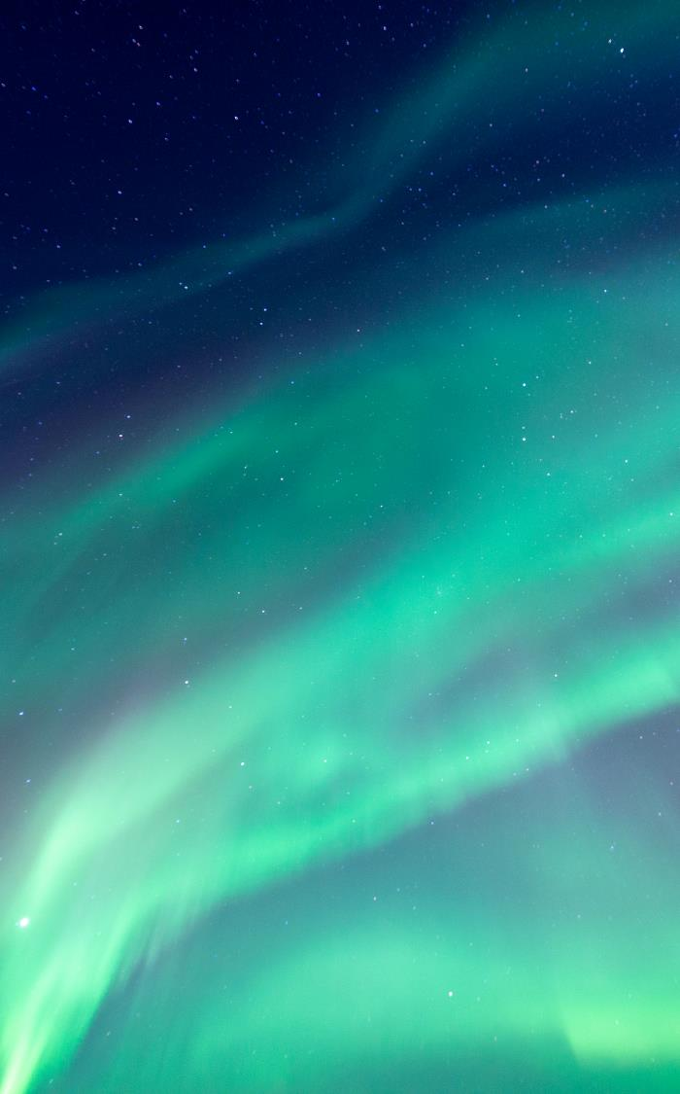
The way to get started is to quit talking and begin doing.
Walt Disney

Slide 25
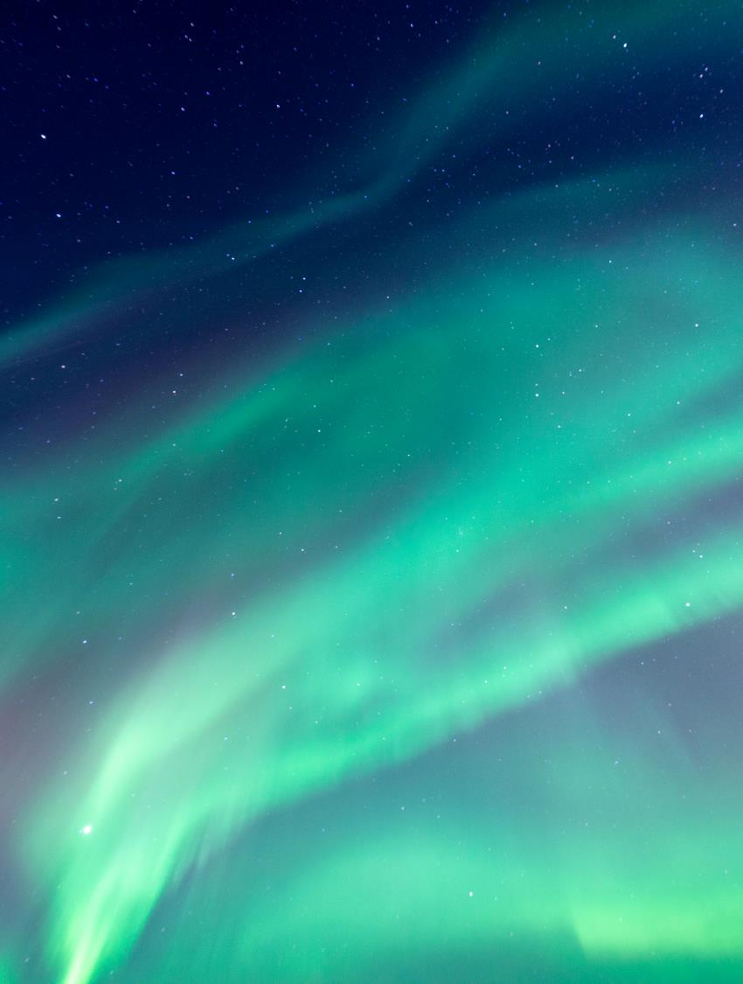
Thank You
God Bless you!
Email Address: drronaldpowell@cox.net
Website Address: Crosswinds International.org

