Slide 1
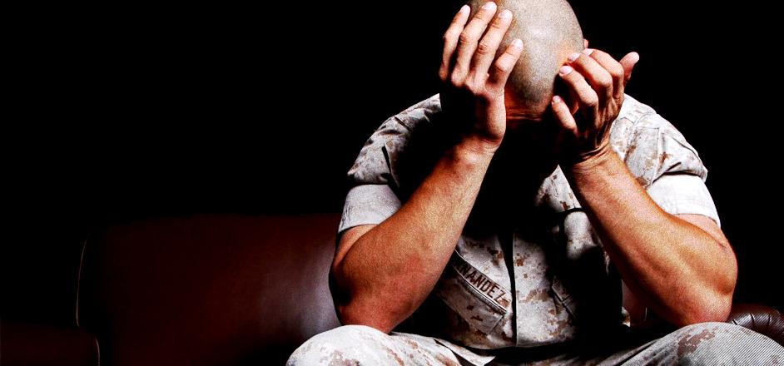
Living a life of Miracles and Breakthroughs
With Bishop Ronald K. Powell

Slide 2
Jesus said many outstanding things about prayer:
“everyone who asks receives,”
“nothing will be impossible to you,”
“you will receive whatever you ask,”
“believe that you receive what you ask in prayer, and it will be yours,” and …
“ask anything in Jesus’ name, and He will do it”
(Matthew 7:8, Matthew 17:20, Matthew 21:21, Mark 11:24, and John 14:14 respectively).
In other words, Jesus declares that miracles should be a normal experience for a praying Christian!.

Slide 3
1. We develop faith through taking risks.
We need to step out of the boat and see if we sink.
We need to place our feet in the roaring river to see if God stops its flow.
Faith is demonstrated by doing things that show belief in God over things that you see.
You will never see miracles through your prayer if you are too afraid to take risks in what you pray.

Slide 4
2. We Need Faith to Have Supernatural Breakthroughs in Prayer
If you have faith as small as a mustard seed… (Matthew 17:20).
We develop faith through are personal time with God.
Learn more about Him through reading the Bible.
Be encouraged by stories like Joshua asking for the sun to stand still. God is the same yesterday, today, He can do it again. Learn more about God through your personal prayers.
Ask God things in prayer and wait for how He answers you. This communication with God will grow your faith.

Slide 5
3. Holiness Will Lead You to Take Risks in Prayer
Without holiness no one will see the Lord (Hebrews 12:14).
Holiness does not mean you never sin. Holiness is primarily being set apart.
This will include making choices that are different than the world.
It includes a healthy fear of God that will keep you from sin. However, holiness primarily is a commitment of the heart to follow God above all else.
This will include choosing to obey God’s leading to pray for someone even if you are afraid, they will mock you or afraid that God will not come through. What do we love more, God or our comfort?

Slide 6
4. Thankfulness Will Move God’s Spirit Toward Breakthrough…
Give thanks in all circumstances (1 Thessalonians 5:17-19).
Thanksgiving is the oil that enables God’s Spirit to greater functionality through your life.
Thanksgiving reveals what you are focusing on.
Doubt and fear focus on the circumstances of life.
Thanksgiving realizes that every good thing comes for our Father.
Thanksgiving also is an act of faith in the prayer promises of Jesus – the One who promised is faithful to complete it.

Slide 7
5. Community Will Increase Your Faith in the Supernatural
That you and I may be mutually encouraged by each other’s faith (Romans 1:12).
Your faith is strengthened by others with faith. This is why God sent Mary to stay with Elizabeth during the early stages of her pregnancy with Jesus.
God was doing a new thing, and He was protecting Mary by having her be with someone who was also experiencing God’s miracles.
By allowing the testimonies of others in our services who are experiencing the hand of God, you can be encouraged to trust God for similar acts. The promises of God are not for a select few; they are for all who trust God enough to pursue them.

Slide 8
6. Be Led by The Spirit
Paul urged, “Walk in the Spirit, and you shall not fulfill the lust of the flesh”.

Slide 9
6. Be Led by The Spirit
Like marriage, when you live daily in harmony with each other, the fullness of each life is shared and experienced by the other. This is true in the entire family as well.
When you walk in harmony, love, and complete sacrifice of yourself to your family, each person experiences all you are and have to offer day after day.

Slide 10
6. Be Led by The Spirit
Each life is enriched.
The expressions, in Christ and in the Spirit mean in complete union with. Jesus spoke of being in the Father and the Father in Him. Jesus expressed this in a wonderful way, indicating His walk with the Father was the pattern for our walk with Him.
So, it is with the Holy Spirit. We are to walk in the Spirit. If we do, the fullness of the Spirit will be real and active in us. Jesus expressed the magnitude of this relationship.

Slide 11
6. Be Led by The Spirit
When the Spirit of truth comes, He will guide you into all the truth. For He will not speak on His own, but He will speak whatever He hears. He will also declare to you what is to come. He will glorify Me, because He will take from what is Mine and declare it to you. Everything the Father has is Mine. This is why I told you that He takes from what is Mine and will declare it to you.
As the Holy Spirit works in your life, He will do two things which enable you to receive all the Father wants to give to you.

Slide 12
The Spirit will make you AWARE of the enormous riches God has at your disposal.
The Spirit Himself testifies together with our spirit that we are God’s children, and if children, also heirs —heirs of God and coheirs with Christ—seeing that we suffer with Him so that we may also be glorified with Him.

Slide 13
The Spirit will make you AWARE of the enormous riches God has at your disposal.
1. God loves you and desires to share with you the resources of heaven. The Spirit’s role is to make you fully aware of the enormous resources available to you from the Father. It is possible to live a Christian life in defeat, joylessness, and fear because you are not aware of all that is at your disposal as a fellow heir with Christ
2. The Spirit qualifies you to receive what the Father wants to give you.

Slide 14
The Spirit will make you AWARE of the enormous riches God has at your disposal.
For the Lord God is a sun and shield. The Lord gives grace and glory; He does not withhold the good from those who live with integrity.
The Promise is that “No good thing will He withhold from those who walk uprightly.”
This being so, the Spirit is determined to help you “walk uprightly” so that you can receive God’s best for your life.
The Spirit will guide and convict you, preparing you to receive all that your Father has to give.
How important is it to walk in the Spirit? If you are walking in the Spirit, then all that belongs to Jesus will also be available to you. How do you do this?

Slide 15
Believe – Come to Christ – Hear – Obey – Experience…
Closing
Let us be the people of God that rebukes the protagonists of the world with the miraculous.
Sure, Jesus told Thomas it is better for those who believe and don’t see, but He still showed Thomas His hands and feet.
God wants to be experienced and will remove every barrier if we would just let Him.

Slide 16
Closing
When people patiently and expectantly wait on God in the midst of difficult circumstances, suddenly God breaks through.
So don’t give up! Don’t stop believing!
Stay full of hope and expectation. God’s power is limitless, and He’ll break through for you.

Slide 17
Let us Pray

