Slide 1
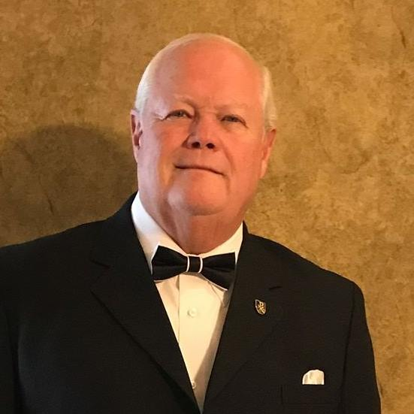
“Purpose”
Is there any purpose in my life?
People everywhere long to know the purpose for their lives. Yet for many, that sense of purpose seems difficult to realize.

Slide 2
(2 Corinthians 3:18)
“We, who with unveiled faces all reflect the Lord’s glory, are being transformed into his likeness with ever-increasing glory, which comes from the Lord, who is the Spirit.”

Slide 3
What Is My Purpose in Life?
Your purpose in life is that which gives you a reason for living, the reason why God put you here on earth.

Slide 4
What Is My Purpose in Life?
Your purpose in life is an expression of your personal significance to God.

Slide 5
What Is My Purpose in Life?
Your purpose in life will be unique to you, based on God’s personalized plan for you.

Slide 6
Q “I don’t feel like my life has any purpose. Is there any hope for me?”
Yes. You have hope—you were created by the God of hope. In the Bible, God says that He created you with a specific plan for your life.

Slide 7
(Jeremiah 29:11)
“For I know the plans I have for you,’ declares the LORD, ‘plans to prosper you and not to harm you, plans to give you hope and a future.”

Slide 8
What Is My Significance?
Your significance means your importance.
Your significance refers to your personal value, your individual worth.

Slide 9
A sense of significance is one of your three God-given inner needs. Those three inner needs are:
LOVE — receiving an unchanging, unconditional commitment from another for what is best for you.
“My command is this: Love each other as I have loved you.” (John 15:12)

Slide 10
A sense of significance is one of your three God-given inner needs. Those three inner needs are:
SIGNIFICANCE— knowing the meaning and purpose for your life.
“I cry out to God Most High, to God, who fulfills his purpose for me.” (Psalm 57:2)

Slide 11
A sense of significance is one of your three God-given inner needs. Those three inner needs are:
SECURITY—
being grounded with an unshakable sense of belonging and acceptance
“He who fears the LORD has a secure fortress.” (Proverbs 14:26)

Slide 12
Even if you haven’t said these exact words, the following statements express a desire of your heart:
“I want my life to count.”
“I want my life to make a difference.”
“I want my life to be significant.”
“I want my life to have meaning.”

Slide 13
Even if you haven’t said these exact words, the following statements express a desire of your heart:
“I want my life to have purpose.”
“I want to have an impact.” “I want to do something important.”

Slide 14
Q “I’ve always felt insignificant. When comparing myself to others who are more gifted and accomplished than I am, how can I not feel insignificant?”
You already have God-given significance … not because of anything you have done, but because of what Christ has done for you.
You were significant enough for God to create you in His image.

Slide 15
Q “I’ve always felt insignificant. When comparing myself to others who are more gifted and accomplished than I am, how can I not feel insignificant?”
“Then God said, ‘Let us make man in our image, in our likeness, and let them rule over the fish of the sea and the birds of the air, over the livestock, over all the earth, and over all the creatures that move along the ground.’” (Genesis 1:26)

Slide 16
You were significant enough for the Lord to design a preplanned future for you.
“‘For I know the plans I have for you,’ declares the LORD, ‘plans to prosper you and not to harm you, plans to give you hope and a future.’” (Jeremiah 29:11)

Slide 17
You were significant enough for Jesus to die on the cross for you.
“For God so loved the world that he gave his one and only Son, that whoever believes in him shall not perish but have eternal life.” (John 3:16)

Slide 18
Realize that Jesus would not die for anything or anyone insignificant. You, indeed, have God-given worth. .
“Are not five sparrows sold for two pennies? Yet not one of them is forgotten by God. Indeed, the very hairs of your head are all numbered. Don’t be afraid; you are worth more than many sparrows.” (Luke 12:6–7)

Slide 19
What Are Some Key Questions about Your Purpose?

Slide 20
What Are Some Key Questions about Your Purpose?
Q “Do I have only one purpose in life?”
No. You will have several purposes, depending on the major roles in your life.

Slide 21
For example, a teenager’s purpose may be:
To grow in Christlike character
“For those God foreknew he also predestined to be conformed to the likeness of his Son.” (Romans 8:29)

Slide 22
For example, a teenager’s purpose may be:
To bring honor to his parents
“Honor your father and your mother.” (Exodus 20:12)

Slide 23
For example, a teenager’s purpose may be:
  To be the best student he can possibly be in order to bring glory to God
“Whatever you do, work at it with all your heart, as working for the Lord, not for men.” (Colossians 3:23)
“Whatever you do, work at it with all your heart, as working for the Lord, not for men.” (Colossians 3:23)

Slide 24
Q “Can my purposes change?”
  Yes. Some purposes will change, depending on the major changes in your life. For example, a former student may marry and have children. Therefore, some of his former purposes as a student are no longer applicable. Now, his major life purposes may be:
“Whatever you do, work at it with all your heart, as working for the Lord, not for men.” (Colossians 3:23)

Slide 25
Q “Can my purposes change?”
  To grow in Christlike character
  “
  “For those God foreknew he also predestined to be conformed to the likeness of his Son.” (Romans 8:29)

Slide 26
Q “Can my purposes change?”
  To sacrificially love his wife as Christ loved the church.
  “Husbands, love your wives, just as Christ loved the church and gave himself up for her.” (Ephesians 5:25)

Slide 27
Q “Can my purposes change?”
  To teach his children by lifestyle
  “Love the LORD your God with all your heart and with all your soul and with all your strength. These commandments that I give you today are to be upon your hearts. Impress them on your children. Talk about them when you sit at home and when you walk along the road, when you lie down and when you get up.” (Deuteronomy 6:5–7)

Slide 28
Q “Are purposes and goals the same?”
  No. Purposes are different from goals; however, they are related.

Slide 29
Q “Are purposes and goals the same?”
Your purposes answer, “Why am I here on earth?”
Your goals answer, “What do I want to do here on earth?”
The relationship between the two is that the goals you set should work together to help you reach your purposes.

Slide 30
Q “Are purposes and goals the same?”
  For example, one of your purposes could be to “honor your father and your mother.” Yet, if your father is painfully critical, your short-term goal could be to pray for him every time you are around him and every time you think of him. You would be doing what Jesus said: “Pray for those who persecute you.” (Matthew 5:44)

Slide 31
Q “What is God’s purpose for my life?”
  God’s highest purpose for your life is to conform you to the character of Christ. The New Testament Greek word for “conform” is summorphos, which means “made like another.” The apostle Paul said, “For those God foreknew he also predestined to be conformed to the likeness of his Son.” (Romans 8:29)

Slide 32
Q “What should my highest purpose be?”
  Your highest purpose—and that of all creation—is to bring glory to God. The Bible highlights this by saying: “In him we were also chosen, having been predestined according to the plan of him who works out everything in conformity with the purpose of his will, in order that we, who were the first to hope in Christ, might be for the praise of his glory.” (Ephesians 1:11–12)

Slide 33
The New Testament Greek word for “glory,” doxa, signifies “an estimate” of worth.
  An “estimate” from a jeweler is a piece of paper that reflects the accurate value of a piece of jewelry. When you accurately reflect the character of Christ, you give God glory!
  “So whether you eat or drink or whatever you do, do it all for the glory of God.” (1 Corinthians 10:31)

Slide 34
Let’s Pray
Reach us at:
www.crosswindsinternational.org

