Slide 1
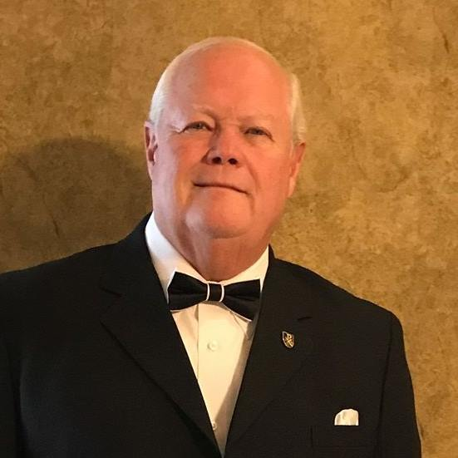
How to Develop a Life Plan
Do you have a Life plan?
Proverbs 29:18 King James Version
¹⁸ Where there is no vision, the people perish: but he that keepeth the law, happy is he.

Slide 2
“Now all has been heard; here is the conclusion of the matter: Fear God and keep his commandments, for this is the whole duty of man. For God will bring every deed into judgment, including every hidden thing, whether it is good or evil.” (Ecclesiastes 12:13–14)
Last Week

Slide 3
to be like God in true righteousness and holiness
“Put on the new self, created to be like God in true righteousness and holiness.” (Ephesians 4:24)
You were created …

Slide 4
to let God be the true King of your heart
“Seek first his kingdom and his righteousness.” (Matthew 6:33)
You were created …

Slide 5
to be the image bearer of God.
God created man in his own image, in the image of God he created him; male and female he created them.” (Genesis 1:27)
You were created …

Slide 6
to be conformed to the character of Christ
“Those God foreknew he also predestined to be conformed to the likeness of his Son.” (Romans 8:29)
You were created …

Slide 7
“Everyone who is called by my name … I created for my glory … I formed and made.” (Isaiah 43:7)
to bring glory to God

Slide 8
Q “Does God have a personal and unique purpose for my life?”
Discover the earthly purpose of your life.

Slide 9
Yes, and the purposes for your life were preplanned in the heart of God.
“For we are God’s workmanship, created in Christ Jesus to do good works, which God prepared in advance for us to do.” (Ephesians 2:10)
Discover the earthly purpose of your life.

Slide 10
“I will instruct you and teach you in the way you should go; I will counsel you and watch over you.” (Psalm 32:8)
Realize God’s promise to reveal His purpose for you.

Slide 11
“Do not be anxious about anything, but in everything, by prayer and petition, with thanksgiving, present your requests to God. And the peace of God, which transcends all understanding, will guard your hearts and your minds in Christ Jesus.” (Philippians 4:6–7)
Realize the power of prayer to reveal God’s purpose.

Slide 12
“We have different gifts, according to the grace given us. If a man’s gift is prophesying, let him use it in proportion to his faith. If it is serving, let him serve; if it is teaching, let him teach; if it is encouraging, let him encourage; if it is contributing to the needs of others, let him give generously; if it is leadership, let him govern diligently; if it is showing mercy, let him do it cheerfully.” (Romans 12:6–8)
Realize how God will use your spiritual gifts to accomplish your purpose.

Slide 13
“A wise man listens to advice.” (Proverbs 12:15)
What are your God-given responsibilities?
What activities have been most fulfilling, bringing joy to your heart?
What work has been most successful to you?
What is your primary God-given spiritual gift for serving others?
What desires do you often think about?
Realize the value of asking practical questions of godly counselors.

Slide 14
What desires do you often think about?
“Delight yourself in the LORD and he will give you the desires of your heart.” (Psalm 37:4)
Realize the value of asking practical questions of godly counselors.

Slide 15
How to Develop a Life Plan
Let us Pray

