Slide 1
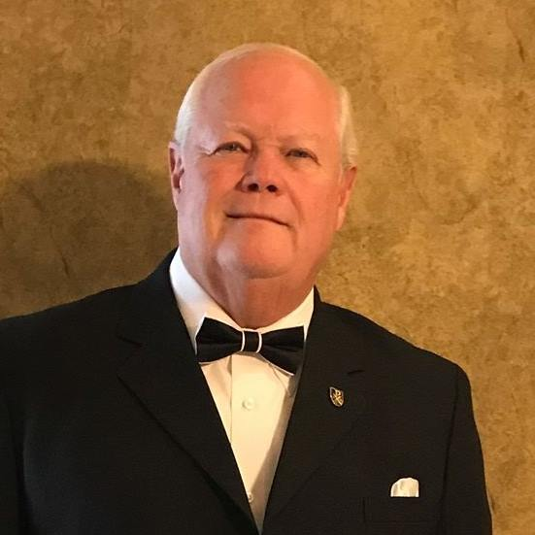
Proverbs 17:28
Even a fool, when he holdeth his peace, is counted wise: and he that shutteth his lips is esteemed a man of understanding.
Every Idle Word (part 2)
With Bishop Ronald K. Powell

Slide 2
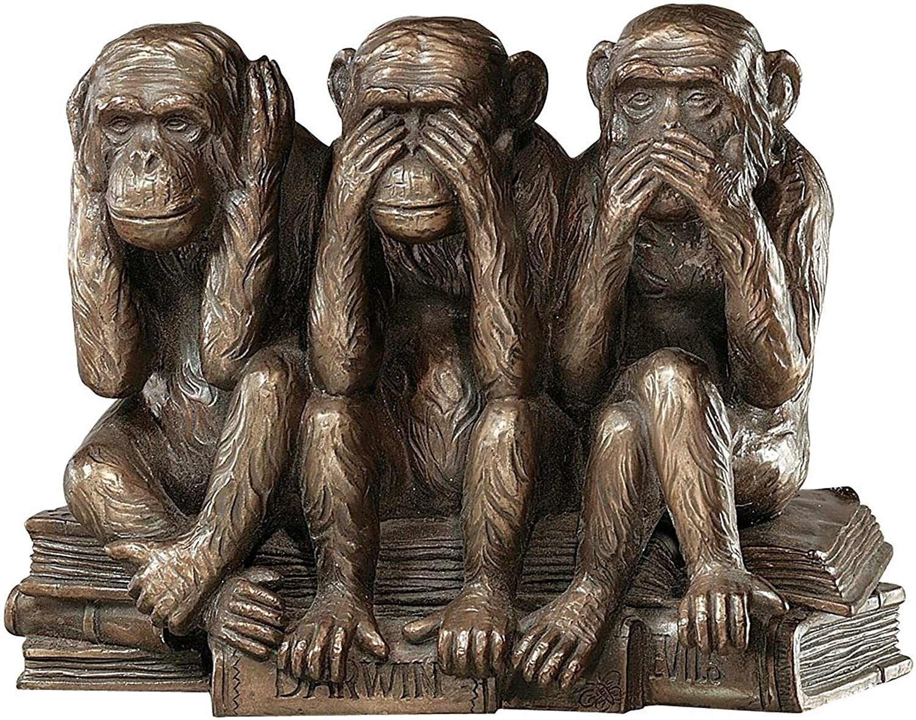
Anyone can do it, even a fool.
Cut your words in half – others will consider you a wise and knowledgeable person.
What a proverb!
Here is profound advice and a wise tip to quickly enhance what others think about you.
Improve your image and reputation today…

Slide 3
Hasty speech, unstudied speech, or much speech marks a fool.
Closing your mouth and reducing your words will cause others to assume you are a wise and understanding person, even if you are a fool.
God and King Solomon, both truly wise, guarantee it.
Improve your image and reputation today…

Slide 4
Proverbs 15:2 The tongue of the wise uses knowledge rightly, But the mouth of fools pours forth foolishness.
Proverbs 29:11 A fool vents all his feelings, But a wise man holds them back.
Speech reveals character…

Slide 5
Ecclesiastes 5:3 For a dream comes through much activity, And a fool’s voice is known by his many words.
Speech reveals character…

Slide 6
Ecclesiastes 10:12-14 12 The words of a wise man’s mouth are gracious, But the lips of a fool shall swallow him up; 13 The words of his mouth begin with foolishness,
And the end of his talk is raving madness. 14 A fool also multiplies words. No man knows what is to be; Who can tell him what will be after him?
Speech reveals character…

Slide 7
Careful, deliberate, profitable, and proper speech marks a wise man.
Hasty, impulsive, vain, and froward words mark a foolish and wicked man. A fool seldom says anything profitable or suitable (Eccl 10:3), but reducing his words will cause others to think he is careful and deliberate.
Speech reveals character…

Slide 8
You learn by listening, not by talking.
You should not talk until necessary or profitable.
Others will assume your silence indicates careful observation and deep consideration of the topic and a deep search for the right thoughts and words before speaking.
Has a wise reputation ever been so cheap? Never!
It is wise to see and hear well, but to say little…

Slide 9
Proverbs 10:19 In the multitude of words sin is not lacking, But he who restrains his lips is wise.
Proverbs 18:21 Death and life are in the power of the tongue, And those who love it will eat its fruit.
The tongue is dangerous and easily hurts others…

Slide 10
Turn to James 3:2-12

Slide 11
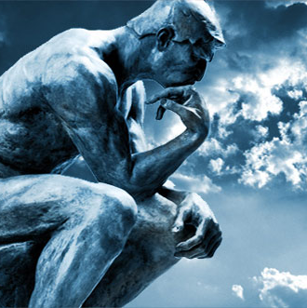
Proverbs 17:27 He that hath knowledge spareth his words: and a man of understanding is of an excellent spirit.
Job 13:5 O that ye would altogether hold your peace! and it should be your wisdom.
So wise men limit words to avoid sin…

Slide 12
Proverbs 15:28 The heart of the righteous studieth to answer: but the mouth of the wicked poureth out evil things.
They study before speaking

Slide 13
James 1:19-20 Wherefore, my beloved brethren, let every man be swift to hear, slow to speak, slow to wrath: 20 For the wrath of man worketh not the righteousness of God.
It is better to be swift at hearing than at speaking

Slide 14
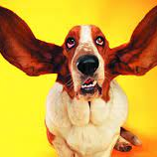
God gave you two ears but only one mouth. Cutting your words in half will then match your anatomy.

Slide 15
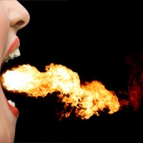
Psalm 39:1-3 I said, I will take heed to my ways, that I sin not with my tongue: I will keep my mouth with a bridle, while the wicked is before me. 2 I was dumb with silence, I held my peace, even from good; and my sorrow was stirred. 3 My heart was hot within me, while I was musing the fire burned: then spake I with my tongue,
Ah, but the fire to speak burns in some men

Slide 16
They cannot quench this fire; they cannot reduce the heat; they cannot rule the impulse; they must talk, now!
What a curse to have an unruly mouth and tell everyone within hearing distance that you are a fool.
Close your mouth, and even though you truly are one, no one but you will know it.
Ah, but the fire to speak burns in some men

Slide 17
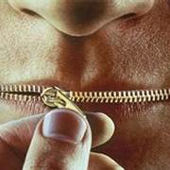
This proverb does not apply to all men, as some do not speak enough.

Slide 18
Proverbs 10:21 The lips of the righteous feed many: but fools die for want of wisdom
.
Proverbs 12:18 There is that speaketh like the piercings of a sword: but the tongue of the wise is health.
Wise men learn the balance, not too much to be foolish, enough to be a tree of life

Slide 19
Proverbs 15:4 A wholesome tongue is a tree of life: but perverseness therein is a breach in the spirit.
Proverbs 15:23 A man hath joy by the answer of his mouth: and a word spoken in due season, how good is it!
Wise men learn the balance, not too much to be foolish, enough to be a tree of life

Slide 20
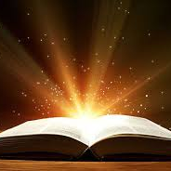
It is this careful application of absolute Bible statements that results in truth and wisdom.
If you press this rule on quiet men that seldom speak, they would never say anything.

Slide 21
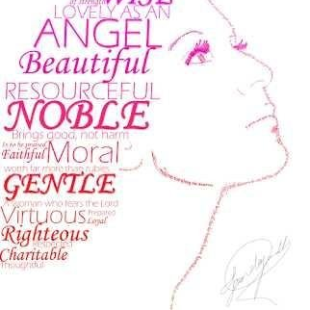
1 Peter 3:3-4 3 Your beauty should not come from outward adornment, such as elaborate hairstyles and the wearing of gold jewelry or fine clothes. 4 Rather, it should be that of your inner self, the unfading beauty of a gentle and quiet spirit, which is of great worth in God’s sight.
If this rule is true for men, it is truer for women, whose adorning feature is a meek and quiet spirit

Slide 22
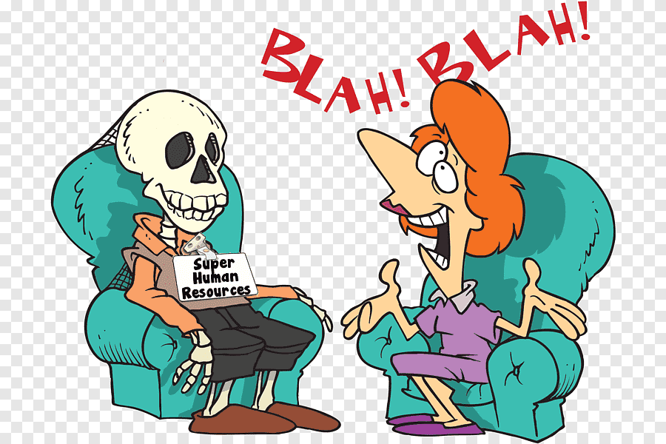
Proverbs 9:13 Folly is an unruly woman; she is simple and knows nothing.
Proverbs 11:16 A kindhearted woman gains honor, but ruthless men gain only wealth.
Proverbs 27:15 A quarrelsome wife is like the dripping of a leaky roof in a rainstorm;
A talkative woman should cut her words in half to make sure she is not despised as the odious and clamorous woman.

Slide 23
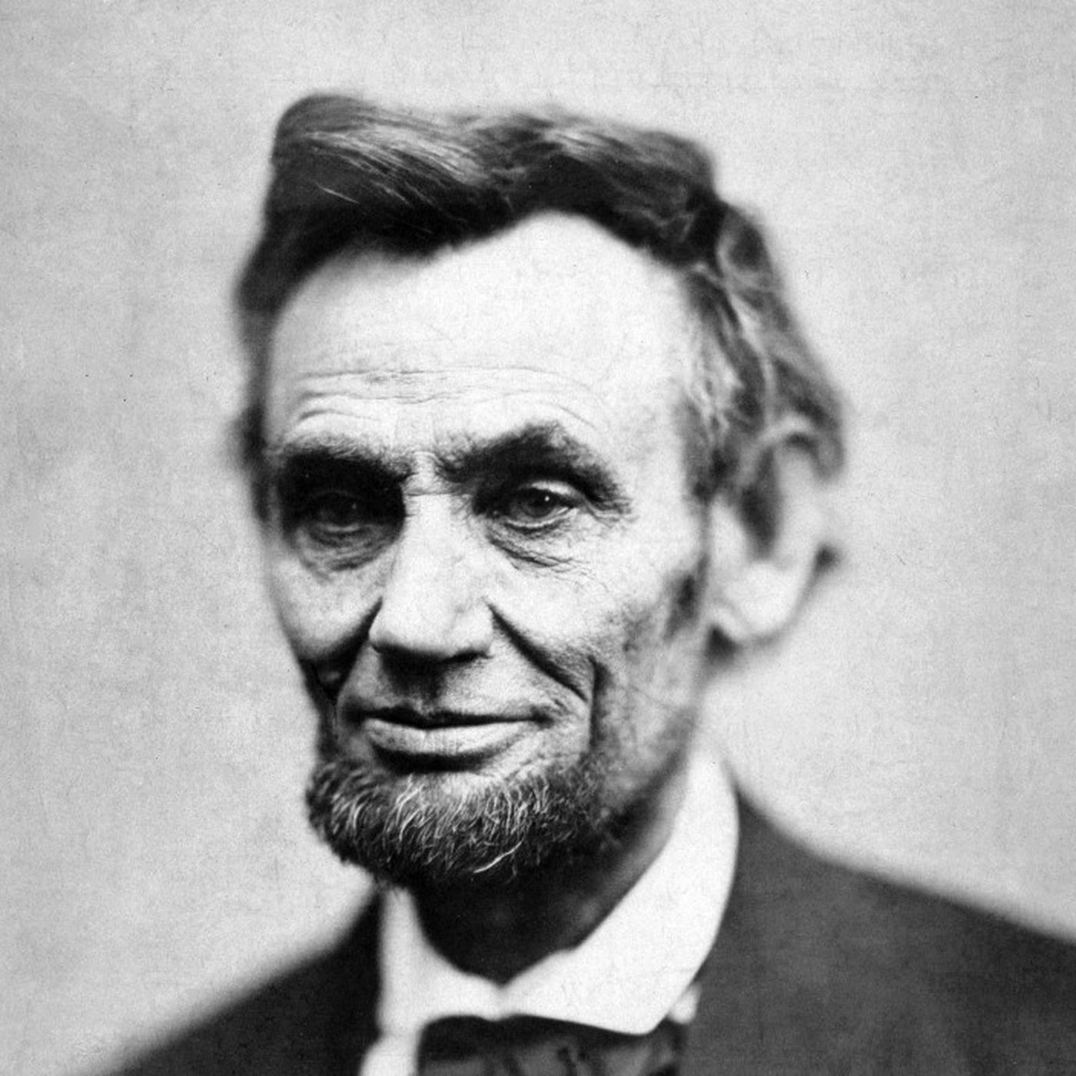
President Abraham Lincoln said “It is better to remain silent and be thought a fool, than to speak out and remove all doubt.”
It is safer and more beneficial to be reserved, try it.
President Abraham Lincoln

Slide 24
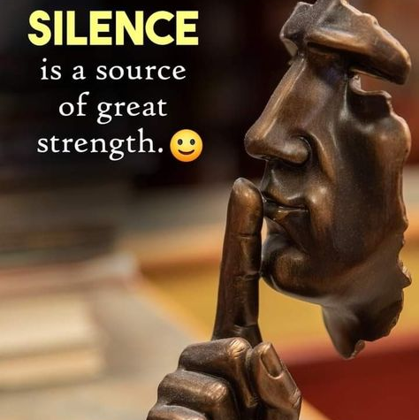
If you do not have anything necessary, profitable, or good to say, why talk?
Others do not need noise to be happy or content.
Silence is golden.
Making conversation to fill a void is disturbing the peace and foolish talking, for which you will be judged.
Silence is golden

Slide 25
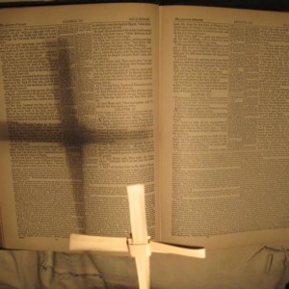
Ephesians 5:3-5 3 But among you there must not be even a hint of sexual immorality, or of any kind of impurity, or of greed, because these are improper for God’s holy people. 4 Nor should there be obscenity, foolish talk or coarse joking, which are out of place, but rather thanksgiving. 5 For of this you can be sure: No immoral, impure or greedy person—such a person is an idolater—has any inheritance in the kingdom of Christ and of God.
Nor should there be obscenity, foolish talk or coarse joking,

Slide 26
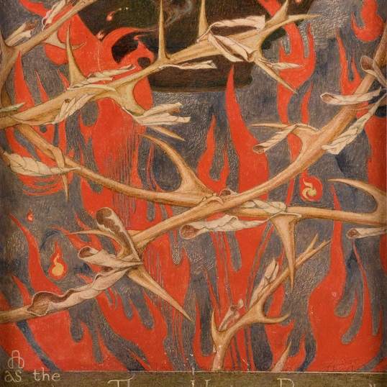
Ecclesiastes 7:4-6 4 The heart of the wise is in the house of mourning, but the heart of fools is in the house of pleasure. 5 It is better to heed the rebuke of a wise person than to listen to the song of fools. 6 Like the crackling of thorns under the pot, so is the laughter of fools. This too is meaningless.
You are then the fulfillment of crackling thorns that Solomon so despised.

Slide 27
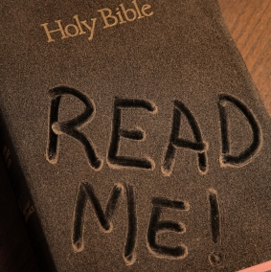
Most people do not appreciate the incredible value of the Bible, for they have not read it, or they have not had teachers that read it.
Thank God for inspiring a book that covers everything from creation to the effect of speech on reputation to the final judgment and everything in between.
Closing:

Slide 28
The Lord Jesus Christ warned that you will give an account for every idle word in the Day of Judgment (Matt 12:36).
So provide wisely for your future at His judgment seat and protect your present reputation by holding your peace and shutting your lips.
Here is a double blessing, at least. Please God and men by reducing your words.
Closing:

Slide 29

Though men may think you wise for your reduced speech, the living Word of God is not deceived at all.
All things are naked and opened before His eyes; He discerns the very thoughts and intents of your heart (Heb 4:12-14).
So it is better to forsake your foolishness altogether and seek true wisdom in your heart. You cannot mislead Him.
Closing:

