Slide 1
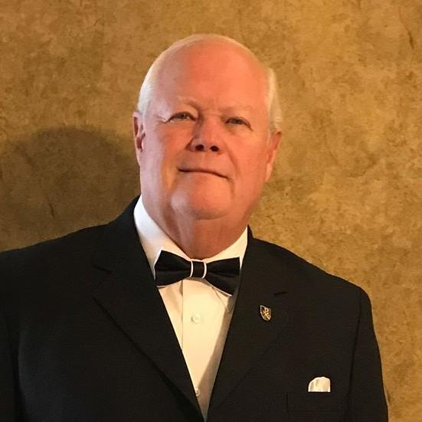
“MISPLACED PURPOSES (part 2) ”
Is there any purpose in my life?
With Bishop Ronald K. Powell

Slide 2
Introduction
“There is a way that seems right to a man, but in the end, it leads to death.”
(Proverbs 14:12)

Slide 3
1. Roads to Nowhere
Those who waste their lives chasing worldly desires eventually come to realize their ultimate emptiness.
Fulfillment is never found in earthly power, pleasure or personal gain.

Slide 4
1. Roads to Nowhere
“I have seen all the things that are done under the sun; all of them are meaningless, a chasing after the wind.”
(Ecclesiastes 1:14)

Slide 5
1. Roads to Nowhere
Externally focused
concerned about outward appearances of success.
Materialistic
impressed with money and possessions.
Pleasure seeking
seeking happiness as highest goal in life—hedonism.

Slide 6
1. Roads to Nowhere
Task oriented
placing projects over people—workaholism
Insecure
people-pleasing, codependent relationships
Negative thinking
dissatisfied, disinterested, bored and bitter

Slide 7
1. Roads to Nowhere
Escaping reality
numbing reality through alcohol, food, drugs, activities
Sexually promiscuous
addicted to the “high” of sexual passion
Status seeking
seeking fame, power or intellectualism as highest goal in life

Slide 8
2. Thoughts of Meaninglessness
“Life has no meaning.”
“Life’s not worth living.”
“I have no sense of purpose.”
“You can’t count on anything.”
“I feel insignificant.”
“Nothing is worthwhile.”
“Nothing really matters.”
“What’s the point of it all?”

Slide 9
2. Thoughts of Meaninglessness
“When I surveyed all that my hands had done and what I had toiled to achieve, everything was meaningless, a chasing after the wind; nothing was gained under the sun.”
(Ecclesiastes 2:11)

Slide 10
3. CAUSES FOR NOT FINDING PURPOSE IN LIFE
Can you imagine being the richest of the rich? Wouldn’t wealth provide for every purpose in life? King Solomon was abundantly blessed with power and every conceivable material possession. With his 700 wives and 300 concubines, he lavished upon himself every human pleasure. Yet, all these things could not bring satisfaction to his soul. Through Solomon, we see that money cannot buy meaning to life … possessions will never buy purpose in life.

Slide 11
3. CAUSES FOR NOT FINDING PURPOSE IN LIFE
“God gives a man wealth, possessions and honor, so that he lacks nothing his heart desires, but God does not enable him to enjoy them, and a stranger enjoys them instead. This is meaningless, a grievous evil.”
(Ecclesiastes 6:2)

Slide 12
4. Seeking Significance “In All the Wrong Places”
“Enter through the narrow gate. For wide is the gate and broad is the road that leads to destruction, and many enter through it.”
(Matthew 7:13)

Slide 13
4. Seeking Significance “In All the Wrong Places”
seeking to be happy
seeking to be holy
Seeking to be religious in a church
seeking to grow in a relationship with Christ
seeking cultural Christianity
seeking biblical Christianity
Seeking external do’s and don'ts

Slide 14
4. Seeking Significance “In All the Wrong Places”
seeking your own will
seeking God’s will
seeking to live for present gain
Seeking external do’s and don’ts
seeking internal obedience of the heart
seeking to live for eternal values

Slide 15
4. Seeking Significance “In All the Wrong Places”
Seeking external do’s and dont’s
seeking internal obedience of the heart
Seeking human approval
seeking God’s approval
“So, we fix our eyes not on what is seen, but on what is unseen. For what is seen is temporary, but what is unseen is eternal.”
(2 Corinthians 4:18)

Slide 16
4. Seeking Significance “In All the Wrong Places”
Seeking external do’s and dont’s
seeking internal obedience of the heart
Seeking human approval
seeking God’s approval
Root Cause
WRONG BELIEF:
“I’ll feel significant if my possessions, popularity and power increase.”
RIGHT BELIEF:
My significance is based on God’s fulfilling His purpose for me by conforming my character to Christ’s character.

Slide 17
4. Seeking Significance “In All the Wrong Places”
Seeking external do’s and dont’s
seeking internal obedience of the heart
Seeking human approval
seeking God’s approval
“The LORD will fulfill his purpose for me.”
(Psalm 138:8)

Slide 18
5. SOLUTION
Seeking external do’s and dont’s
seeking internal obedience of the heart
Seeking human approval
seeking God’s approval
“We know that in all things God works for the good of those who love him, who have been called according to his purpose.”
(Romans 8:28)

Slide 19
5. SOLUTION
Seeking external do’s and dont’s
seeking internal obedience of the heart
Seeking human approval
seeking God’s approval
“Now all has been heard; here is the conclusion of the matter: Fear God and keep his commandments, for this is the whole duty of man. For God will bring every deed into judgment, including every hidden thing, whether it is good or evil.”
(Ecclesiastes 12:13–14)

Slide 20
Closing
Solomon may be considered the wisest of men, but he undoubtedly learned much through trial and error … mostly error. His last recorded writing, Ecclesiastes, is Solomon’s autobiography. In it he documents his continual efforts to find satisfaction—efforts that brought no fulfillment, only futility. By reading Ecclesiastes, you can learn what to eliminate in life. What can look like the proverbial “pot of gold” is merely a chasing after the wind … in the end, that pot is empty.

Slide 21
Let’s Pray
Reach us at:
www.crosswindsinternational.org

