Slide 1
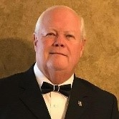
Dealing with Hurt as God has spoken.
With Bishop Ronald K. Powell

Slide 2
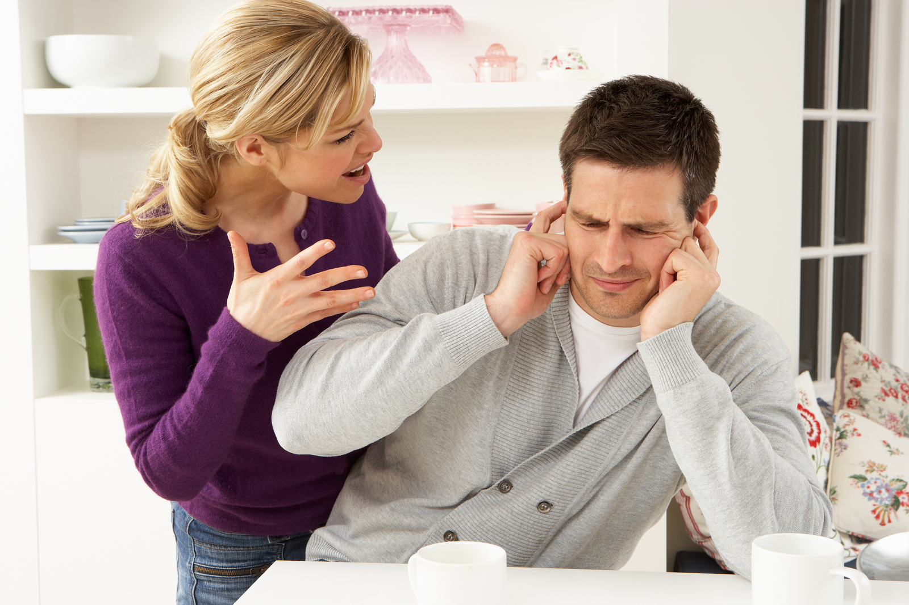
Definition of hurt
1 : a cause of injury or damage
2a : a bodily injury or wound
2b : mental or emotional distress or anguish : suffering getting past the hurt of a bitter divorce
3 : wrong, harm
What is Hurt?

Slide 3
1. Forgiveness is not minimizing the seriousness of an offense.
2. Forgiveness is not an instant restoration of trust.
3. Forgiveness is not resuming a relationship without any changes.
Why Should I forgive Hurts?

Slide 4
1. Because God has forgiven me.
Ephesians 4:32 NLT
32 Instead, be kind to each other, tenderhearted, forgiving one another, just as God through Christ has forgiven you.
Why should I let go of my hurt?

Slide 5
Job 5:2 TEV
2 To worry yourself to death with resentment would be a foolish, senseless thing to do.
Job 18:4 TEV
4 You are only hurting yourself with your anger. Will the earth be deserted because you are angry? Will God move mountains to satisfy you
2. Because Resentment
doesn’t work.

Slide 6
Job 21:23–25 TEV
23 Some people stay healthy till the day they die; they die happy and at ease, their bodies well nourished. 25 Others have no happiness at all; they live and die with bitter hearts.
2. Because Resentment
doesn’t work.

Slide 7
Matthew 6:14–15 NLT
14 “If you forgive those who sin against you, your heavenly Father will forgive you. 15 But if you refuse to forgive others, your Father will not forgive your sins.
3. Because I will need more forgiveness in the future. .

Slide 8
2 Peter 1:3–8 NLT
3 By his divine power, God has given us everything we need for living a godly life. We have received all of this by coming to know him, the one who called us to himself by means of his marvelous glory and excellence. 4 And because of his glory and excellence, he has given us great and precious promises. These are the promises that enable you to share his divine nature and escape the world’s corruption caused by human desires. 5 In view of all this, make every effort to respond to God’s promises. Supplement your faith with a generous provision of moral excellence, and moral excellence with knowledge, 6 and knowledge with self-control, and self-control with patient endurance, and patient endurance with godliness, 7 and godliness with brotherly affection, and brotherly affection with love for everyone. 8 The more you grow like this, the more productive and useful you will be in your knowledge of our Lord Jesus Christ.
4. Where do I get the power to let go?

Slide 9
2. Refocus on God’s purpose for my life.
Job 11:13–16 The Living Bible
13 “Before you turn to God and stretch out your hands to him, get rid of your sins and leave all iniquity behind you. 15 Only then, without the spots of sin to defile you, can you walk steadily forward to God without fear. 16 Only then can you forget your misery. It will all be in the past.
5. How do I let go of those who’ve
hurt me?

Slide 10
4. Respond to evil with good.
Romans 12:21 NLT
21 Don’t let evil conquer you, but conquer evil by doing good.
How do I let go of those who’ve hurt me?

Slide 11
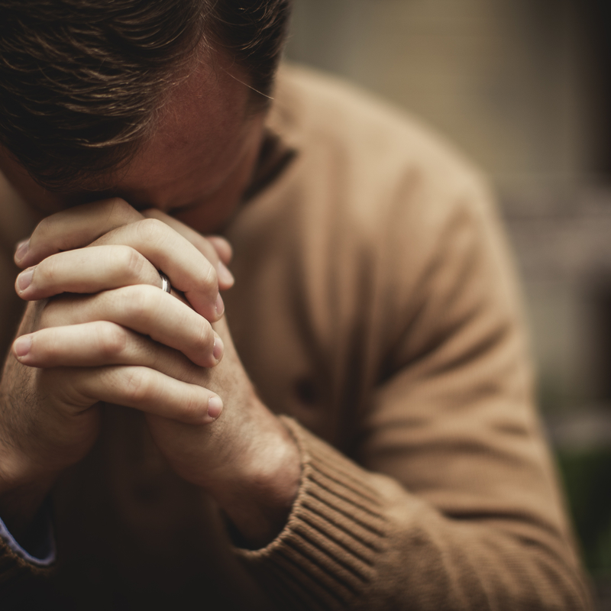
Closing and Prayer

