Slide 1
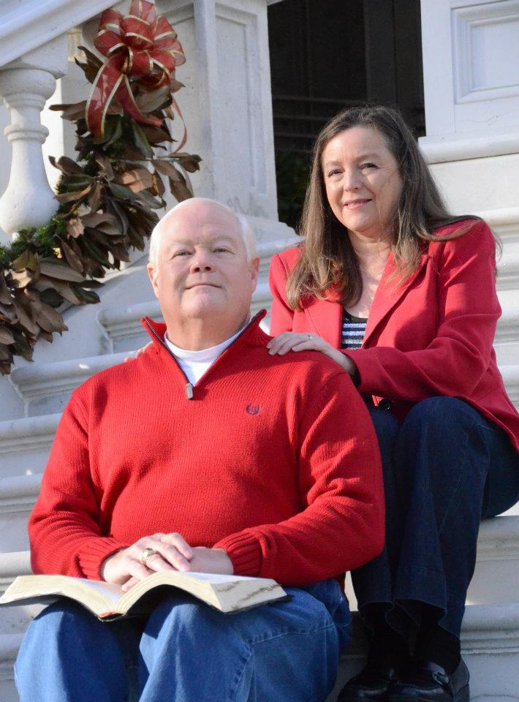
Keep your heart with all diligence!
With Bishop Ronald Powell

Slide 2
Regular self-examination
Proverbs 4:23-27
(23) Keep your heart with all diligence, for out of it spring the issues of life.
(24) Put away from you a deceitful mouth, and put perverse lips far from you.
(25) Let your eyes look straight ahead, and your eyelids look right before you.
(26) Ponder the path of your feet, and let all your ways be established.
(27) Do not turn to the right or the left; Remove your foot from evil.

Slide 3
Why is this so important?
Because our hearts, our minds, guide and direct everything we do, and if we do not guard and protect them from the ungodly ideas, beliefs, and entertainments, they can cause our spiritual downfall.
It is in our minds and hearts that our characters are shaped, and if we allow perverse and unrighteous character to enter, the righteous character that God wants to see in us will never form.

Slide 4
The other instructions that Solomon gives spring from this.
He tells us to ponder and control what comes out of our mouth and what we allow our eyes to view.
He teaches us to make sure our feet stay on the right path, as well as to work on establishing our habits and manner of living, meaning we should not become involved in insensitive, hasty, careless, and destructive actions.
The prophet Haggai puts all this very concisely, “Consider your ways!” (Haggai 1:5, 7)

Slide 5
(Haggai 1:5, 7)
Haggai 1:5
5 Now therefore thus saith the Lord of hosts; Consider your ways.
Haggai 1:7
7 Thus saith the Lord of hosts; Consider your ways.

Slide 6
Ecclesiastes 5:1-3
5:1 Keep thy foot when thou goest to the house of God, and be more ready to hear, than to give the sacrifice of fools: for they consider not that they do evil.
5:2 Be not rash with thy mouth, and let not thine heart be hasty to utter anything before God: for God is in heaven, and thou upon earth: therefore, let thy words be few.
5:3 For a dream cometh through the multitude of business; and a fool’s voice is known by multitude of words.

Slide 7
2 Corinthians 13:5
5 Examine yourselves, whether ye be in the faith; prove your own selves. Know ye not your own selves, how that Jesus Christ is in you, except ye be reprobates?

Slide 8
Unless indeed you are disqualified
Disqualified (“reprobates” in the King James Version, Strong’s #1384: adókimos) means, according to Vine’s, “not standing the test, rejected.”
It suggests “unacceptable,” “disapproved,” “unworthy,” “spurious,” “worthless,” “cast away.”
This word’s meaning is illustrated by the following verses:

Slide 9
Romans 1:28:
Romans 1:28: And even as they did not like to retain God in their knowledge, God gave them over to a debased [adókimon] mind, to do those things which are not fitting.

Slide 10
Titus 1:16:
Titus 1:16: They profess to know God, but in works they deny Him, being abominable, disobedient, and disqualified [adókimoi] for every good work.

Slide 11
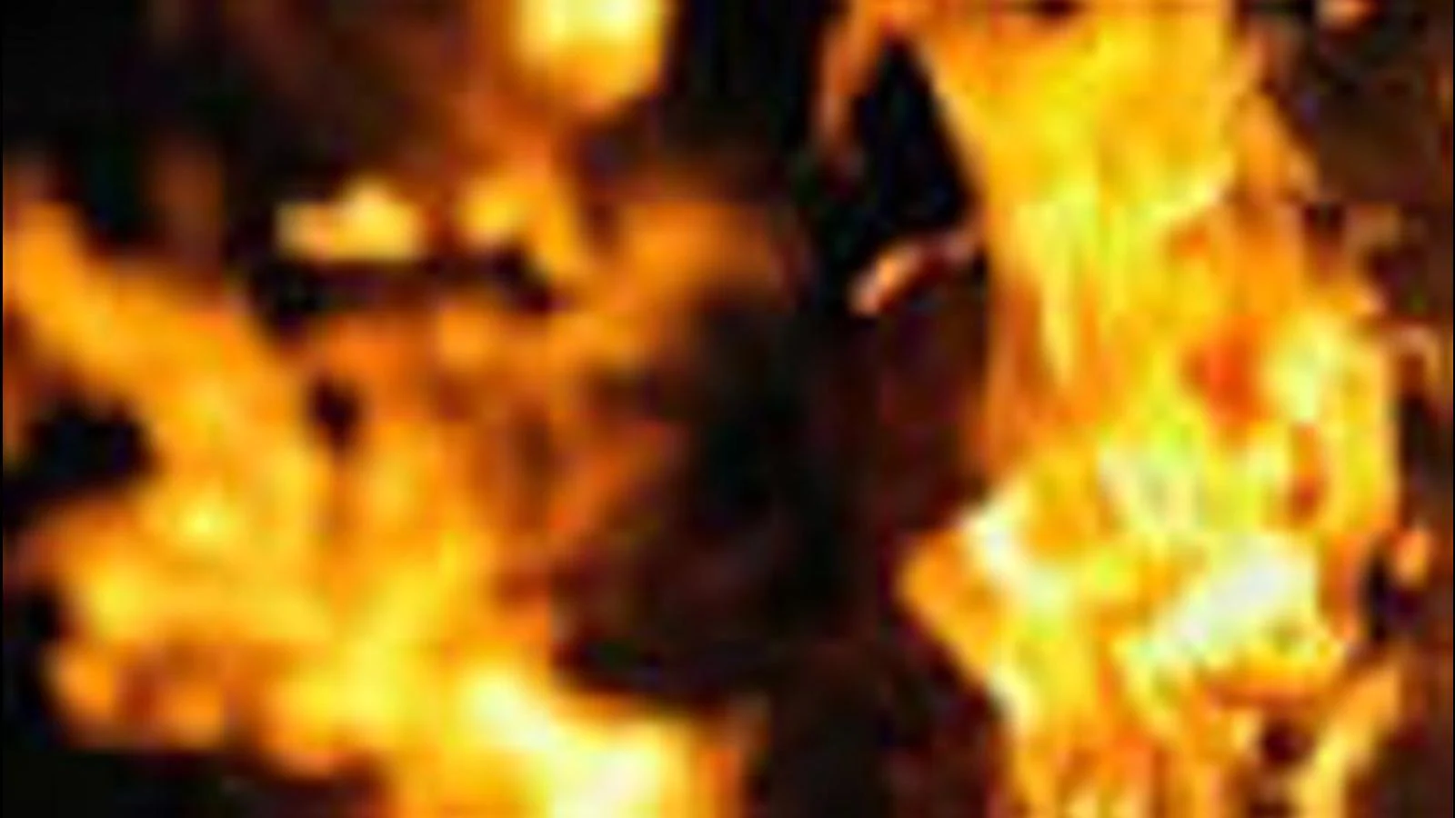
Hebrews 6:7-8:
Hebrews 6:7-8: For the earth which drinks in the rain that often comes upon it, and bears herbs useful for those by whom it is cultivated, receives blessing from God; but if it bears thorns and briars, it is rejected [adókimos] and near to being cursed, whose end is to be burned.

Slide 12
Being disqualified or rejected is the opposite of having Jesus Christ dwell in us;
It is being unfit or unworthy of His presence in us.
In other words, a disqualified person is cut off from God!
This is the worst possible outcome of a Christian’s life: to return to a life of sin and have so much pride that he or she rejects salvation and all that comes with it! God’s Word clearly shows that it can happen (see Hebrews 6:4-6; 10:26-31)!

Slide 13
Hebrews 6:4-6
4 For it is impossible for those who were once enlightened, and have tasted of the heavenly gift, and were made partakers of the Holy Ghost,
5 And have tasted the good word of God, and the powers of the world to come,
6 If they shall fall away, to renew them again unto repentance; seeing they crucify to themselves the Son of God afresh, and put him to an open shame.

Slide 14
Hebrews 10:26-31
26 For if we sin willfully after that we have received the knowledge of the truth, there remaineth no more sacrifice for sins,
27 But a certain fearful looking for of judgment and fiery indignation, which shall devour the adversaries.
28 He that despised Moses’ law died without mercy under two or three witnesses:
29 Of how much sorer punishment, suppose ye, shall he be thought worthy, who hath trodden underfoot the Son of God, and hath counted the blood of the covenant, wherewith he was sanctified, an unholy thing, and hath done despite unto the Spirit of grace?
30 For we know him that hath said, Vengeance belongeth unto me, I will recompense, saith the Lord. And again, The Lord shall judge his people.
31 It is a fearful thing to fall into the hands of the living God.

Slide 15
God intends for us to discover the reality of our nature.
Of course, it is impossible to fathom it entirely, but we can and must come to grips with the potential for evil that exists in every one of us.
We must at least regularly measure the extent that we have overcome the evil in us and the sincerity of our commitment to our relationship with God.
As we examine ourselves this and every year, God expects us to prepare ourselves as mature Christians, to rededicate ourselves to Him afresh and to put sin out of our lives diligently and actively.

Slide 16
1 John 1:9
If we confess our sins, he is faithful and just to forgive us our sins, and to cleanse us from all unrighteousness.

Slide 17
Closing
Regular self-examination is a proven way to make sure that it does not happen to us!

Slide 18
Closing
As we exercise circumspection (or perhaps being circum-suspect) we must take God’s will for us into our cautious examining in our prayers, study, and meditation, emulating the Psalmist’s David commitment to God to walk circumspectly, avoiding the world’s alluring distractions.
We have to learn from the mistakes we have made, determined to mature spiritually, taking ourselves away from the dangers we have previously encountered, harnessing our behavior, including our tongues.

Slide 19
Let us Pray

