Slide 1

Today's Thought : Grasshopper mentality
With Bishop Ronald K. Powell

Slide 2
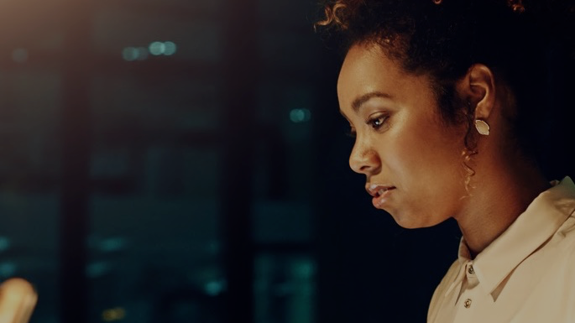
Grasshopper mentality
I want to build upon a thought from a last week, as I feel strongly about how this mindset must change in all of our lives.
Today's thought that we are fasting from is the "grasshopper mentality" or the "grasshopper complex."

Slide 3
Grasshopper mentality
The thoughts that go with this would be:
I feel small.
I feel inferior.
My opposition is huge.
My problems are bigger than me.
I'm not up for the challenge."

Slide 4
Grasshopper mentality
The 10 spies, sent out by Moses, in Numbers 13:33 gave an evil report.
They said, "...we saw the giants in the land and we became like grasshoppers in OUR OWN SIGHT, AND SO we were like grasshoppers in their sight."

Slide 5
Grasshopper mentality
The longer they focused on their opposition, the bigger their opposition became.
Soon their faith in the God Who had brought them out of the bondage of Egypt, was swallowed up.
With it went their ability to believe that they could indeed conquer and possess the land. Others saw them the way they saw themselves.

Slide 6
We're changing the way we see ourselves today!
Let’s deal with this:
“ROYALTY destroys inferiority.”
When you know you are in God’s royal family, you will no longer feel inferior or think like a grasshopper.
Romans 5:17 says “…through the gift of righteousness, we reign as kings in this life.”
We have received the GIFT of righteousness (2 Corinthians 5:21), therefore we are kings! We are royal!

Slide 7
We're changing the way we see ourselves today!
Let’s deal with this:
“We live life from His position, His seat.”
Ephesians 2:6 says, “He raised us up with Him, and seated us with Him in heavenly places.”
“We are made in His image.” (Genesis 1:26).
We have His divine image, with His divine breath, endowed with His divine authority.
When you look at yourself in the mirror, you are looking at the image of God!

Slide 8
We're changing the way we see ourselves today!
“Let no man therefore judge you…” (Colossians 2:16)
This doesn’t mean we avoid accountability or responsibility; but we are inferior to no one.
Paul said in 2 Corinthians 11:5, “for I consider myself NOT in the least INFERIOR to the most eminent apostles – his peers.”
We are masters over life. Romans 6:14 says, “Sin is not our master.”
Luke 10:19 says: we have authority over all the power of the enemy, so the devil is not our master either.

Slide 9
We're changing the way we see ourselves today!
When we are born again, we are reunited with the original authority God created us to walk in, because we are re-united with the Author.
We are reunited with our original mastery over life because we are reunited with the Master.

Slide 10
We're changing the way we see ourselves today!
Here is a revealing name given to Jesus by His disciples – Master.
Master means: one who controls or influences events or things.
When He healed the sick, they called Him, Master.
When He calmed the storm, they called Him, Master.
When He forgave the unforgivable, they called Him – Master.
He was master over life, and according to 1 John 4:17, “as He is, so are we in this world.”

Slide 11
THINK IT and SAY IT: !
I am not inferior to anything or anyone, because I am made in the image of God.
I am the righteousness of God; therefore, I reign in this life as a king in God’s kingdom.

Slide 12
THINK IT and SAY IT: !
I am in the royal family, and ROYALTY DESTROYS INFERIORITY.
I have His divine image; His divine breath and I am endowed with His divine authority.
My peers, friends, employers and employees are not superior to me.
I respect them because they are made in the image of God, but I will not cower to anyone, be intimidated by anyone or shrink back because of anyone.

Slide 13
THINK IT and SAY IT: !
I am as He is in this life.
I am a master over life and its circumstances.
I will not be mastered by anything anymore!
I am not under man’s opinion and judgment.
I am under God’s.

Slide 14
THINK IT and SAY IT: !
I am seated with Christ in heavenly places; therefore, I see myself from His point of view (a conqueror).
I see life from His point of view.
I’m bigger than the mountains; taller than the trees; and more a giant than the giants!
No grasshopper mentality lives in my head anymore.
I shall by all means go up and take possession of the promise land!

Slide 15
THINK IT and SAY IT: !
Meditate today: Royalty destroys inferiority!

