Slide 1
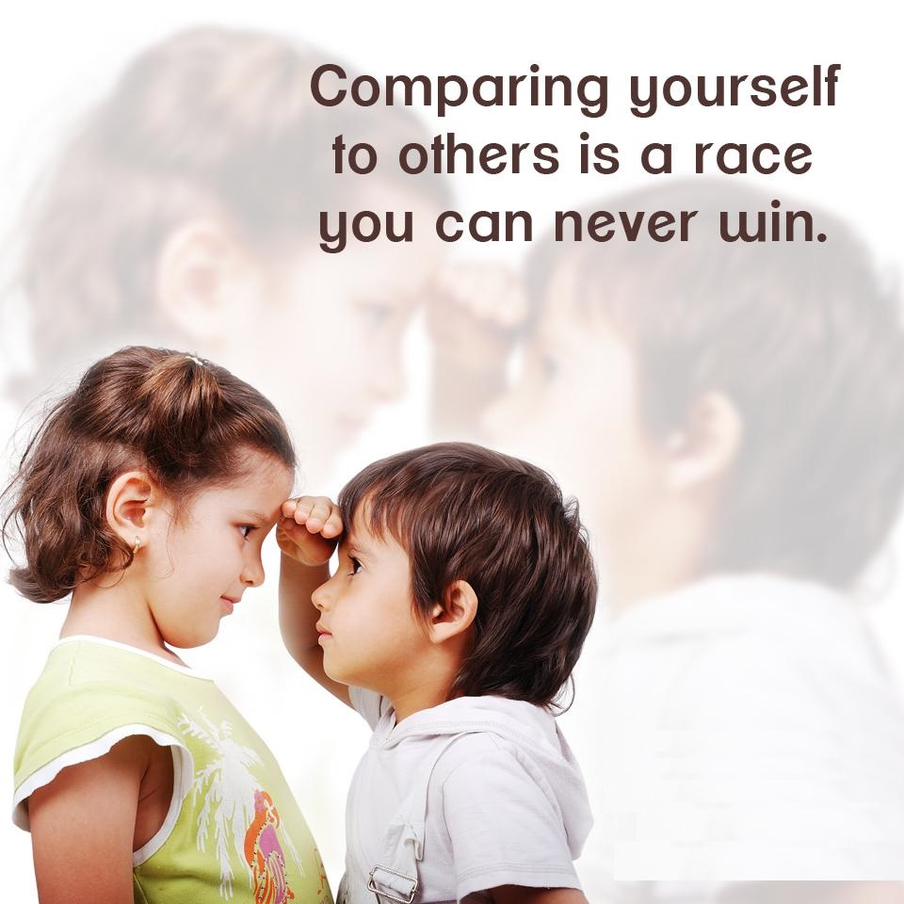
With
Bishop Ronald K. Powell

Slide 2
Wrong Thinking: My life is not as good as others
This is the day the Lord has made! Let us rejoice and be glad in it.
Remember, we are fasting, abstaining from and giving up WRONG THINKING.

Slide 3
Our Commitment
We have to commit ourselves to give up the thoughts we are fasting from.
And we’re never going to go back to thinking this way!
Today we’re fasting from the thought that says:
“My life is not as good as others.”

Slide 4
Comparison Thinking
I’m not as well off, pretty or successful.
My life is not as easy or fun.
Things seem to work out for them better than me.

Slide 5
Comparison Thinking
Friends, this is a deadly way of thinking that we are going to stop TODAY.
The same people that you think are better off than you, may look at you the same way.
You have no idea what goes on, on the inside of others.
But more importantly, you have the life that God gave you, and nobody can be better at it, than you.

Slide 6
Let’s take this thought captive. How?
Give up the temptation to compare yourself to others.
Society trains us to compare ourselves to one another.
But 2 Corinthians 10:12 says that when we do this, we are without understanding. And understanding is what gives us the power to be happy and free!

Slide 7
Let’s take this thought captive. How?
Give up the temptation to compare yourself to others.
Society trains us to compare ourselves to one another.
But 2 Corinthians 10:12 says that when we do this, we are without understanding.
And understanding is what gives us the power to be happy and free! (Proverbs 3:13-19)

Slide 8
2 Corinthians 10:12
2 Corinthians 10:12
The Message
12 We’re not, understand, putting ourselves in a league with those who boast that they’re our superiors. We wouldn’t dare do that. But in all this comparing and grading and competing, they quite miss the point.

Slide 9
Free yourself today from the comparison trap
We’ll come back to this more later during our fast, but let’s start by ABSTAINING FROM COMPARISONS.
(Her figure, his money, their marriage, their children, their college, she’s a better mother, he’s a better dad, etc.). When you compare, you despair.

Slide 10
Free yourself today from the comparison trap
Realize God has reserved a special gift and portion for you that no one can take.
(1 Samuel 9:23-24) There is a portion reserved for you.

Slide 11
1 Samuel 9:22-24
22-23 Samuel took Saul and his servant and led them into the dining hall at the shrine and seated them at the head of the table. There were about thirty guests. Then Samuel directed the chef, “Bring the choice cut I pointed out to you, the one I told you to reserve.”
24 The chef brought it and placed it before Saul with a flourish, saying, “This meal was kept aside just for you. Eat! It was especially prepared for this time and occasion with these guests.”
Saul ate with Samuel—a memorable day!

Slide 12
Proverbs 3:13-20
The Very Tree of Life
¹³⁻¹⁸ You’re blessed when you meet Lady Wisdom, when you make friends with Madame Insight. She’s worth far more than money in the bank; her friendship is better than a big salary. Her value exceeds all the trappings of wealth; nothing you could wish for holds a candle to her. With one hand she gives long life, with the other she confers recognition. Her manner is beautiful, her life wonderfully complete. She’s the very Tree of Life to those who embrace her. Hold her tight—and be blessed!
¹⁹⁻²⁰ With Lady Wisdom, God formed Earth; with Madame Insight, he raised Heaven. They knew when to signal rivers and springs to the surface, and dew to descend from the night skies.

Slide 13
Live your life to please God.
2 Corinthians 5:9 says “We have this as our ambition – to be pleasing to God.”
When you are busy living to please Him, you no longer focus on what other people are experiencing; or how you stack up against them.
Stop living for the respect and esteem of others. He is not looking at how you compare to others, but He is looking at whether you believe Him, trust Him, and HONOR Him.
Colossians 3:1-2 says “If then you have been raised up with Christ, keep seeking the things above, where Christ is, seated at the right hand of God. Set your mind on the things above, not on the things that are on earth.” You see, we need to be eternally minded.

Slide 14
When you read a promise in scripture, TAKE IT PERSONALLY.
Put your name in it, and accept that God is writing to you: take for example Luke 12:42 which says:
“YOUR heavenly Father, has chosen gladly to give you the Kingdom!”
James 1:17 says “Every good and perfect gift comes from above from the Father of lights, in whom there is no shifting shadow of turning.”

Slide 15
Stop thinking backwards.
This means, stop looking at what you DON’T have, and START TODAY looking at what you do have. You have eternal life.
You are God’s son or daughter.
You are part of a spiritual family.
You are a part of a REVOLUTION – FROM THE INSIDE OUT.
Thinking this way, creates an attitude of faith for all that God has for you.

Slide 16
Think this and say this:
“I am secure.
I have a special gift and treasure that God has given me.
There is a portion and a place in God’s kingdom reserved for me.
I have a GREAT life, because God is my Father, and He has chosen gladly to give me His Kingdom.
I am lacking nothing and therefore I am not jealous or envious of what ANYONE else has!”

