Slide 1
I'm Alone In This Storm
With Bishop Ronald K. Powell

Slide 2
Today's Thought : I'm Alone In This Storm
When we fast from wrong thinking, we're not just discerning between "right" and "wrong"; we also need to distinguish between "right" and "almost right.
"There are many things we have believed that are almost right.”
It's "almost right" to believe that if we worship God with all our heart, we can usher ourselves into the presence of God.
Many ministers will even say, "let's press into His presence." But you see, beloved, we are in His presence already, because we have passed through the veil that separated us from the holy of holies.
It is through the body and blood of Jesus that we pass through the veil. (Hebrews 10:19-20)

Slide 3
Hebrews 10:19-20
19 Having therefore, brethren, boldness to enter into the holiest by the blood of Jesus,
20 By a new and living way, which he hath consecrated for us, through the veil, that is to say, his flesh;

Slide 4
We now stand in His presence unashamed, without guilt, without condemnation, without separation.
Building upon the last few days, today we’re fasting from the thought that says, “I’m alone in this.” “Where is God when I need Him most.”

Slide 5
When the disciples tried to cross over to the other side of the sea in the boat (Mark 4:36-40), they were overwhelmed by the storm that struck their ship. They thought they would perish. They feared for their life, bailing out water furiously. Have you ever been in a storm? The waters crashing against you; you don’t know what to do; you feel helpless. You cry out, “Lord where are you? Don’t you care?”

Slide 6
The disciples forgot one small detail in the midst of their storm………..Jesus was in the boat with them! There was nothing greater than His presence! Let’s overcome the thought that says, “I’m alone in this storm.” “Where is God when I need Him most?”

Slide 7
1. He is in the boat with you!
In Mark 4:36-40, Jesus was asleep in the boat.
Someone asked me once – “how do we wake Jesus up, when He is asleep in our boat, in the middle of a storm?”
Well, I said, “You don’t wake Him up. You rest with Him!” If He’s not worried, don’t you worry. HIS PRESENCE calmed the storm then, just as it will do now.

Slide 8
2. The disciples didn’t need Jesus to awake. They needed to awake to the fact that God was with them.
When you know He is with you, there is nothing to fear; therefore, there was nothing to fear.
Psalm 23:4 says, “though I walk through the valley of the shadow of death, I will fear NO EVIL for You are with me!”

Slide 9
3. Great miracle: Jesus calmed the storm. Greater miracle: Jesus slept IN THE MIDST of it.
When you realize He is in your boat with you, you will have supernatural peace.
Calming the storm is great.
Peace in the midst of it is greater!

Slide 10
4. DO NOT MISTAKE FIRE IN YOUR LIFE FOR GOD’S ABSENCE.
In Daniel 3:22-25, Jesus was the 4th man in the fire with Shadrach, Meshach and Abednego.
His presence was felt in the middle of the fire.
Just because you don’t feel His presence, doesn’t mean He isn’t there.
BELIEVE HE IS WITH YOU, and eventually, your situation will FEEL HIS PRESENCE!

Slide 11
5. Psalm 91:10 says, “No evil shall befall you, nor shall any plague come near your tent.”
Notice, the next verse says, “for He will give His angel charge concerning you.”
There are many angels involved in our lives, but this is talking about HIS ANGEL.
The Old Testament “Angel” is Jesus Christ. He is Lord, therefore He has charge concerning us!

Slide 12
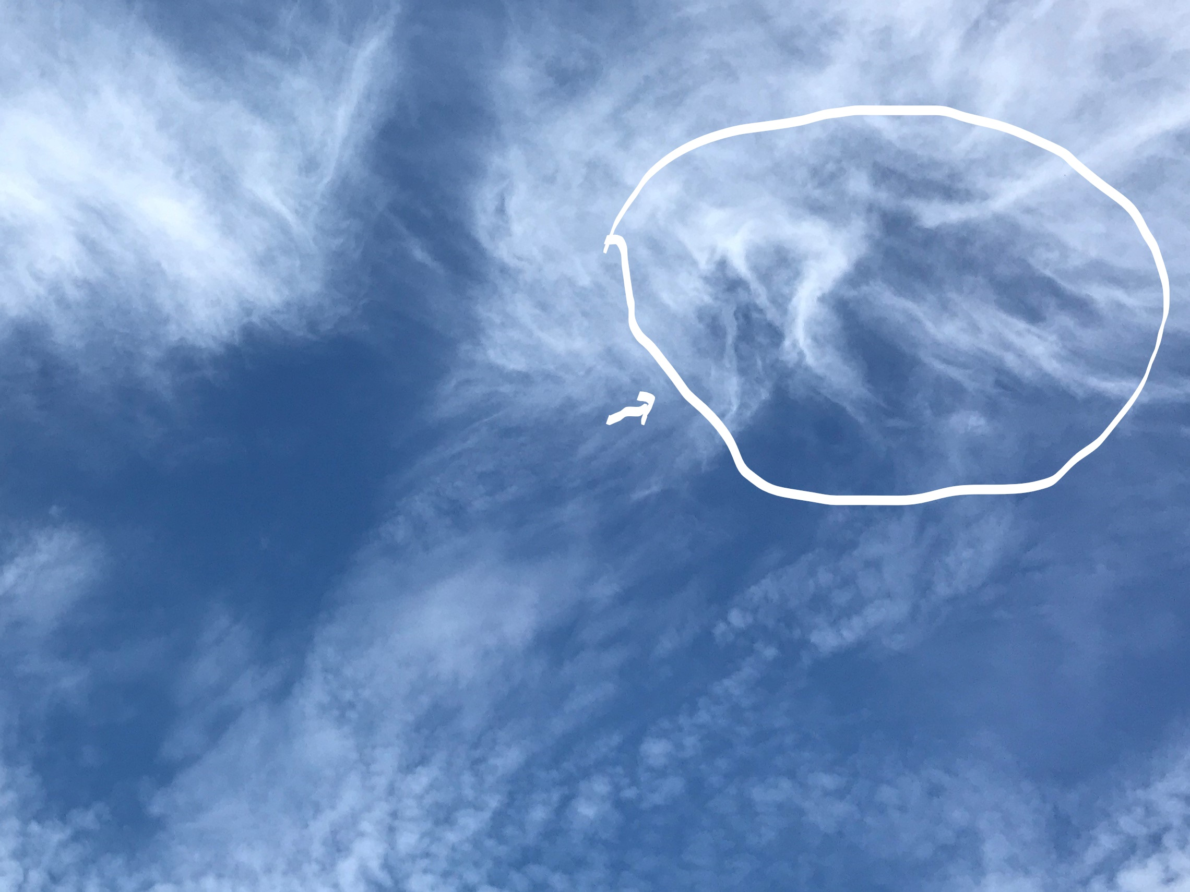

Slide 13
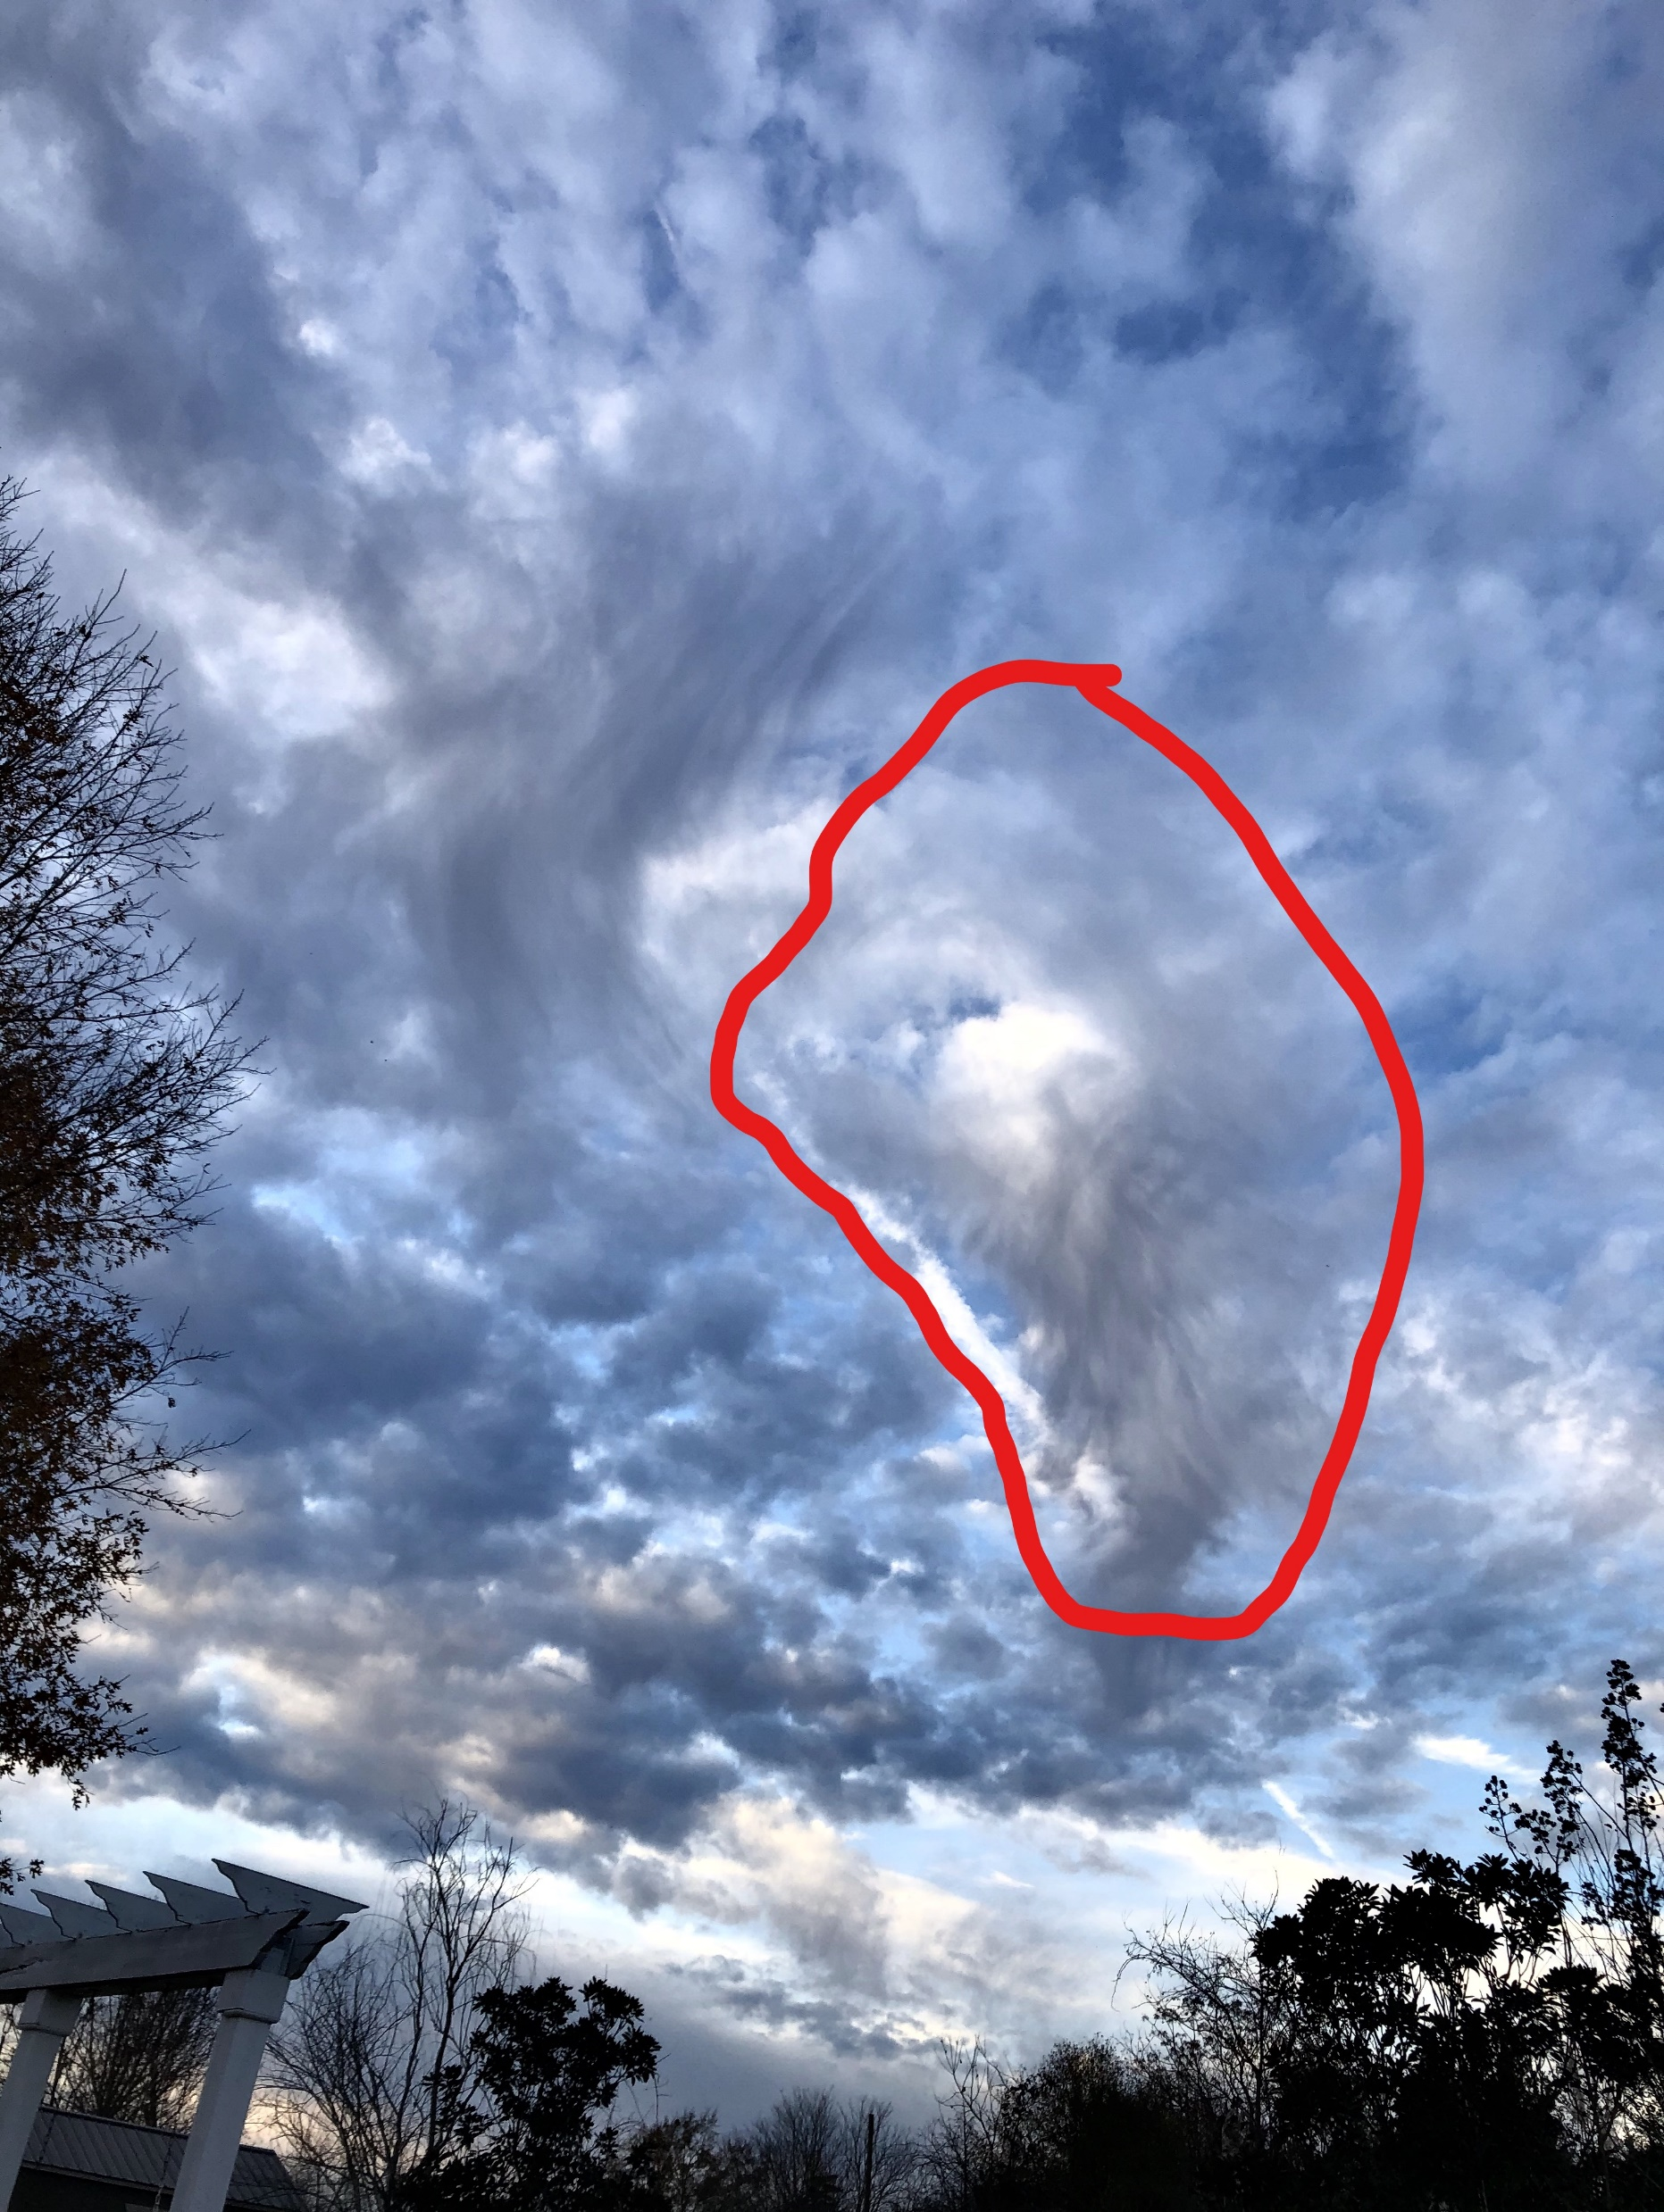

Slide 14
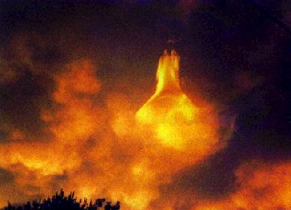

Slide 15
THINK IT & SAY IT:
There is nothing greater than God’s presence, and His presence is with me and in me. As surely as He was with Moses, He is with me.

Slide 16
THINK IT & SAY IT:
I am not trying to get in God’s presence. I am already in, through the blood of Jesus.
He is in my boat with me. He is not “over there.” He is “here” right now – with me and in me!
There is nothing greater than God’s presence, and His presence is with me and in me. As surely as He was with Moses, He is with me.

Slide 17
THINK IT & SAY IT:
I awake to the fact that He is with me.
There is no separation.
I can rest with Him, in the midst of any storm.
I can walk with Him in the midst of the fire.

Slide 18
THINK IT & SAY IT:
I am fearless, because He is with me.
Therefore, no evil shall befall me, nor shall any plague come near my dwelling place – my church, my home, my body, my life – in Jesus. name.

Slide 19
Let’s Pray

