Slide 1
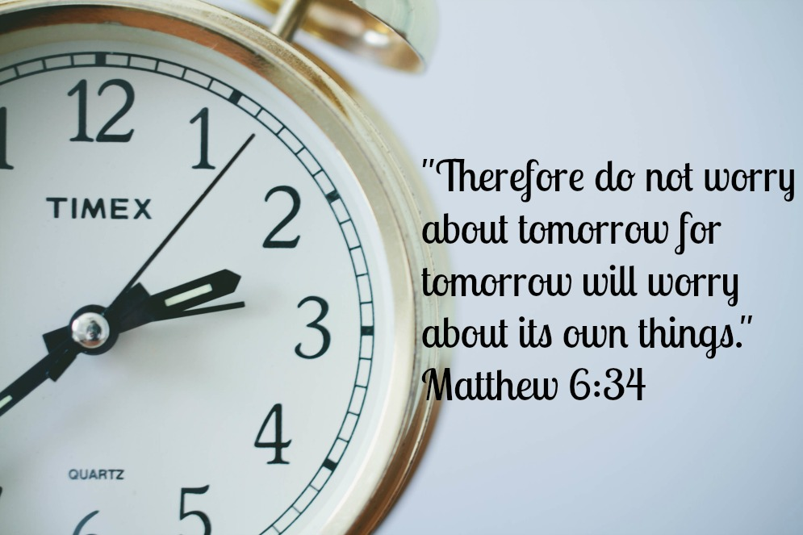
Today’s Thought:
“You just never know what the future holds”
With:
Bishop Ronald K. Powell

Slide 2
Today’s Thought:
“You just never know what the future holds”
Let’s stay in this and continue to fast from wrong thinking
and feast on right thinking.
Remember, right thinking produces right living!

Slide 3
“You just never know what the future holds.”
Thoughts that go with this:
You never know what is going to happen.
You cannot control what happens in your life.
There is not much I can do about it.”

Slide 4
“You just never know what the future holds.”
Too many of us acquiesce our power and authority to do something about our situation, because we think it’s all up to God or the future is already destined.
And while it’s true, that we can’t control everything that happens in the world, we can control what happens in our lives.

Slide 5
“You just never know what the future holds.”
Sow a thought, reap an action.
Sow an action, reap a habit.
Sow a habit, reap your character.
Sow character, reap your destiny!
We have the power to create the future we desire.

Slide 6
“You just never know what the future holds.”
Let’s change our thinking.
Let’s replace the thought that “you never know what the future holds,” with “I hold the future in my hands (based on the seeds I sow.)”

Slide 7
1. Believe what God said.
Jeremiah 29:11 says, “I know the thoughts I have for you – for good and not evil – to give you a FUTURE and a HOPE.”
God's future for us is good.
Expect it.

Slide 8
2. Your life is a garden.
In Genesis 2:7 God put man in the garden.
But in Luke 17:21 God put the garden IN MAN.
Jesus said, “The Kingdom of God is within you.”
In Mark 4:13-20 Jesus said, the soil of the kingdom of God is in our hearts.

Slide 9
3. We determine our future by the seed we sow.
Galatians 6:7 says, “Don’t be deceived. Whatever a man sows, is exactly what he will reap.”
I’m talking about sowing the SEED OF GOD’S WORD. The Word is the seed.
Promises from God’s Word contain the power to come to pass, when planted in the fertile soil of our heart.

Slide 10
4. You have the power and permission from God to grow whatever kind of life you want.
Proverbs 4:18 says, “Watch over your heart with all diligence, for from it flow the issues of life.”

Slide 11
5. Realize you are in control of the things that can choke out your desired harvest.
Mark 4:17-20 says there are 3 things that can choke out the harvest of God’s Word in your life:
the desires for other things,
the deceitfulness of riches,
and worry!

Slide 12
6. Desire God’s promises in your life.
2 Corinthians 1:20 says, “All the promises of God are yes, in Him…”
Sow the seed of God’s promises in your life.
The answer is yes!

Slide 13
7. Meditate on the power God has given you.
God has given you the Power to choose (Deut. 30:15);
the Power of your seed (Galatians 6:7);
the Power of your tongue (Proverbs 18:21);
the Power of the Holy Spirit (Acts 1:8, John 16:13)

Slide 14
THINK IT & SAY IT
I accept in my heart and mind that God has a good future in store for me.
But he has given me the stewardship over the garden of my heart.
I will watch what goes into my heart through my eyes, ears, and mouth.

Slide 15
THINK IT & SAY IT
I determine my own future by the seeds I sow.
The Word of God contains the seeds of God’s promises, that God has given me permission and power to sow into my heart.

Slide 16
THINK IT & SAY IT
Jeremiah 32:27. “Behold, I am the LORD, the God of all flesh: is there any thing too hard for me?”
^{Mark 9:23} Jesus said unto him, “If thou canst believe, all things are possible to him that believeth.”

Slide 17
THINK IT & SAY IT
Matthew 21:22 New International Version
22 If you believe, you will receive whatever you ask for in prayer.”

Slide 18
Let’s Pray
Visit us at:
https://www.crosswindsinternational.org/
https://www.facebook.com/drronaldpowell
https://www.instagram.com/drronaldpowell/
https://www.linkedin.com/in/drronaldpowell/?authType=name&authToken=N8ki
https://twitter.com/Cognitivedoc
https://vimeo.com/crosswindsinternational
https://www.youtube.com/c/DrRonaldPowellCWI/videos

