Slide 1
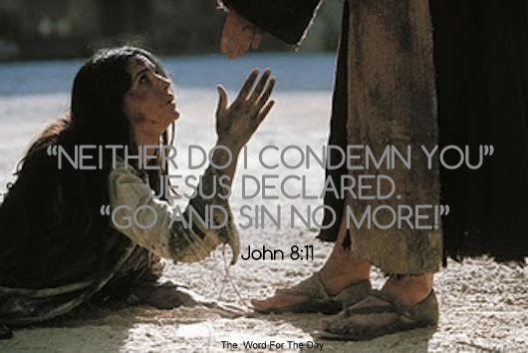
Today's Thought : God Is Judging Me
With Bishop Ronald K Powell

Slide 2
We're fasting today from the thought that says: "God is judging me.“ "Why is God doing this to me?" "Why is this happening to me?"

Slide 3
We all feel at times like when we don't measure up, that perhaps God is mad at us. And we replaced that wrong thinking with the thought that: "God is not mad at me, He is mad about me."
Today, I want to build upon what I shared with you recently -

Slide 4
When something goes wrong, it's easy to think, "maybe God is letting this happen because of what I did or what I didn't do."

Slide 5
This kind of thinking distorts the true view of our Heavenly Father.
We need to stop seeing God as a vengeful and judgmental God.
He is just. But His justice is satisfied, through the shed blood of Jesus. All that's left is His mercy and grace.
We're going to blast this "judgment mentality" out of our heads!

Slide 6
1. It is impossible for God to give anything that is not good.
Psalm 84:11 says "No good thing does He withhold from the righteous."
(And don't forget: you are righteous through the blood of Jesus, not through your own works.)

Slide 7
2. God's judgment "passed over" the children of Israel through the blood of lambs.
In Exodus 12:12-13 God said, "On that same night I will pass through Egypt and strike down every firstborn - both men and animals - and I will bring judgment on all the gods of Egypt. I am the LORD. The blood will be a sign for you on the houses where you are; and when I see the blood, I will pass over you. No destructive plague will touch you when I strike Egypt."
Therefore, God's judgment passes over us more powerfully through the blood of Jesus.

Slide 8
3. Every good and perfect gift comes from above, from the Father of lights! James 1:17 God doesn't change. He is GOOD, and the author of good. Never doubt that again.

Slide 9
4. EMBRACE HIS MERCY.
Lamentations 3:22 says His mercy is new EVERY MORNING.
I love what Paul says in Hebrews 4:16, ¹⁶ Let us therefore come boldly unto the throne of grace, that we may obtain mercy, and find grace to help in time of need. “
So let's walk right up to Him and get what He is so ready to give. “
Take the mercy, accept the help. HE IS NOT JUDGING YOU!

Slide 10
5. Meditate on what mercy is.
A woman approached Napoleon to ask for mercy for her son and let him go free. He was to be hanged for crimes against Napoleon and France.
"Do you know what he has done, madam? He doesn't deserve mercy!“
She responded: "If he deserved it, it wouldn't be mercy, sir." Napoleon released him.

Slide 11
The next time you think, "why is this happening to me," EXPECT GOD TO TURN IT INTO SOMETHING GOOD, rather than thinking God is judging you.

Slide 12
THINK IT & SAY IT:
God is NOT judging me.
He is my Father, and He is madly in love with me.
I deserve judgment, but He gives me mercy.

Slide 13
THINK IT & SAY IT:
When things don’t go right, I will not believe it's God's judgment.
I will not believe that I have lost favor with Him.
His favor SURROUNDS ME like a shield.

Slide 14
THINK IT & SAY IT:
His judgment passed over the children of Israel, therefore His judgment passes over me.
I expect GOOD to happen to me.
EVERY DAY, something good is going to happen.

Slide 15
THINK IT & SAY IT:
I embrace His mercy.
It follows me all the days of my life.
No matter what happens in my life, I expect God to turn into something good!

Slide 16
Let Us Pray
Visit us @:
https://www.crosswindsinternational.org/
https://www.youtube.com/c/DrRonaldPowellCWI/videos
https://www.facebook.com/drronaldpowell/
https://twitter.com/Cognitivedoc

