Slide 1
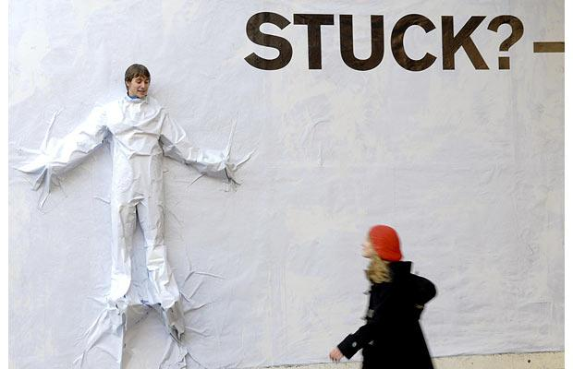
Rewiring your thinking: Today’s Message : “I’m Stuck”
With
Bishop Ronald K. Powell

Slide 2
Introduction
Good morning!
I am hearing amazing testimonies from people about what is happening in their lives through our FAST FROM WRONG THINKING!

Slide 3
Testimonies
I have heard people say they HAVE MORE ENERGY; they are FREE FROM DEPRESSION; their MARRIAGE IS BETTER THAN EVER.
I had one lady tell me yesterday that she has lost 10 pounds in the last couple of weeks, simply by changing the way she thinks.
She said she literally hasn’t been as hungry. Why? Because the Bible says, “man does not live on bread alone but on every Word that proceeds from the mouth of God.”
When you replace wrong thinking with right thinking, it changes you FROM THE INSIDE OUT.

Slide 4
Your testimony is next!!!!
We’ve all thought that at times.
Sometimes we feel we’ve blown it, or we’re at the end of our rope.
There’s nothing we can do, but it’s a lie.
There’s always something that we can do. There’s always a way.

Slide 5
Your testimony is next!!!!
Friends, the devil would love for you to believe there’s nothing you can do about your situation.
He wants you stuck! He wants you immobilized. He wants you defeated.
And he achieves that by getting us to believe this lie.

Slide 6
Your testimony is next!!!!
This way of thinking keeps you from being decisive and taking action.
Action produces results.
But the thought that you can’t do anything about your situation or you don’t know what to do about it, STOPS ACTION.

Slide 7
Your testimony is next!!!!
This way of thinking keeps you from being decisive and taking action.
Action produces results.
But the thought that you can’t do anything about your situation or you don’t know what to do about it, STOPS ACTION.
Let’s change that today!

Slide 8
1. Believe in the ministry of the Holy Spirit in your everyday life.
Romans 8:26 says, “We don’t always know how to pray as we should, but the Spirit intercedes for us…”
No matter what your situation is, the Holy Spirit knows how to bring about God’s will for your life, as you pray and worship Him.

Slide 9
2. Think this thought today: PRAYER CHANGES THINGS.
There’s nothing you can’t impact with prayer. PRAYER gets you unstuck. It gets you moving again toward victory.
Never see prayer as something that is weak. It is powerful.
“And all things, whatsoever you shall ASK in prayer, believing, you SHALL RECEIVE.” (Matthew 21:22)

Slide 10
3. Believe that FAITH FINDS A WAY.
In Mark 2:1-5, the four friends of the paralyzed man, could not find a way into the house where Jesus was. They were stuck.
BUT THEY BELIEVED THERE WAS SOMETHING THEY COULD DO ABOUT THE SITUATION.
Listen, by believing there was a way, they found one! They went up on the roof and lowered him down through the ceiling tiles, and the man was healed.
Why? Because faith found a way! When we don’t think it, we don’t look for it.

Slide 11
4. Remember, Jesus is the 4th man in the fire.
When it seemed like the 3 Hebrew men were going to be burned in the fiery furnace, Jesus showed up.
What was an impossible situation was made possible because Jesus was with them. AND HE IS WITH YOU, in your fire.
John 14:6 says, “I am the WAY, the truth and the life.” Folks, He is “the way”, when there just seems to be no way.
He IS YOUR WAY out of whatever situation you are in. EXPECT HIM to make a way.

Slide 12
5. Stop thinking you have to figure it all out right away.
When you feel stuck, just take one step forward.
When Jesus was tempted to back down, and not go to the cross – the Bible says, “He went forward a little…”
(Mark 14:35) When you feel paralyzed – like there’s nothing you can do, just take a step. Don’t think about all the steps. Just take the first one.
In a relationship, the first step may be: saying you’re sorry. If it’s finances, maybe it’s just cutting one area of spending, or giving one extra offering. If it’s in your health, take the first step and have a salad. Just take that one little step!

Slide 13
THINK IT & SAY IT
I believe in the ministry of the Holy Spirit to intercede for me when things aren’t working out.
He will work through the situation to bring about God’s will. He will bring me through.
As I pray, I believe things will change; they will improve.
I walk by faith, not by sight, and faith finds a way.

Slide 14
THINK IT & SAY IT
I THINK AND BELIEVE THERE IS ALWAYS A WAY, even when it seems like there is none. And that way of thinking, opens the door.
Jesus is the Way when there is no way.
He is with me no matter what fire I’m in; and no matter what the situation.
I expect Him to make a way for me.

Slide 15
THINK IT & SAY IT
When I feel stuck, I will think about one step I can take that will move me toward healing, toward blessing, and toward God’s will for my life.

Slide 16
Let us Pray

