Slide 1
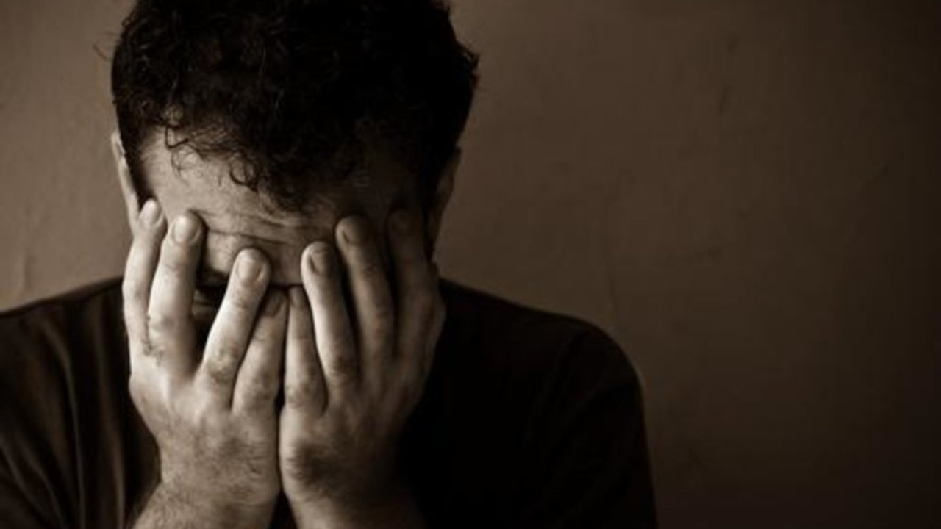
Wrong Thinking: “I feel Guilty”
with
Bishop Ronald K. Powell

Slide 2
Ever thought that? Or its cousin thoughts: You don't do enough. You are not good enough. You do not say the right things. You do not take care of yourself. You do not measure up. You do not do as much for others as you should. You eat too much.
“I feel Guilty”

Slide 3
All this line of thinking produces: guilt, which leads to self-hatred, anger toward others, bad decisions, harsh words, procrastination, and fear. So often, we feel guilty because we THINK we do not do enough for God and for others. We are not good and holy enough.
“I feel Guilty”

Slide 4
Nothing robs us of our true purpose more than thoughts and feelings of guilt.
This thinking has enslaved people for centuries.

Slide 5
That is manipulation. God motivates by love. Romans 2:4 says, "It's the love and kindness of God that leads us to change.“ Often people put a guilt trip on us, to get us to do something or to give in to them. God is not like that, and He wants you free.
God does not motivate by guilt.

Slide 6
1. Jesus declares you: NOT GUILTY. This does not mean that you have never done wrong. This means, that He washes your wrong with His blood.
Let us fast from guilt:

Slide 7
3. Meditate on Job 10:7 which says, "According to your knowledge, I AM INDEED NOT GUILTY..." (NASB)
Let us fast from guilt:

Slide 8
4. When you blow it, do not deny it. Admit it; confess it. 1 John 1:9 says, "If you confess your sin, He is faithful and just to forgive you and to CLEANSE YOU FROM ALL UNRIGHTEOUSNESS."
Let us fast from guilt:

Slide 9
5. It has been already done! Believe that it is already done! Hebrews 1:3 says, "He cleansed us from our sin."
Let us fast from guilt:

Slide 10
6. Stop thinking that you must FEEL GUILTY to be forgiven. Sometimes we think we owe it to people to feel guilty and feel bad for everything. Stop thinking that. You do not owe anyone. Do not think guilt somehow pays for something. The blood of Jesus paid it all. It is an insult to His blood, when we feel like we owe God guilt, or we owe it to others to wallow in guilt.
Let us fast from guilt:

Slide 11
7. Stop beating yourself up about what you have not done. How? Live in the "now". Living in the now, stops your mind from bombarding you about the past and future. Enjoy that moment in the now. When you are praying, the devil says, "you should be cleaning." When you are cleaning, the devil says, "you should be reading your Bible." Shut that garbage up. Live in the now.
Let us fast from guilt:

Slide 12
Hebrews 11:1 says, "NOW FAITH IS the substance of things hoped for." And 2 Corinthians 6:2 says, "NOW IS THE TIME OF SALVATION."
Let us fast from guilt:

Slide 13
8. Rest in the fact that you do not have to be perfect. God is not holding you to a perfect standard. Jesus is your perfection. JUST REST!
Let us fast from guilt:

Slide 14
Jesus has declared me: NOT GUILTY. Even when I feel I do not do enough, or that I am not good enough, God says FAITH IN HIM IS ENOUGH.
THINK IT & SAY IT:

Slide 15
I do not have to feel guilt to be forgiven and I am not going to feel guilty when I blow it. I will receive God's forgiveness, since He already cleansed from my sin. I will admit it, receive His mercy, and move on.
THINK IT & SAY IT:

Slide 16
I stop TODAY, beating myself up about all that I have not done, or have done. I choose to live in the now. I will enjoy the moment that I am in and praise God during it.
THINK IT & SAY IT:

Slide 17
I rest in the fact that He is my perfection. I do not have to be perfect. He already is, and I put my faith in Him.
THINK IT & SAY IT:

Slide 18
Visit US at: https://www.crosswindsinternational.org/ https://www.youtube.com/c/DrRonaldPowellCWI/videos https://www.facebook.com/drronaldpowell
Let Us Pray

