Slide 1
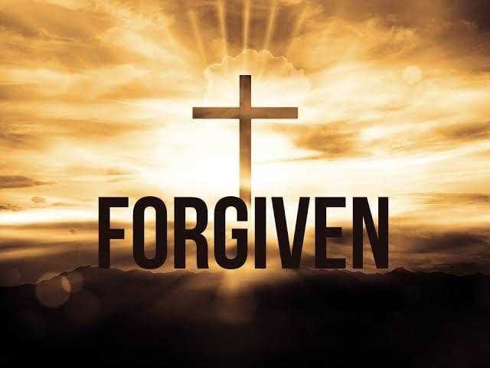
I just can’t forgive myself
With
Bishop Ronald K. Powell

Slide 2
“I just can’t forgive myself.”
Today, I want to share one more thought regarding the subject of forgiveness-however, this time, we are fasting from he thought that says: “I just can’t forgive myself.”
Who hasn’t thought that at one time or another? The devil would love to keep us in self-condemnation for the things we have done or failed to do.
He knows it paralyzes us and prevents us from making the kind of impact that God intended for us.

Slide 3
“I just can’t forgive myself.”
I just read yesterday of a young teenager who accidentally struck his 5-year-old sister, with a car, tragically killing her in their driveway. And as tragic as it is for a child to die in that way at such an early age, the greater tragedy is the difficulty this young man will have forgiving himself.
Though few of us have faced something as dramatic as this, we all need to overcome the thoughts that try to accuse us for what we have done. Hopefully, as well, this message will get to that young man and provide the encouragement he will need in this challenging time.
Let us beat this thought into the ground—hasn’t it beaten us long enough?

Slide 4
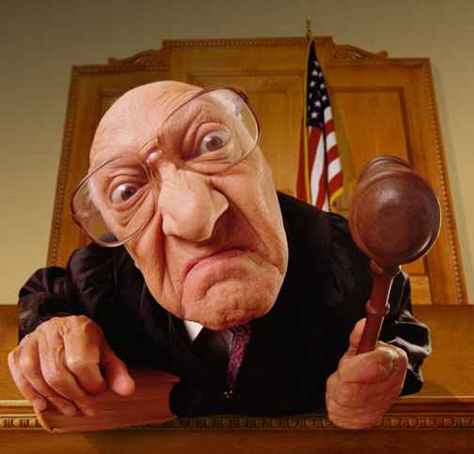
“I just can’t forgive myself.”
1. Realize that we only deserve forgiveness because of the blood of Jesus.
Not because what we did wrong “never happened,” or it was not that bad.
Give up rationalizations and excuses.

Slide 5

2. It was that bad, but God is MORE good!
James 2:13 says mercy triumphs over judgment. His mercy toward you TRUMPS your judgment over yourself. Believe that God is bigger than what you did.
In Luke 22, Peter denied the Lord 3 times, and Jesus forgave him. Later, Peter preached the first sermon after Jesus rose from the dead, and 3000 people were saved in a day!
Peter was able to forgive himself when he knew Jesus had accepted him. In the same way, realize that you have been accepted by God, no matter what you have done—simply by believing in the work of the cross of Jesus Christ.

Slide 6

3-Give up your right to hold ANYTHING against yourself
ANYTHING that God Himself does not hold against you. If God can forgive you, you can forgive yourself. His standard is absolute perfection, and He forgives you.
Psalm 103:12 says,
“As far as east is from west, so far has He removed our transgressions from us.”

Slide 7
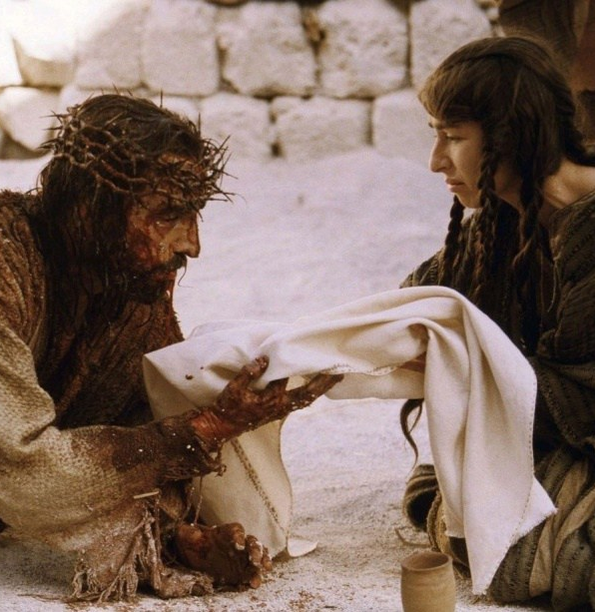
4. Stop rehearsing what you did.
It’s done. It is over. Now accept the 2nd chance that God offers.
Philippians 3:10 says “forgetting what lies behind and reaching forward.”

Slide 8
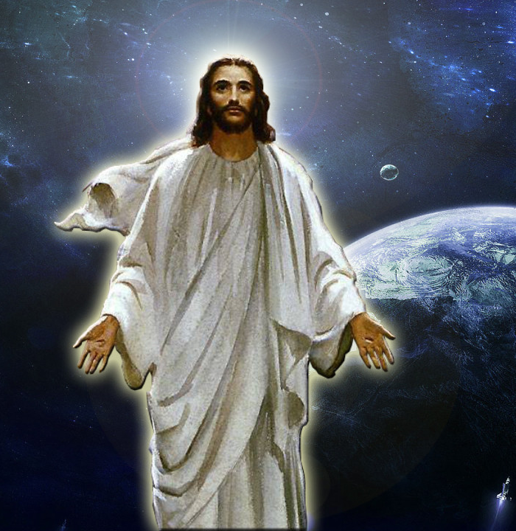
5. Believe that guilt does not come from God.
God does not impose guilt on you to try to get you to stop doing something.
Romans 2:4 says it is His loving kindness that leads us to repentance.
Since this guilt and shame does not come from God, there can be only one other source—the devil.
James 4:7 says,“Submit to God—-resist the devil—–and he will flee from you.”

Slide 9
6. Give up the SELF-PUNISHMENT—
Some people have said to themselves: “I’ll make myself feel bad to pay for what has been done.” Why should we pay the price that has ALREADY been paid for what we have done wrong? Stop beating yourself up—no one beats us up better than ourselves.
The fact is whatever we have done that we cannot seem to forgive ourselves for is already forgiven. By trying to “pay for what we have done,” we are insulting the very blood of Jesus that HAS PAID the price in full.

Slide 10
THINK IT & SAY IT…
I receive mercy today, because of the blood of Jesus.
Though I did not deserve it, God proclaims over me, that I am “not guilty.”
Where I have failed, God’s mercy triumphs over judgment.

Slide 11
THINK IT & SAY IT…
I give up my right today to hold ANYTHING against myself—I deserve to be punished, but Jesus took THAT punishment for me.
I forget what lies behind and press on, moving forward in my life with God, even though I feel like I have blown it beyond repair.

Slide 12
THINK IT & SAY IT…
I reject this guilt and self-condemnation that the devil is trying to put on me. God is the God of 2nd chances.
I will no longer try to make myself feel bad to pay for what has been done.
The price for what I did or failed at has been paid in full by God! In Jesus’ name!

Slide 13
THINK IT & SAY IT…
I reject this guilt and self-condemnation that the devil is trying to put on me. God is the God of 2nd chances.
I will no longer try to make myself feel bad to pay for what has been done.
The price for what I did or failed at has been paid in full by God! In Jesus’ name!

Slide 14
Let Us Pray
Visit at Crosswinds: https://www.crosswindsinternational.org/

