Slide 1
Today’s Thought: “I must be out of God’s will”
With
Bishop Ronald K. Powell

Slide 2
Today’s Thought: “I must be out of God’s will”
Today we are fasting from the thought:
“I must be out of God’s will.”
And the thoughts
that go with it:
What if I miss God’s will?
What if I make the wrong decision?

Slide 3
Today’s Thought: “I must be out of God’s will”
These are some of the thoughts that punish many people; that produce doubt, uncertainty and fear in us–almost becoming self-fulfilling prophecies leading us to make bad decisions.

Slide 4
Today’s Thought: “I must be out of God’s will”
Let’s fast from the thought that we are out of the will of God or that we will probably miss God’s will.

Slide 5
Put first things first.
God’s “will” is His Word:
(“Testament” means “will”)
It’s not a mystery: If you left a “will” for your loved ones, it would focus on what you are doing for them, rather than what they need to do for you (Of course, you would be dead!).
FOCUS ON WHAT GOD HAS DONE.
Read the “will” or the “testament”, as if it were listing what NOW belongs to you since Jesus died and rose again. (Hebrews 9:14-20)

Slide 6
Hebrews 9:14-20
¹⁴ How much more shall the blood of Christ, who through the eternal Spirit offered himself without spot to God, purge your conscience from dead works to serve the living God?
¹⁵ And for this cause he is the mediator of the new testament, that by means of death, for the redemption of the transgressions that were under the first testament, they which are called might receive the promise of eternal inheritance.
¹⁶ For where a testament is, there must also of necessity be the death of the testator.
¹⁷ For a testament is of force after men are dead: otherwise it is of no strength at all while the testator liveth.
¹⁸ Whereupon neither the first testament was dedicated without blood.
¹⁹ For when Moses had spoken every precept to all the people according to the law, he took the blood of calves and of goats, with water, and scarlet wool, and hyssop, and sprinkled both the book, and all the people,
²⁰ Saying, This is the blood of the testament which God hath enjoined unto you.

Slide 7
2. The “will” of God begins with a “state of being” not a “state of doing.”
What I mean by this is: since our foundational scripture is “As a man thinks, so is he” (Proverbs 23:7),
Our focus should be on what God said we ARE, and what God said we HAVE.
Then, that will produce what God wants us to DO. When you know you ARE what God says you are, and you HAVE what God says you have, then you will DO the will of God.
The right decisions will be the byproduct of the right thinking.

Slide 8
3. As you fill your heart up with the Word of God, He will lead you safely into His will!
Psalm 119:9-11 says, “I have hidden your Word in my heart that I might not SIN against Thee.”
“Sin” = missing the mark.
You won’t MISS the “will” or the mark when you hide the Word in your heart!

Slide 9
4. The “will” of God is activated in our life through the giving of thanks.
1 Thessalonians 5:18 says, “In everything give thanks, for this is the WILL OF GOD for you, in Christ Jesus.”
Notice, He doesn’t say “give thanks FOR everything,” but rather: “give thanks IN everything.”
No matter what you are facing right now—the will of God is to give thanks, IN the midst of it.
By thanks and praise CONTINUALLY, we are infesting our situation with the presence and possibilities of God’s power!
Psalm 119:9-11 says, “I have hidden your Word in my heart that I might not SIN against Thee.”

Slide 10
5. The will of God is bigger and broader than most people think.
At a large airport, there are several runways that a plane can land on, safely, arriving at its destination.
Get rid of the mindset that there’s only one runway and you might miss it and crash!
There are several runways in the will of God, and therefore many options that are equally acceptable and approved by God.

Slide 11
6. MORE TO COME ON NEXT SUNDAY!

Slide 12
THINK IT & SAY IT:
I am not going to miss God’s will for my life! His Word is His Will, and I accept and embrace His Word as the cornerstone of my life.

Slide 13
THINK IT & SAY IT:
I AM what God’s Word says I am. And I HAVE what God’s Word says I have.
I have a covenant with God, and knowing that will lead me into the right decisions for my life.
He will keep me in His Will, as I keep His Word in my heart.

Slide 14
THINK IT & SAY IT:
I choose a life of thanks and praise which puts me in the middle of God’s will, AND brings God’s will into the middle of my situation, infesting my surroundings with God’s presence and God’s power! In Jesus’ Name!

Slide 15
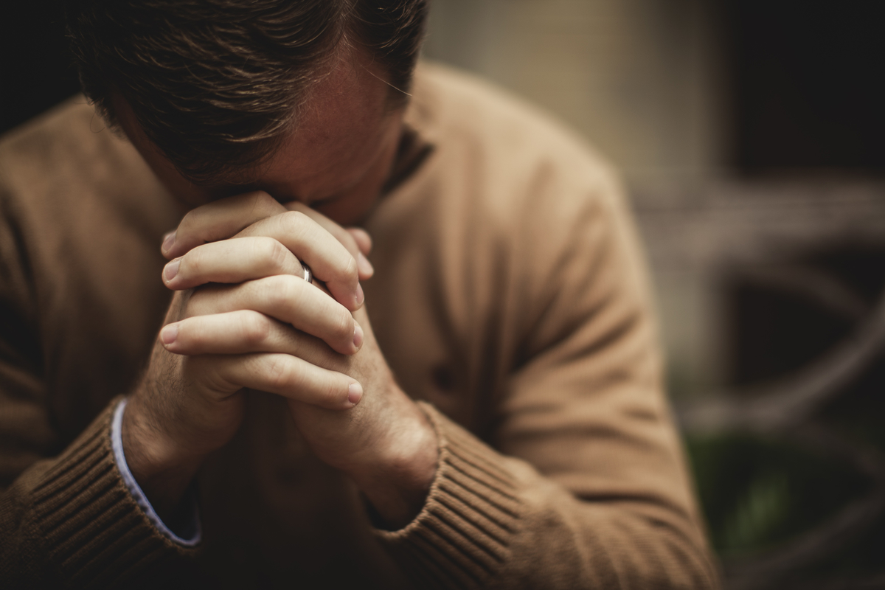
Let us Pray
Visit us at: https://www.crosswindsinternational.org/

