Slide 1
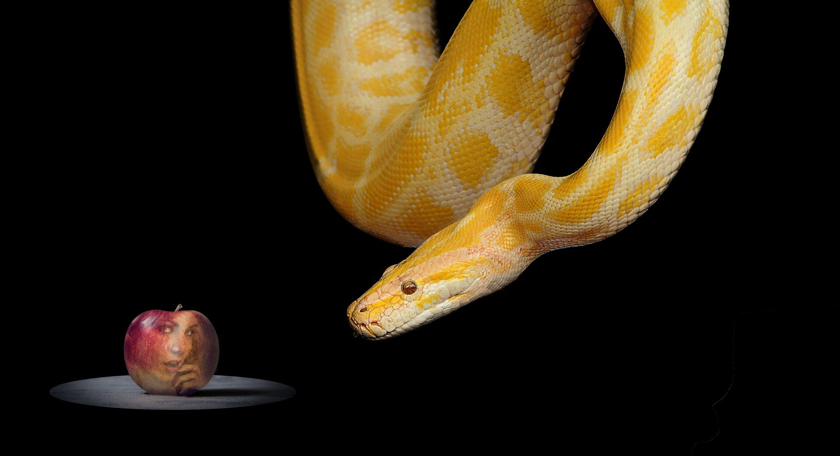
Rewiring the Thoughts of unbelief…
Today’s Thought:
“I don’t believe it!”
With Bishop Ronald K. Powell.

Slide 2
This is the language and vocabulary of hell itself, trying to penetrate your mind.
There are 3 primary things that the devil doesn’t want you to believe:
1. That God’s Word is true AND works.
2. That you have authority over the devil.
3. That God is good, and the author of ONLY good.

Slide 3
For example, if you believe that EVERYTHING that happens in life was pre-destined by God, then you will lower your defenses against the devil.
And Satan would love for you to just accept whatever comes in life, as God’s will. This requires no faith, no battle, and leads to no victory.
It’s vital that we make sure our thinking lines up with the word of God concerning faith and believing.

Slide 4
Your heart is your garden.
Proverbs 4:20 says, “Watch over your heart with all diligence, for out of it flow the issues of life.”
1. Take charge of your garden!

Slide 5
Adam was responsible for the Garden of Eden when Satan crept in through his deceptive lies.
It was Adam’s responsibility to drive that snake out of his garden.
Because he was passive and tolerant of Satan’s thoughts in his garden, his life was ruined!
Your heart is your garden.

Slide 6
Jesus said in Luke 10:19, “Behold I give you authority to tread upon serpents (devils) and scorpions and over ALL the POWER OF THE ENEMY. And nothing shall by any means hurt you.”
This is power that money can’t buy, education can’t acquire, human strength can’t achieve. This is heavenly power that is irrefutable.
2. Do not for a moment submit to the thought that the devil has power over you!

Slide 7
He spoke the Word of God. (Matthew 4:4, Luke 4:4) It is written, man shall not live by bread alone, but by every word that proceeds from the mouth of God.
3. Exercise your authority over the devil—the same way Jesus did

Slide 8
Satan always comes after the Word.
In Genesis, he talked Adam and Eve out of believing what God said.
In Matthew, he tried to talk Jesus out of believing what God said.
4. Hold on to the Word of God.

Slide 9
There’s nothing new under the sun.
In Mark 4:15 he comes immediately to steal the word.
Hide the Word in your heart and it will give you victory whenever necessary. (Psalm 119:9-11)
4. Hold on to the Word of God.

Slide 10
The devil does everything he can to convince you that the Word isn’t true OR that it’s too impossible to come to pass.
That’s why 1 Timothy 6:12 says, “Fight the good fight of faith.”
The battle we’re in is the battle to believe. But nothing is impossible for those who believe. And God is watching over His Word to perform it.
5. Understand spiritual warfare—

Slide 11
1 Corinthians 1:9, 1 Thessalonians 5:24—Faithful is He who called you, and He will bring it to pass!
Think on His faithfulness. Life will present its share of problems, but God is faithful. He called you. He will bring His calling to pass. Our job is to believe.
6. Believe in the faithfulness of God.

Slide 12
Romans 15:13 says joy and peace abound in your life THROUGH believing.
As you are believing what God says, peace will fill your heart. Joy will fill your heart.
7. Expect supernatural peace and joy in your life

Slide 13
Faith will come. (Romans 10:17)
You will begin to believe.
8. When you doubt, fill your mind and mouth with God’s Word.

Slide 14
I take charge of my garden, watching over my heart.
I will not be passive or tolerant of Satan’s thoughts.
I have authority over the devil, and I exercise that authority by speaking the Word of God.
THINK IT & SAY IT:

Slide 15
I fight the fight of faith by believing what God says, and I refuse to accept anything less than the promises of God’s Word.
I believe in the faithfulness of God and trust that He will bring His promises to pass in my life.
THINK IT & SAY IT:

Slide 16
I expect supernatural peace and joy in my life by focusing my faith on believing what God said.
I take control over doubt by filling my mind and mouth with the Word of God.
THINK IT & SAY IT:

Slide 17

Let Us Pray

