Slide 1
Today we’re rewiring the thought that says: “God is not answering my prayers.”

Slide 2
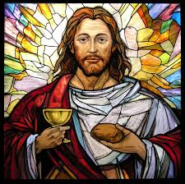
What Does Unanswered Prayer Mean?
This mentality prevents us from receiving all that God has for us.

Slide 3
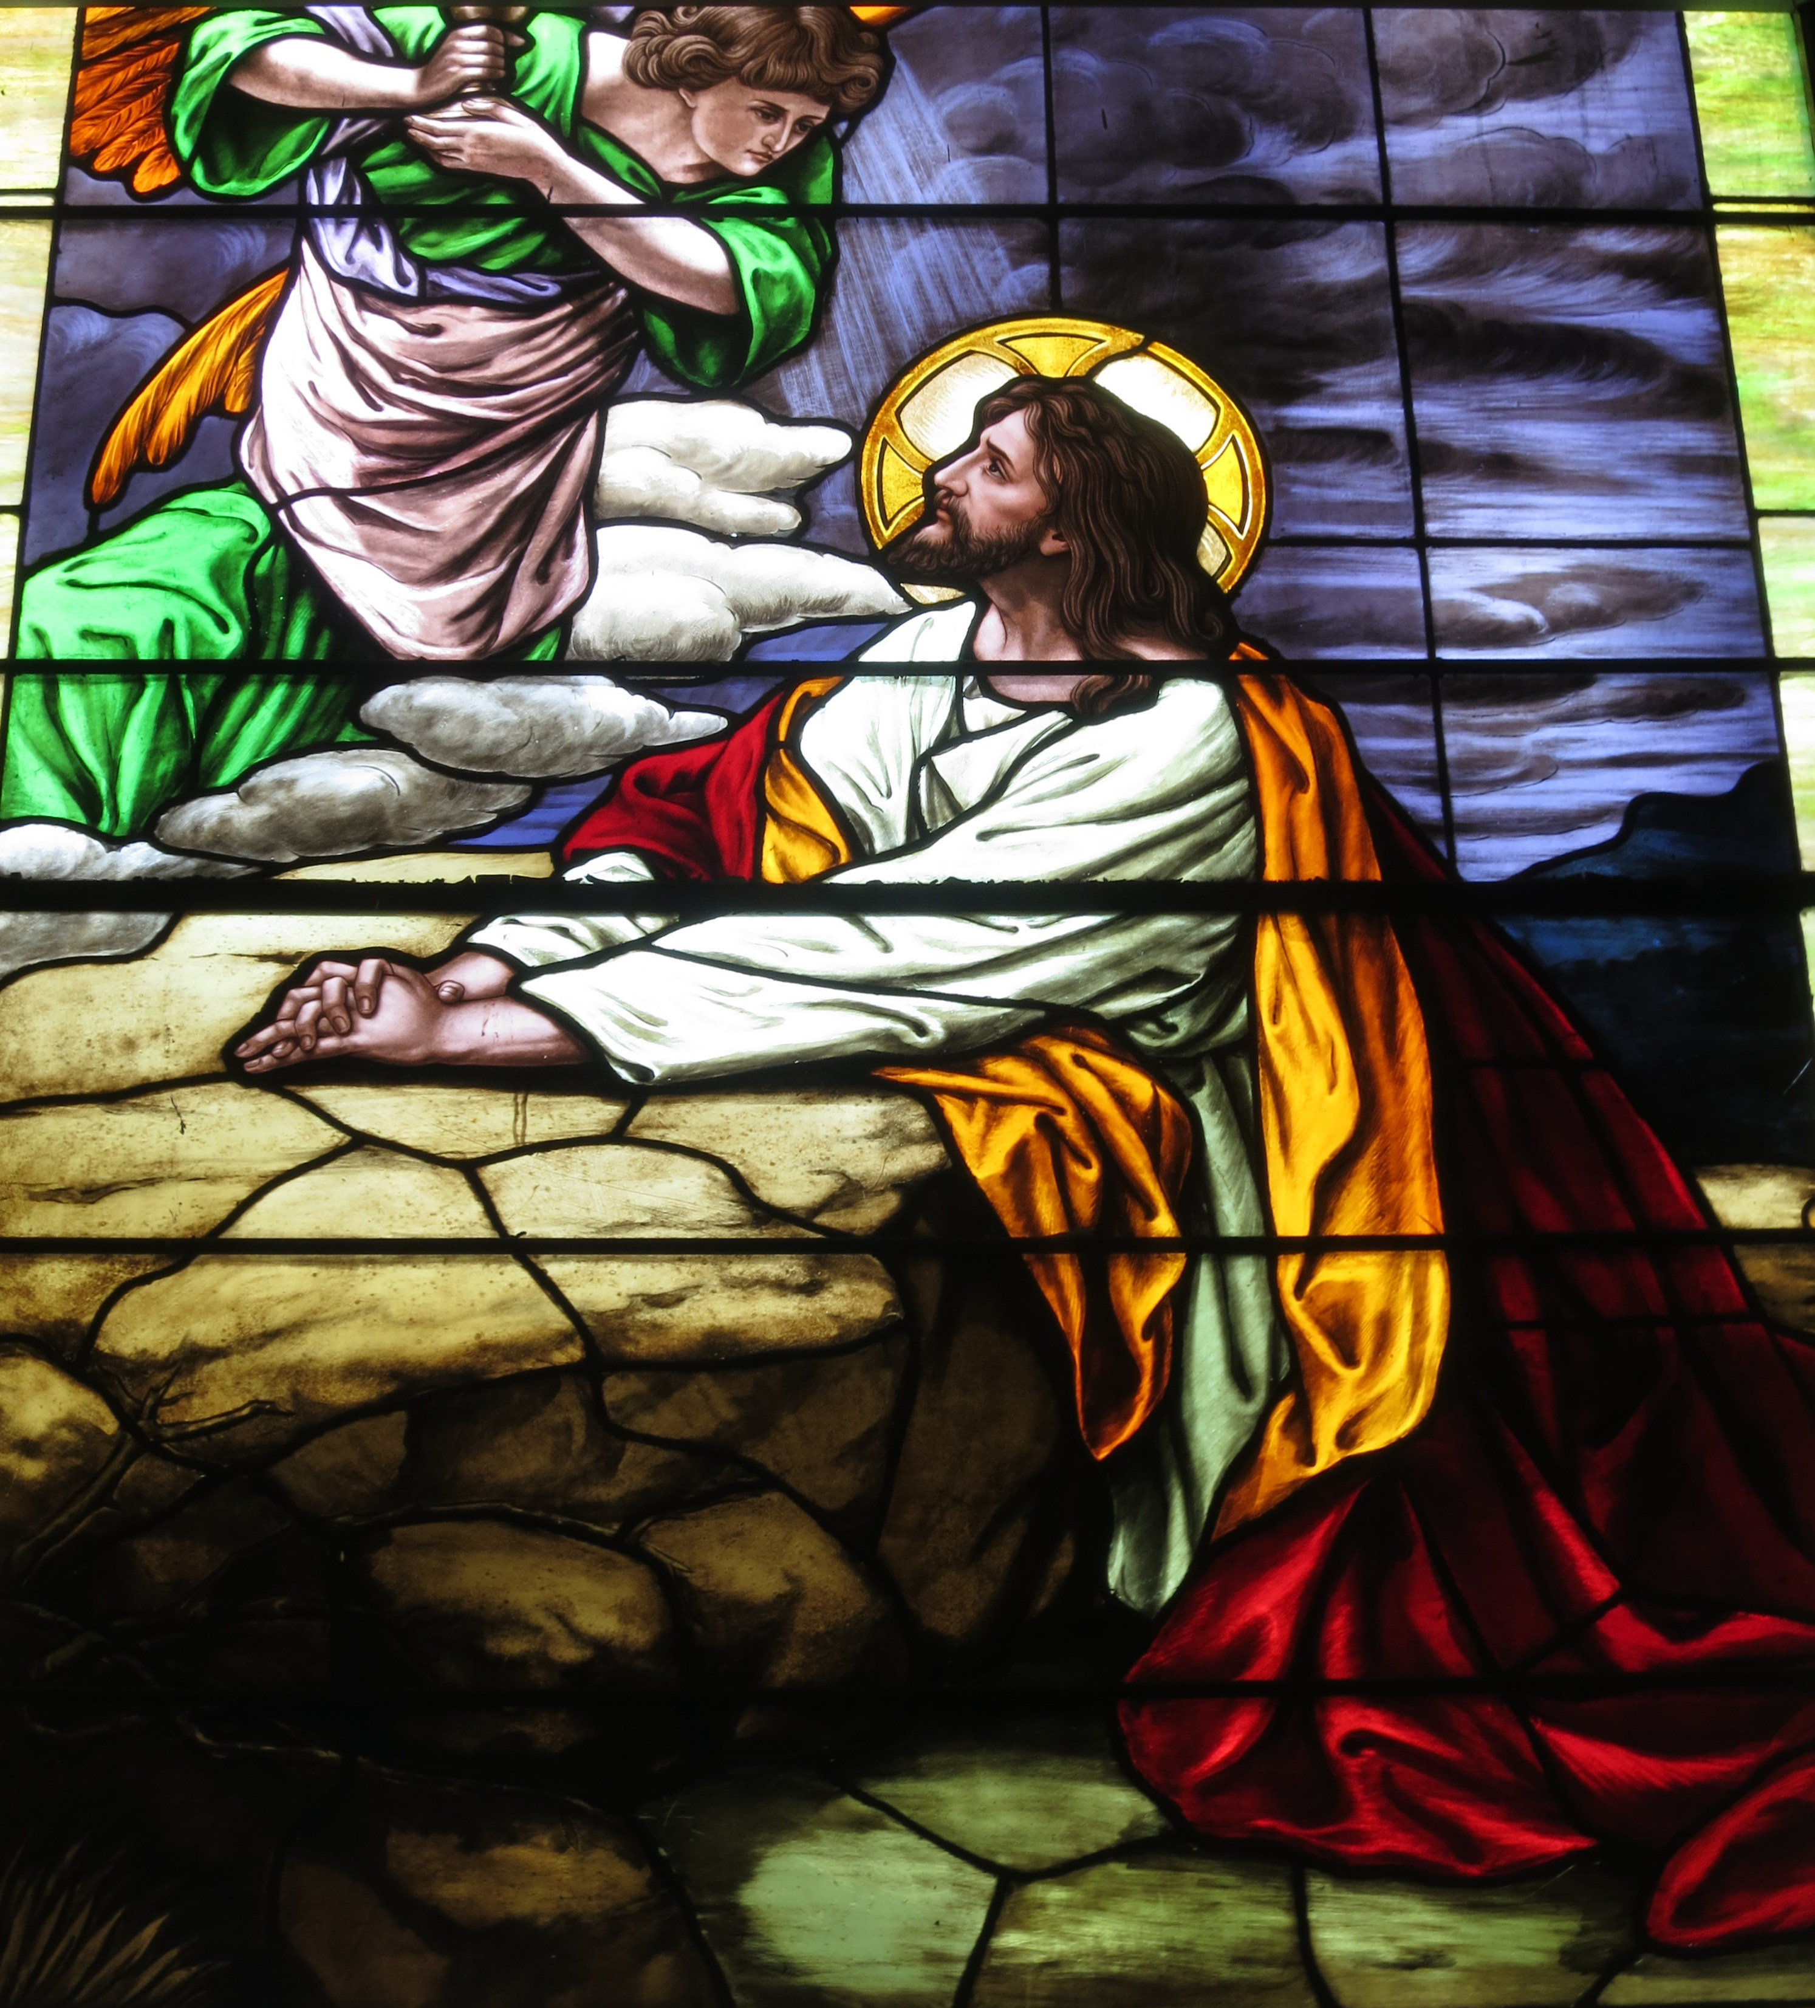
Rewiring the thought that says: “God is not answering my prayers.”
Let’s overcome this thought today by renewing our minds to what God REALLY says about this:

Slide 4
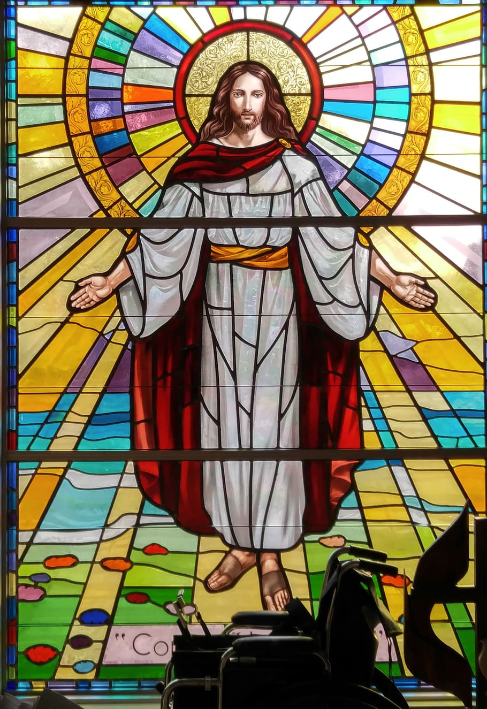
1. Pray the Word of God. God’s Word was God’s idea!
So He intends for it to come to pass. 1 John 5:14-15 says, “If we ask anything according to His will (His Word) we know He hears us…and we know we have whatever we’ve asked.”
John 15:7 says, “If you abide in Me and Words abide in you…ask whatever you wish and it SHALL be done for you.

Slide 5
2. God always says “Yes” to His Word—His promises.
2 Corinthians 1:20 says, “All the promises of God are yes, in Him, and with us is the ‘Amen’.
” There is no assurance that prayer will be answered, if it’s not something God has already promised in His Word.

Slide 6
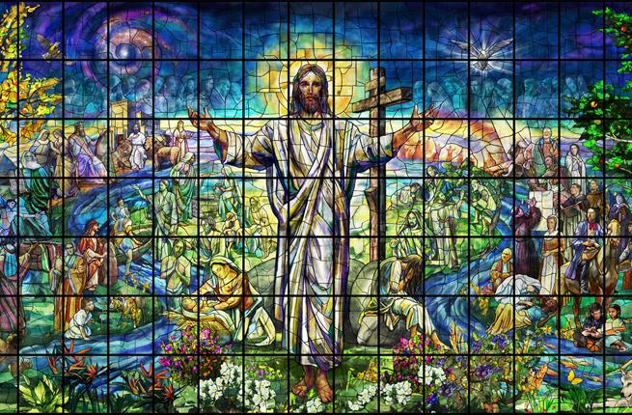
3. Walk by faith.
(2 Corinthians 5:7) Regardless of how you feel, faith says: God has heard me, and He answers.
Mark 11:24 says, “Believe you HAVE received…and it shall be granted to you.”

Slide 7
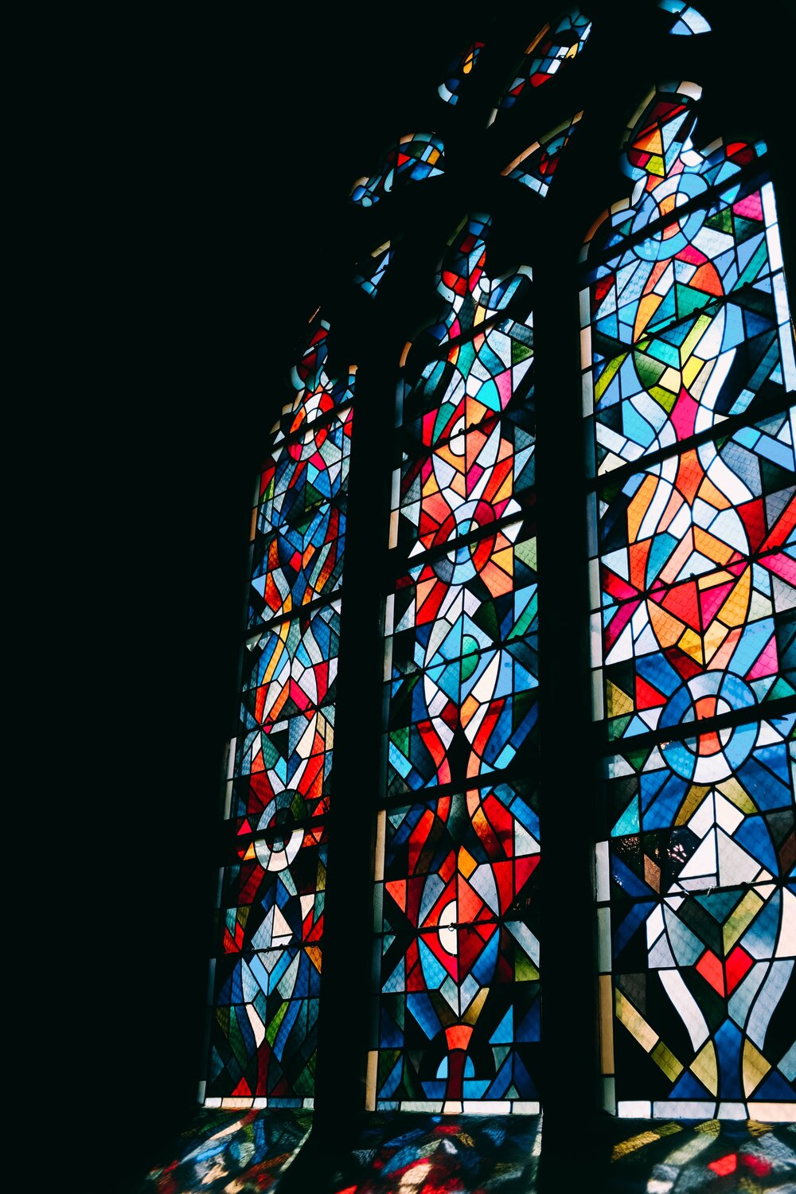
4. Don’t throw in the towel when you don’t see it working.
Hebrews 6:12 says, “…through faith AND patience, we inherit the promises of God.”

Slide 8
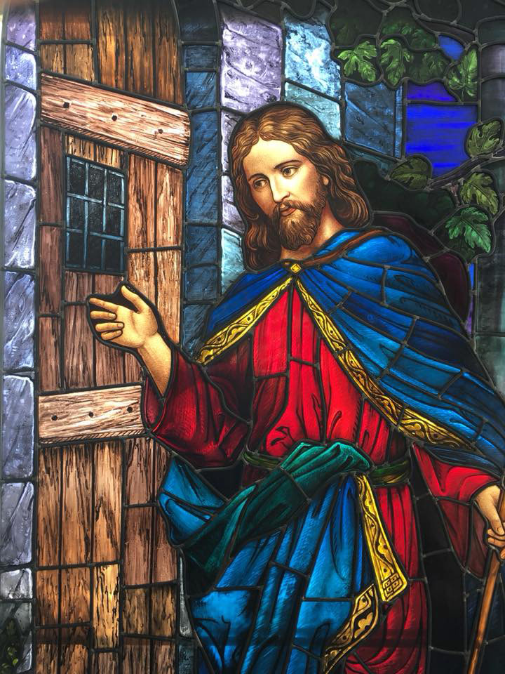
5. Apply the secret of Persistence.
(Luke 18:1-8)
Matthew 7:7 (Amplified) says, “Keep on asking and it shall be given…keep on knocking and the door shall be opened.”

Slide 9
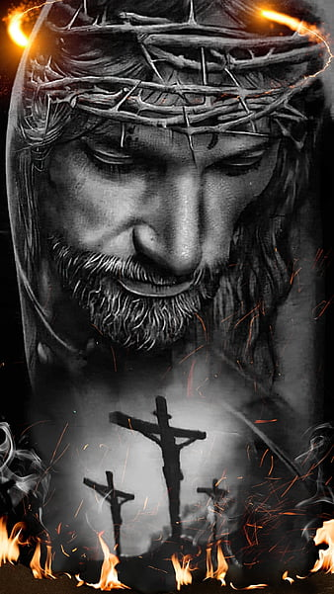
6. Don’t let condemnation rob you of your confidence.
1 John 3:20-22 says, “…If our heart does not condemn us (THERE IS NO CONDEMNATION FOR THOSE WHO ARE IN CHRIST JESUS), then we have confidence toward God; and whatever we ask we receive…”

Slide 10
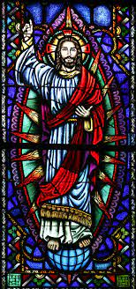
THINK IT & SAY IT:
God DOES answer my prayers.
No matter what I see or feel, I walk by faith, and not by sight.
Condemnation for my mistakes or shortcomings will not rob me of confidence.

Slide 11
THINK IT & SAY IT:
God is bigger than my mistakes.
His Word abides in me, and therefore I can ask and receive.
I won’t be discouraged or give up; because I will reap if I do not faint.
My answer is coming! In Jesus’ Name!

Slide 12
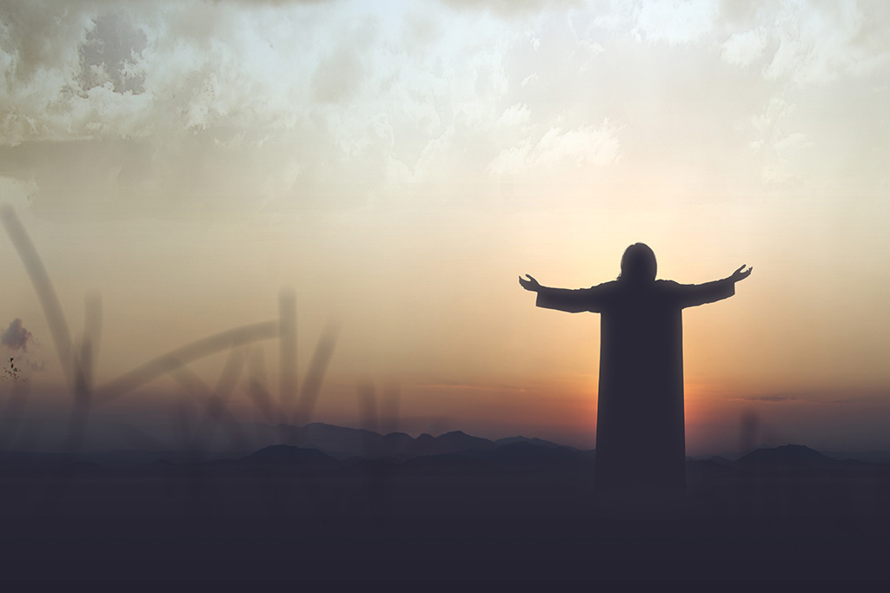
Let Us Pray
https://www.crosswindsinternational.org/

