Slide 1
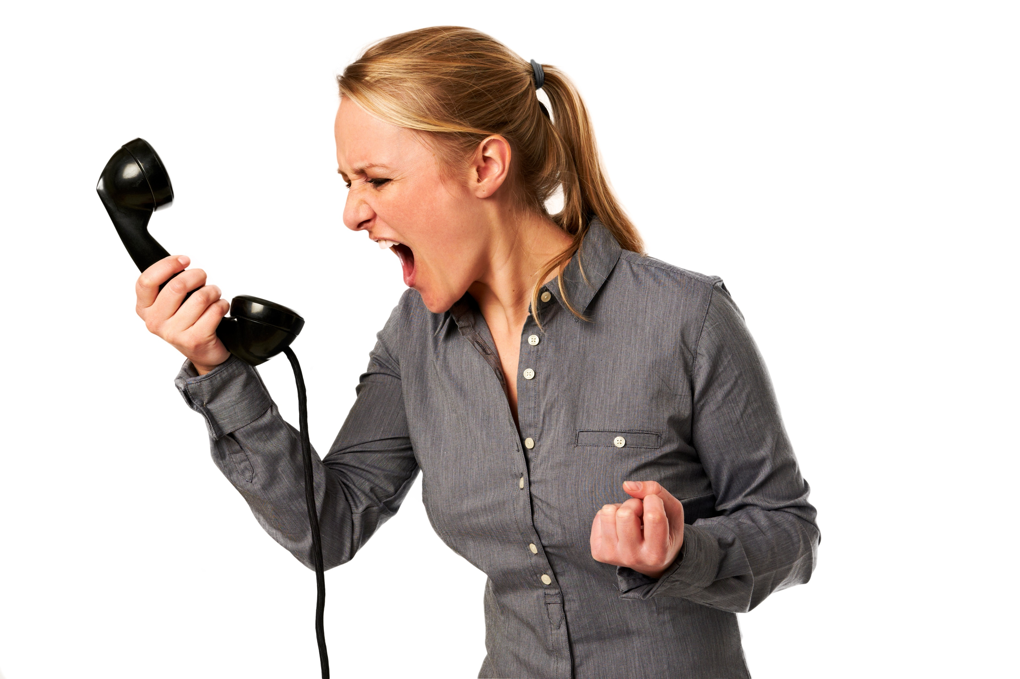
I Can’t Believe This is Happening to Me

Slide 2
Today's Rewire: I can't believe this is happening to me!
When we think this way, we become victims.
The devil wants you to live in shock. He wants you to be stopped by the “paralysis of analysis.”
Folks, every one of us has experienced adversity, trials—a sickness, a sudden break up, a job loss, etc.
In John 16:33, Jesus said, in this world, you’ll have tribulation...but, He went on to say (the key to overcoming this way of thinking)...

Slide 3
1. TAKE COURAGE—How?
Realize that He has overcome the world.
See yourself as an overcomer
Romans 8:37 says you are more than a conqueror!
John said in 1 John 5:4, "Whoever is born of God overcomes the world."
If you are a Christian you have the ability within you to overcome the power of the world ... Including disappointments .

Slide 4
What does it means to be an overcomer?
By Definition: a person who overcomes something : Is one who succeeds in dealing with or gaining control of some problem or difficulty.

Slide 5
2. Stop letting life “happen” to you.
Begin to start happening to life.
The violent take the kingdom by force. (Matthew 11:12)
Force your faith upon the things that happen to you.
Force your victory on your trial.

Slide 6
3. Confront life. Stop reacting to it, and get after it!
2 Corinthians 8:1-2...they overcame their great trial of afflictions with an abundance of joy.
Confront trials with joy.
They also overcame lack with generosity.
Confront lack with giving. It will change!

Slide 7
4. Focus on what’s happening IN YOU, rather than TO YOU.
Jesus could calm the storm AROUND Him, because He had peace and calm WITHIN Him.
Paul said, “We are troubled on every side, but not distressed...” (2 Corinthians 4:8)
Pressure may come from the outside, but remain fixed on God’s Word on the inside.
You will come out of every storm!

Slide 8
5. Remember the power you have in your hand.
Your seeds determine your future. (Galatians 6:7-8)
You can change what happens to you, by changing the seed you sow.
For example, sow the seed of treating others right, and you will reap the harvest of good treatment yourself.
Sow the seed of giving, and you will reap the harvest of receiving.

Slide 9
5. Remember the power you have in your hand.
Your seeds determine your future. (Galatians 6:7-8)
You can change what happens to you, by changing the seed you sow.
For example, sow the seed of treating others right, and you will reap the harvest of good treatment yourself.
Sow the seed of giving, and you will reap the harvest of receiving.

Slide 10
THINK IT & SAY IT:
I take courage today, because Jesus has overcome the world; therefore, I have overcome the world.
As He is, so are we in this world!
I will no longer be a victim of life, but a victor OVER life.
I will happen TO life, rather than the other way around!
I will force my faith upon the things that happen to me, and they will be change.

Slide 11
THINK IT & SAY IT:
I confront trials with joy.
I develop peace within, by believing God’s Word, no matter what is happening on the outside.
I have the power to change my future, by the seeds I sow.
What happens to me will be transformed by what happens IN me, in Jesus’ Name!

Slide 12
Let Us Pray
https://www.crosswindsinternational.org/

