Slide 1
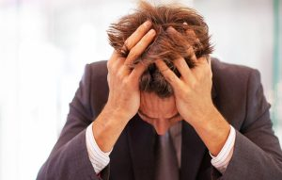
Destroying thoughts of fear. Destroying thoughts of fear.

Slide 2
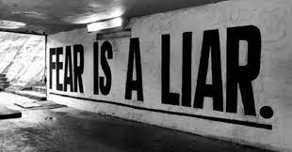
1. Destroying thoughts of fear.
1 John 4:18 says “…fear has torment.”
Perhaps you have felt tormented by the fear of dying, the fear of cancer, the fear of running out of money, or the fear of what someone could do to hurt you.
Today, we put an end to the torment and punishment of fear.

Slide 3
2. Reject and resist whatever isn’t from God.
2 Timothy 1:7 says, “God has not given you the spirit of fear—but power, love and a sound mind.”
Fear is from the devil. Don’t tolerate it for a second.

Slide 4
3. Speak to fear—Mark 11:23
“…say to this mountain (of fear) ‘be removed and cast into the sea’ and do not doubt, but believe those things you say, shall happen.”
The spoken word has more power than the running thoughts in your head. Speak to those thoughts of fear and command them to go.

Slide 5
4.“FAITH COMES FROM HEARING THE WORD OF GOD.”
Understand how fear comes.
Romans 10:17 says, “FAITH COMES FROM HEARING THE WORD OF GOD.”
Therefore, FEAR COMES from hearing things contrary to the Word of God.
What we hear on the news about tragedy, the economy, etc. is the source of fear. Cut it off at its root.
You must spend more time listening to the good news of the Word, rather than the bad news of this world.

Slide 6
5. Expect to walk on water!
Set your hope and expectation on GREAT things happening in your life. Peter walked on water with Jesus showing us that faith can overcome anything.
However, remember why Peter began to sink.
Matthew 14:30—he SAW the wind, he BECAME afraid, he BEGAN to sink. What we focus on produces fear or faith.
FOCUS on the circumstances around you and fear will sink you. FOCUS on the promises of God, and faith will raise you up!

Slide 7
6. Expect to walk on water!
Trust, HE will catch you when you fall. Even when Peter began to sink, Jesus reached out and grabbed His hand to save him. (Matthew 14:31) You always have a safety net, in Him! So, fear not! Set your hope and expectation on GREAT things happening in your life. Peter walked on water with Jesus showing us that faith can overcome anything.
However, remember why Peter began to sink.
Matthew 14:30—he SAW the wind, he BECAME afraid, he BEGAN to sink. What we focus on produces fear or faith.
FOCUS on the circumstances around you and fear will sink you. FOCUS on the promises of God, and faith will raise you up!

Slide 8
THINK IT & SAY IT:
God has not given me the spirit of fear, but power, love and a sound mind.
I reject all forms of fear beginning today.
I speak to fear and command it to leave my life and family.
I walk by faith, not by sight.

Slide 9
THINK IT & SAY IT:
I surrender my ears to listen to God’s Word, and my eyes, to focus on God promises.
I expect the miraculous to happen in my life, and I know God will catch me if I stumble or fall.
Therefore, I will not be afraid, another day in my life, in Jesus Name.

Slide 10
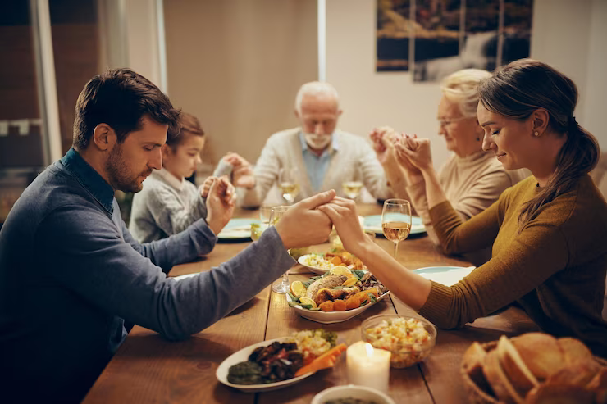
Let us pray
www.crosswindsinternational.org

