Slide 1
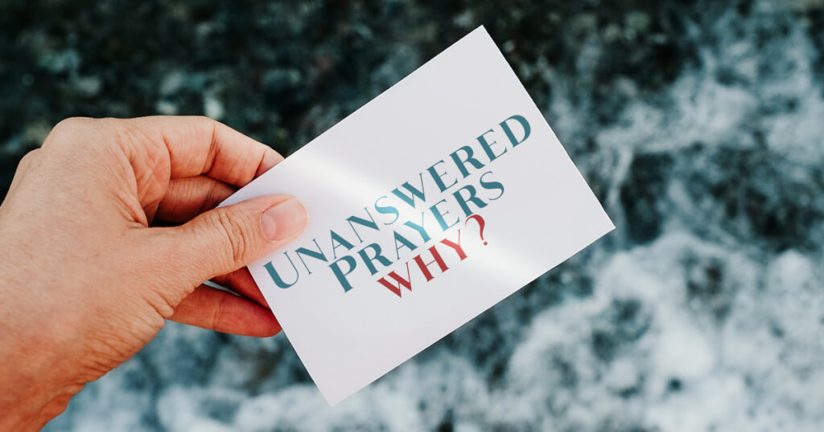
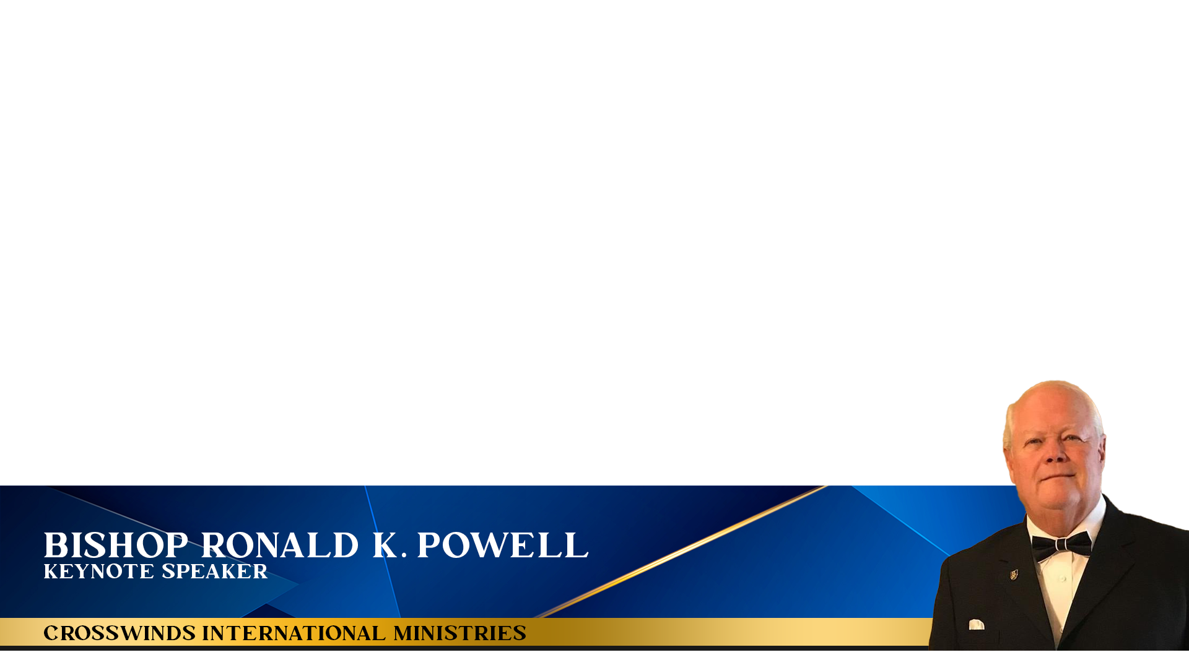

Slide 2
Isaiah 58 The Message Version
58:1“Cry aloud, spare not;
Lift up your voice like a trumpet;
Tell My people their transgression,
And the house of Jacob their sins.
2 Yet they seek Me daily,
And delight to know My ways,
As a nation that did righteousness,
And did not forsake the ordinance of their God.
They ask of Me the ordinances of justice;
They take delight in approaching God.

Slide 3
Isaiah 58 The Message Version
3 ‘Why have we fasted,’ they say, ‘and You have not seen?
Why have we afflicted our souls, and You take no notice?’
“In fact, in the day of your fast you find pleasure,
And exploit all your laborers.
4 Indeed you fast for strife and debate,
And to strike with the fist of wickedness.
You will not fast as you do this day,
To make your voice heard on high.

Slide 4
Isaiah 58 The Message Version
3 ‘Why have we fasted,’ they say, ‘and You have not seen? (Prayers Unanswered)
Why have we afflicted our souls, and You take no notice?’
“In fact, in the day of your fast you find pleasure,
And exploit all your laborers.
4 Indeed you fast for strife and debate,
And to strike with the fist of wickedness.
You will not fast as you do this day,
To make your voice heard on high.

Slide 5
Isaiah 58 The Message Version
5 Is it a fast that I have chosen,
A day for a man to afflict his soul?
Is it to bow down his head like a bulrush,
And to spread out sackcloth and ashes?
Would you call this a fast,
And an acceptable day to the Lord?
6 “Is this not the fast that I have chosen:
To loose the bonds of wickedness,
To undo the heavy burdens,
To let the oppressed go free,
And that you break every yoke?.

Slide 6
Isaiah 58 The Message Version
7 Is it not to share your bread with the hungry,
And that you bring to your house the poor who are cast out;
When you see the naked, that you cover him,
And not hide yourself from your own flesh?
8 Then your light shall break forth like the morning,
Your healing shall spring forth speedily,
And your righteousness shall go before you;
The glory of the LORD shall be your rear guard.

Slide 7
Isaiah 58 The Message Version
9 Then you shall call, and the LORD will answer;
You shall cry, and He will say, ‘Here I am.’
“If you take away the yoke from your midst,
The pointing of the finger, and speaking wickedness,
10 If you extend your soul to the hungry
And satisfy the afflicted soul,
Then your light shall dawn in the darkness,
And your darkness shall be as the noonday.

Slide 8
Isaiah 58 The Message Version
11 The Lord will guide you continually,
And satisfy your soul in drought,
And strengthen your bones;
You shall be like a watered garden,
And like a spring of water, whose waters do not fail.
12 Those from among you
Shall build the old waste places;
You shall raise up the foundations of many generations;
And you shall be called the Repairer of the Breach,
The Restorer of Streets to Dwell In.

Slide 9
Isaiah 58 The Message Version
13 “If you turn away your foot from the Sabbath,
From doing your pleasure on My holy day,
And call the Sabbath a delight,
The holy day of the LORD honorable,
And shall honor Him, not doing your own ways,
Nor finding your own pleasure,
Nor speaking your own words,
14 Then you shall delight yourself in the LORD;
And I will cause you to ride on the high hills of the earth,
And feed you with the heritage of Jacob your father.
The mouth of the LORD has spoken.”

Slide 10
The Message from Isaiah 58
Isaiah 58 is a powerful chapter in the Bible that speaks to the importance of true worship and fasting.
In this chapter, the prophet Isaiah addresses the people of Israel who were observing religious rituals and fasting but were not living out God’s commands in their daily lives.
Isaiah begins by calling the people to cry out loudly and to show their transgressions to God.
He then goes on to point out that the people were fasting and seeking God’s favor, but at the same time they were oppressing their workers, quarreling and fighting with one another and ignoring the needs of the poor and the needy.

Slide 11
The Message from Isaiah 58
Isaiah makes it clear that the kind of fasting that pleases God is not just about abstaining from food or other pleasures, but it is also about doing justice, sharing with those in need, and lifting up the oppressed.
He says that if the people truly fast in this way, then their light will break forth like the dawn, and their healing will quickly appear.

Slide 12
The Message from Isaiah 58
Isaiah also points out that true fasting is not just about outward actions, but it is also about the
condition of the heart. He says that the Lord is not pleased with fasting that is accompanied by strife,
selfishness, and hypocrisy. Rather, he desires a broken and contrite heart that is willing to turn away
from sin and to seek the Lord with humility and sincerity.

Slide 13
The Message from Isaiah 58
In conclusion, Isaiah 58 teaches us that true worship and fasting are not just about religious rituals, but they are also about living out God’s commands in our daily lives.
We must not only abstain from food or other pleasures, but we must also seek justice, share with those in need, and lift up the oppressed.
We must have a heart that is broken and contrite, willing to turn away from sin and to seek the Lord with humility and sincerity.

Slide 14
Let’s Pray
Find More at:
https://www.crosswindsinternational.org/sermons

