Slide 1

https://www.facebook.com/officialbenshapiro/videos/6652757534789654

Slide 2
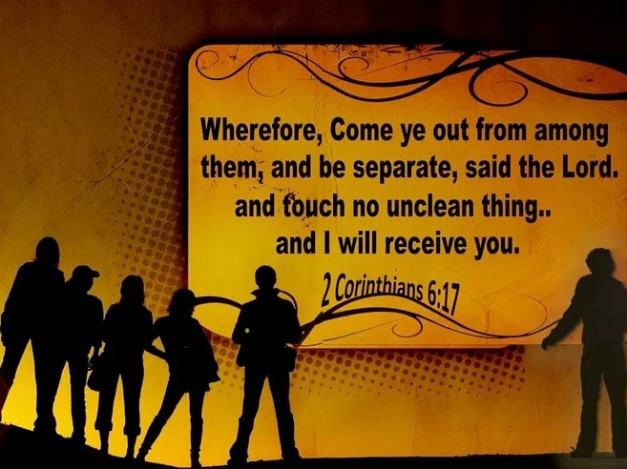
Separate Yourself

Slide 3
The apostle Paul wrote in Romans 12:2,
The apostle Paul wrote in Romans 12:2, “Do not conform to the pattern of this world but be transformed by the renewing of your mind. Then you will be able to test and approve what God’s will is—his good, pleasing and perfect will.”
This verse urges us to avoid conforming to the ways of the world, and instead to be transformed through the power of the Holy Spirit.

Slide 4
Separation from the world is a concept that is often mentioned in the Bible, particularly in the New Testament. It refers to the idea that Christians should distance themselves from the values, beliefs, and behaviors of the secular world, and instead focus on following the teachings of Jesus Christ.

Slide 5
Paul wrote in 2 Corinthians 6:17, Therefore go out from their midst, and be separate from them says the Lord, and touch no unclean thing; then I will welcome you. Romans 16:17, I appeal to you, brothers, to watch out for those who cause divisions and create obstacles contrary to the doctrine that you have been taught; avoid them.

Slide 6
2 John 10-11 English Standard Version, If anyone comes to you and does not bring this teaching, do not receive him into your house or give him any greeting, for whoever greets him takes part in his wicked works. In 1 John 2:15-17, we read, “Do not love the world or anything in the world. If anyone loves the world, love for the Father is not in them. For everything in the world—the lust of the flesh, the lust of the eyes, and the pride of life—comes not from the Father but from the world. The world and its desires pass away, but whoever does the will of God lives forever.” This passage emphasizes that our allegiance should be to God, not to the things of the world.

Slide 7
Furthermore, James 4:4 states, “You adulterous people, don’t you know that friendship with the world means enmity against God? Therefore, anyone who chooses to be a friend of the world becomes an enemy of God.” This verse makes it clear that we cannot serve both God and the world; we must choose one or the other.

Slide 8
It is important to note, however, that separation from the world does not mean we should isolate ourselves from non-believers or refuse to engage with the culture at large. Rather, we are called to be “in the world, but not of the world” (John 17:14-16). This means we should strive to be a positive influence on those around us, while still maintaining our commitment to God’s standards and values.

Slide 9
Believers need to quit bowing down to industries, activism, and politics that are not representative of the Sane Godly interest. It is time to get fed up and come out from among them. Love not the World! Quit shopping in stores that represent this present insanity. When you do you send them a message that will make a mark $ on the people trying to lead our country into Hell.

Slide 10
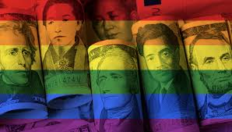
The Power To make “PRIDE” Industries Think!

Slide 11
1 Timothy 6:3-5 King James Version Says: If any man teaches otherwise, and consent not to wholesome words, even the words of our Lord Jesus Christ, and to the doctrine which is according to godliness; He is proud, knowing nothing, but doting about questions and strifes of words, whereof cometh envy, strife, railings, evil surmisings, Perverse disputings of men of corrupt minds, and destitute of the truth, supposing that gain is godliness: from such withdraw thyself.

Slide 12
In conclusion, separation from the world is a vital aspect of the Christian life. By choosing to follow God’s will instead of the ways of the world, we can experience true freedom and fulfillment in life. Let us strive to be transformed by the renewing of our minds, and to live in a way that honors God and blesses those around us.

Slide 13
LET US ALL PRAY
Visit Our Web Library
https://www.crosswindsinternational.org/sermons/

