Slide 1
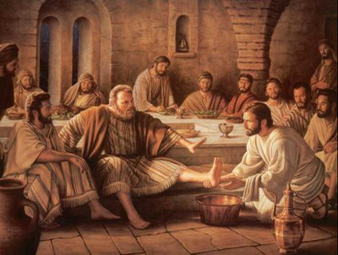
True Humility: Practices and Results
With Bishop Ronald K. Powell
This Photo by Unknown author is licensed under CC BY-NC-ND.

Slide 2
Introduction

Slide 3
Understanding True Humility:
Definition: humbleness: a modest or low view of one's own importance; humbleness:
Humility is not about thinking less of ourselves but thinking of ourselves less (Philippians 2:3).
It involves acknowledging our dependence on God and recognizing His sovereignty over our lives (James 4:6).

Slide 4
Jesus as the Ultimate Example:
Jesus, the Son of God, exemplified true humility by willingly leaving His heavenly glory and taking on human form (Philippians 2:5-8).
He humbly served His disciples by washing their feet, assuming the role of a servant (John 13:3-5).
Jesus taught that true greatness is found in being a servant to all (Matthew 23:11).

Slide 5
Practices of True Humility:
Submission to God:
True humility begins with surrendering our will to God’s will and acknowledging His authority in our lives (James 4:7).
It involves seeking His guidance through prayer and immersing ourselves in His Word (Psalm 119:105).

Slide 6
Serving Others:
True humility compels us to put the needs of others before our own (Galatians 5:13).
It motivates us to engage in acts of kindness, compassion, and selflessness, mirroring the heart of Christ (Mark 10:45).

Slide 7
Cultivating a Teachable Spirit:
True humility requires recognizing that we have much to learn and being open to correction and guidance (Proverbs 9:9).
It humbly seeks wisdom from others, allowing room for growth, transformation, and maturity (James 1:19).

Slide 8
Results of True Humility:
God’s Favor and Grace:
Scripture tells us that God opposes the proud but extends His grace to the humble (James 4:6).
He exalts the humble, bestowing upon them His guidance, wisdom, and strength (Psalm 147:6).

Slide 9
Unity and Healthy Relationships:
True humility fosters unity among believers and promotes harmonious relationships (Ephesians 4:2-3).
It helps us overcome conflicts and promotes forgiveness and reconciliation, paving the way for genuine love and understanding (Colossians 3:12-13).

Slide 10
Spiritual Growth and Transformation:
Embracing true humility opens our hearts to receive God’s teachings and enables us to grow in our faith (1 Peter 5:5-6).
It leads to a transformed character, as we are conformed to the image of Christ, reflecting His love, compassion, and grace (Romans 12:2).
Micah6:8

Slide 11
Conclusion:
In conclusion, true humility is not a sign of weakness but a mark of spiritual maturity and strength. It involves submitting to God, serving others, and cultivating a teachable spirit. As we embrace humility, we position ourselves to receive God’s favor and grace, experience unity and healthy relationships, and undergo profound spiritual growth and transformation. Let us strive to follow the example of our Lord Jesus Christ, who humbled Himself for our sake, and live lives characterized by true humility. May we draw closer to God, reflect His love to the world around us, and impact lives through the power of true humility.

