Slide 1
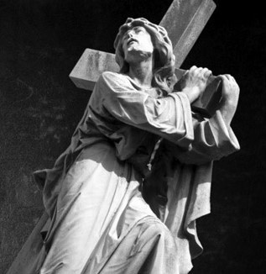
The Mind & Thoughts of Christ ~ Transforming Our Thinking

