Slide 1
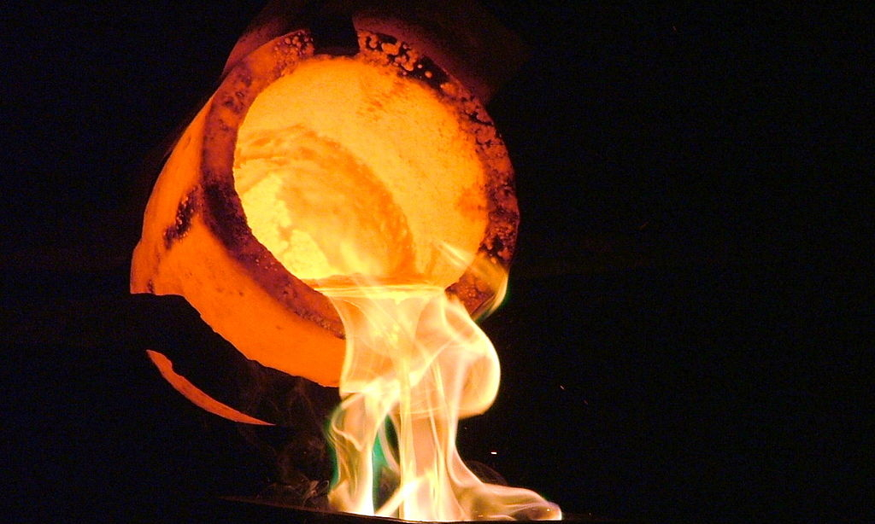
Tested by God
But maybe not the way that you think…

Slide 2

Supporting scriptures:
PROVERBS 27:21
JEREMIAH 6:27
2 TIMOTHY 1:7
JOHN 5:24
ROMANS 8:1-2
MARK 9:23-25
COLOSSIANS 2 6-7
ROMANS 8:26-28
JAMES 1:13
PSALM 51:5
EPHESIANS 2:3
GENESIS 8:21
ROMANS 5:12
EPHESIANS 2:8-10
1 JOHN 4:6-8
JAMES 4:8
JEREMIAH 33:3
COLOSSIANS 2:13-14
REVELATION 4:11
GALATIANS 3:28-29
JOHN 1:4
JOHN 1:9
JOHN 6:44
JOHN 12:32
GENESIS 1:27
PSALM 139:13-14
PSALM 18:30, DEUT 32:4
JOHN 3:16, ROMANS 5:8
EPHESIANS 1:7
EPHESIANS 1:4
ISAIAH 44:22
ISAIAH 41:9
EPHESIANS 2:4-10
JEREMIAH 29:11
1 JOHN 4:16
JOHN 1:12-13

