Slide 1
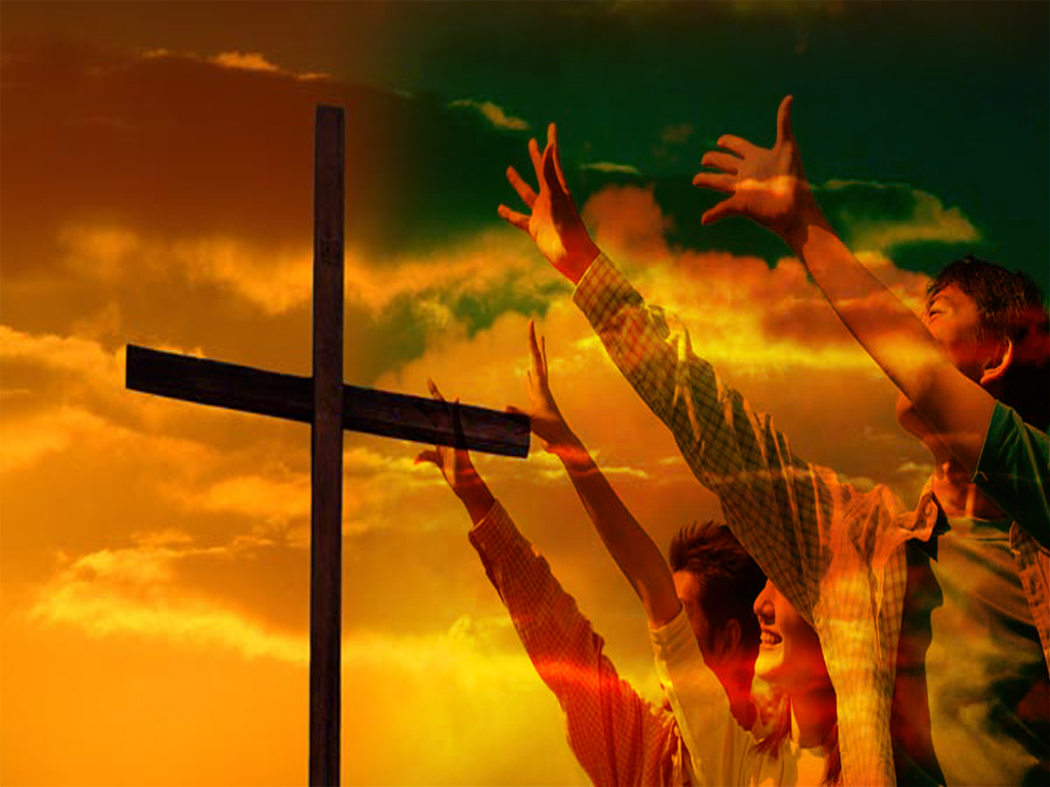
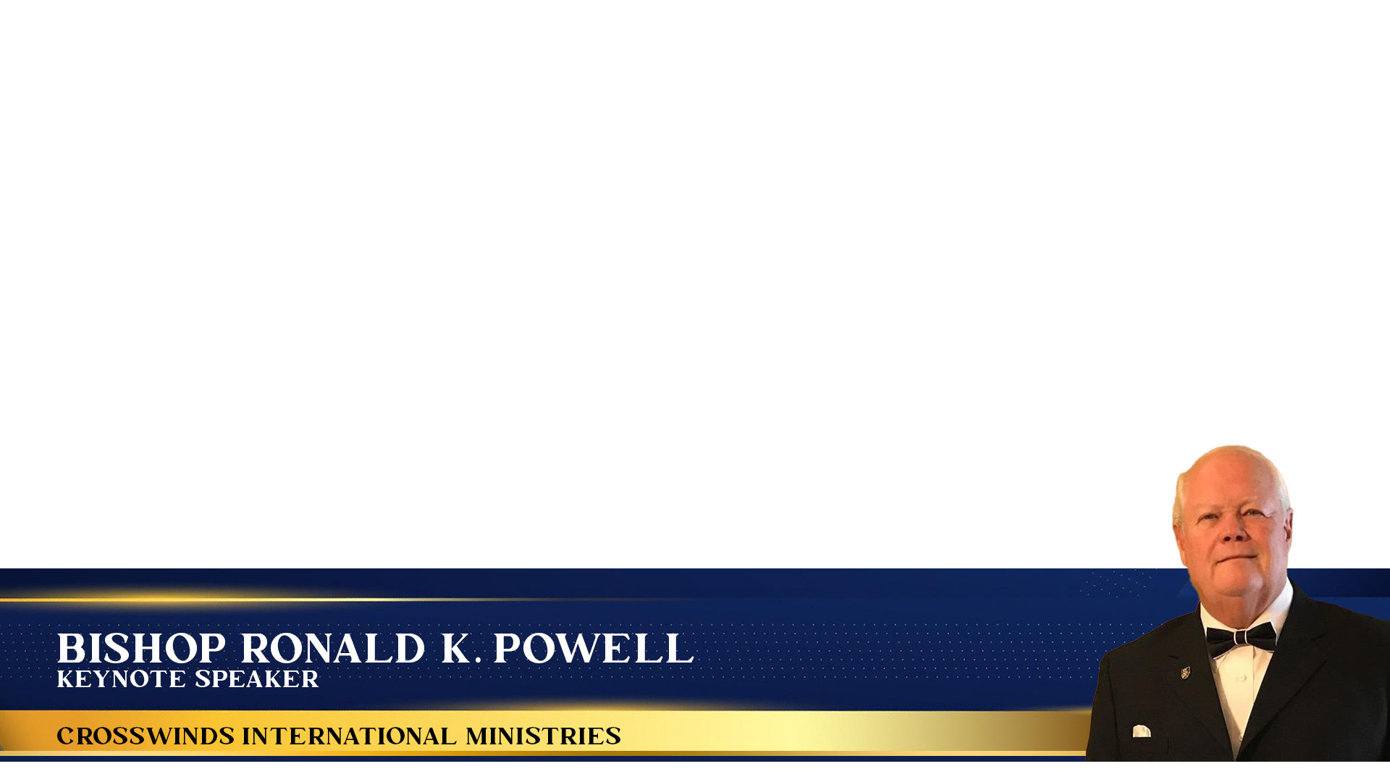
God & Me: Discovering Intimacy in the Divine Connection

Slide 2
Introduction:
•The longing for connection:
We all have a deep desire for meaningful connection. Often, we seek fulfillment in worldly relationships, only to be left feeling that something is still missing.
•A different kind of connection: Our relationship with God offers a depth of connection beyond anything the world can provide. It's a haven where we are fully known, unconditionally loved, and divinely guided.

Slide 3
Point 1: Who is God?
A God of love: "For God so loved the world that he gave his one and only Son, that whoever believes in him shall not perish but have eternal life." (John 3:16)
A God of forgiveness: "If we confess our sins, he is faithful and just and will forgive us our sins and purify us from all unrighteousness.” (1 John 1:9)
A God of presence: "The Lord your God is with you, the mighty warrior who saves." (Zephaniah 3:17)
Omniscient (all-knowing): "He reveals deep things from darkness and brings light to deepest shadow; he exposes motives in the light of day." (Job 37:16)
Omnipotent (all-powerful): "For with God nothing is impossible." (Luke 1:37)
Faithful: "Know therefore that the Lord your God is God; he is the faithful God who keeps covenant loyalty to a thousand generations of those who love him and keep his commandments." (Deuteronomy 7:9)

Slide 4
Point 2: Who Am I?
Created in God's image: "So God created mankind in his own image, in the image of God he created them; male and female he created them." (Genesis 1:27)
Loved unconditionally: "See what great love the Father has lavished on us, that we should be called children of God!” (1 John 3:1)
Imperfect, yet forgiven: "For all have sinned and fall short of the glory of God." (Romans 3:23)
Unique and valuable: "For you are fearfully and wonderfully made; wonderful are your works; my soul knows that very well." (Psalm 139:14)
Destined for purpose: "For we are God’s handiwork, created in Christ Jesus to do good works, which God prepared in advance for us to do." (Ephesians 2:10)
Can overcome challenges: "I can do all things through him who strengthens me." (Philippians 4:13)

Slide 5
Point 3: Strengthening the God & Me Connection
Prayer: "Rejoice always, pray continually, give thanks in all circumstances; for this is God’s will for you in Christ Jesus." (1 Thessalonians 5:16-18) [Discuss the power of prayer— honest conversation with God]
Scripture: "All Scripture is God-breathed and is useful for teaching, rebuking, correcting and training in righteousness." (2 Timothy 3:16) [Emphasize how scripture speaks to our lives and reveals God's character]
Worship: "Let us come before him with thanksgiving and extol him with music and song." (Psalm 95:2) [Highlight the importance of expressing gratitude and adoration]
Seeking wisdom: "If any of you lacks wisdom, you should ask God, who gives generously to all without finding fault, and it will be given to you." (James 1:5)
Meditation: "My soul finds rest in God alone; my salvation comes from him." (Psalm 62:1)
Service: "Whatever you do, work at it with all your heart, as working for the Lord, not for human masters." (Colossians 3:23)

Slide 6
Conclusion:
Relationship over rules: Christianity isn't about adhering to rigid laws but about nurturing an intimate bond with a loving God.
Journey of transformation: This relationship will change us— refining our character and drawing us closer to the divine heart.
Invitation: Will you choose a deeper connection with God today? He is waiting, arms open wide.
Let’s Pray:
Visit Us @: www.crosswindsinternational.org

